Slide 1
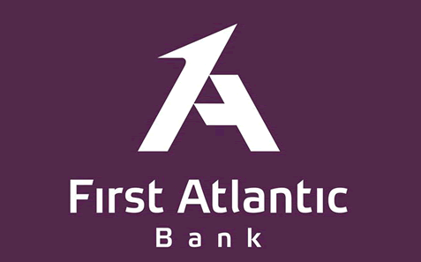
Privileged
FIRST ATLANTIC BANK
COMPANY PROFILE
PRESENTED AT
THE 5TH GHANA MANGO WEEK

Slide 2
CONTENT
Executive Summary
4
Organization Milestone
5
Key Achievements and Accolades
8
Financial Highlights
11
Service Suite
13
Product Suite
14

Slide 3
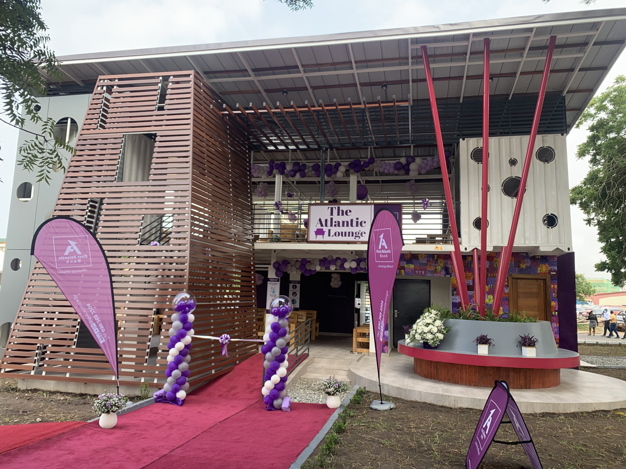
FIRST ATLANTIC BANK IN PERSPECTIVE

Slide 4
EXECUTIVE SUMMARY
First Atlantic Bank is notable Ghanaian financial institution, serving individual customers, small and medium enterprises and large corporations with a full suite of banking, investment, and risk management products and services.
The bank offers unrivalled customer service and convenience in Ghana, fondly branded as the “Purple Experience”. FAB is visible and welcoming to all local and foreign customers. The bank offers 8 Product classes across all sectors within the Ghanaian economy to facilitate business growth.
FAB’s banking channels cover multiple strategic locations in Ghana and service a diverse mix of business relationships with knowledgeable personal & business, corporate, and private banking offices, efficient ATMs and convenient online banking and mobile access.
FAB holds strong personal, business, and corporate banking experience, and is a gateway for trade and investment flows across Africa. Corporations, government bodies, institutions and individuals in and outside of Ghana use FAB as their chosen reliable intermediary.
FAB provides industry-leading support to many economic sectors of Ghana and regularly holds leadership forums and B2B events in partnership with foreign trade missions and local partners.

Slide 5
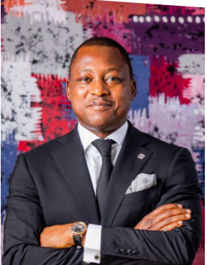
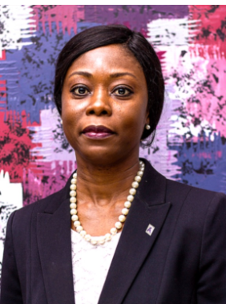
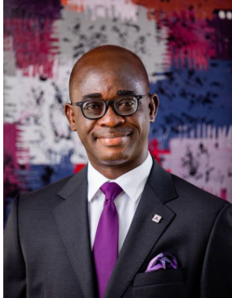
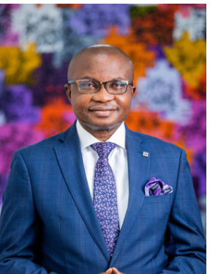
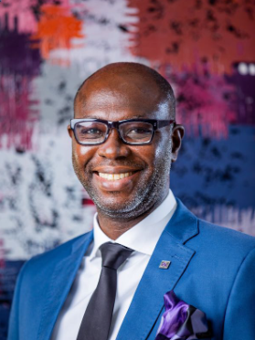
EXECUTIVE MANAGEMENT
MD/CEO
ED -Risk
ED - Business
COO
CFO

Slide 6
Key Achievements and Accolades
2007
2008
2009
2010
2012
Best Bank, Customer Care
Best Bank, Trade Finance
Best Bank, Customer Care
Best Bank, Medium Term Loan Financing
Best Bank, Customer Care
Best Bank, Short Term Loan Financing
Best Bank, Corporate Banking
Best Bank, Long Term Loan Financing
Best Bank, Advisory Services
2013
2014
2015
2019
2021
1st Runner Up, Trade Deal of
the Year
1st Runner Up, Trade Deal of the Year
MTN Momo Emerging partner bank with great impact
5-Star Service Quality
5-Star Customer Satisfaction
Best Bank, Enterprise Financing
2nd Runner Up, Best Bank Retail Finance
2nd Runner Up, Best Bank
Growth

Slide 7
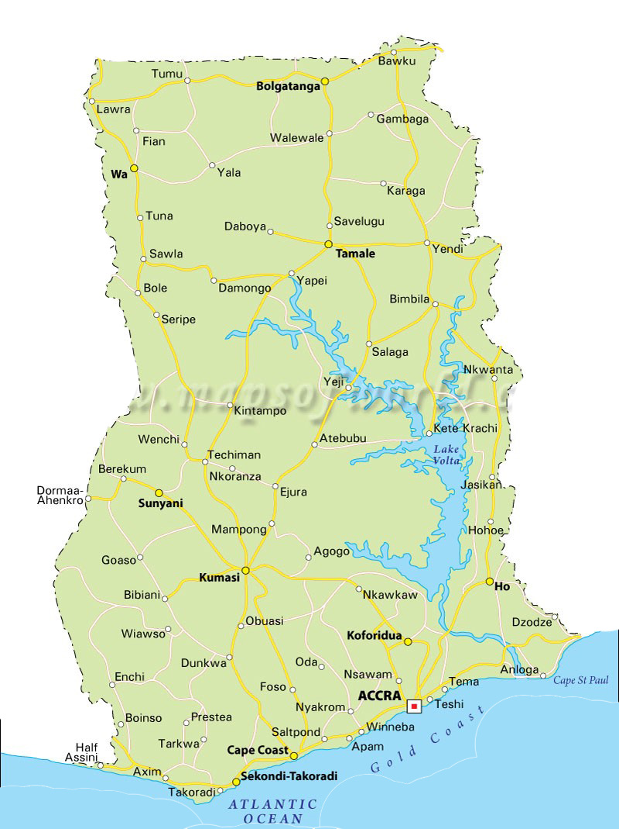
PHYSICAL CHANNELS – 35 BRANCHES & 48 ATMs
Techiman
Tamale
Kumasi – Adum
Kumasi - Suame
Accra- Madina
Kumasi - Nhyiaeso
Accra- Dzorwulu
Kumasi - Manhyia
Accra- Osu Main
Accra - Oxford Street
Accra - Kotobabi
Accra - Lagos Avenue
Accra - Sakaman
Accra - American House
Accra - Abossey Okai
Accra - Max Mart
Accra - N.I.A
Accra - Airport
Accra- Kantamanto
Accra - Lapaz
Accra Central
Accra - Spintex Road
Accra - North Ridge
Accra - Achimota
Accra - Ring Road
Accra - Head Office
Tema-Ashaiman
Accra - Weija
Tema - Sakumono
Accra - Kasoa
Tema - Community 1
Accra – Trade Fair
Tema - Community 25
Tema - Mall
Takoradi

Slide 8
FINANCIAL PERFORMANCE HIGHLIGHTS
First Atlantic Banks’s Total Assets increased from GHS1.44 billion in 2016 to GHS 4.66 billion in 2021 representing a CAGR circa 27%. Total Deposit also increased from GHS 0.89 billion to GHS 3.78 billion over the same period. Loans and advances grew from GHS 0.37 billion in 2015 to GHS 1.01 billion.
The bank has grown its PBT by 643%, from GHS 25 million in 2016 to GHS 156 million in 2021.
Figures provided for 2021

Slide 9
WHAT WE OFFER

Slide 10
SERVICE SUITE
The Purple Experience at First Atlantic Bank
Cash Management
Treasury Services
Personal & Business Banking
Corporate Banking
Public Sector
Financial Institutions
Private Banking
Trade Services
Asset management and brokerage services are offered through our Associate companies First Atlantic Asset Management Limited (FAAM) and First Atlantic Brokers Limited (FAbL)
Notes:
- The bank offers unrivalled customer service and convenience in Ghana, and is fondly branded as the “Purple Experience”. FAB is visible and welcoming to all local and foreign customers.
- First Atlantic Bank is Ghana’s notable financial institution, serving individual customers, small- and medium enterprises and large corporations with a full suite of banking, investment, and risk management products and services.
FAB’s banking channels cover multiple strategic locations in Ghana and service a diverse mix of business relationships with knowledgeable personal & business, corporate, and private banking offices, efficient ATMs and convenient online banking and mobile access
FAB holds strong personal, business, and corporate banking experience, and is a gateway for trade and investment flows across Africa. Corporations, government bodies, institutions and individuals in and outside of Ghana use FAB as their chosen reliable intermediary.
FAB provides industry-leading support to many economic sectors of Ghana and regularly holds Thought Leadership forums and B2B events in partnership with foreign trade missions and local partners.

Slide 11
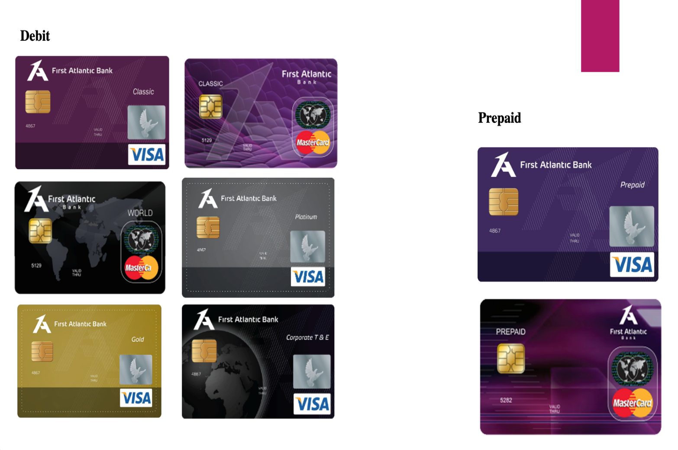
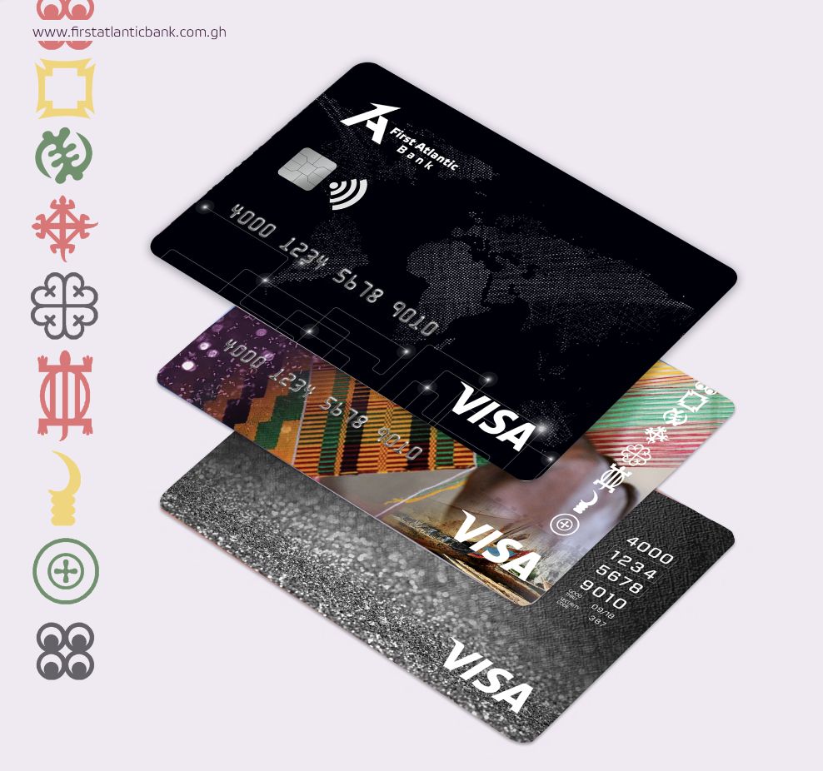
FAB CARDS - DEBIT, PREPAID AND CREDIT CARDS
Credit cards

Slide 12
KEY PRODUCTS OFFERING
DISCOUNTING OF RECEIVABLES FROM REPUTABLE INSTITUTIONS APPROVED BY THE BANK. | PRE - SETTLEMENT LINES TO SUPPORT THE RECEIPT OF INFLOWS FROM OFFTAKERS OFFSHORE
PROJECT EXPANSION SUPPORT. | COMPETITIVE RATES FOR EXPORT PROCEEDS
EXPORT FINANCE FACILITY

Slide 13
OUR PRODUCT SUITE
8 Product classes across all sectors within the Ghanaian economy to facilitate business growth.
Treasury
Assets
Liabilities
Trade
World Class Treasury
Innovative Treasury Products
White Label Platforms
Commercial Papers
Proprietary Trading
Settlement Platforms
Structured approach to asset growth
Sector specific product program
Consumer Loans
Project Finance
Working Capital
Commercial Lending
Differentiated Products
Offer Convenience
Product Innovation
Current Accounts
Savings Accounts
Call Deposits
Term Deposits
Treasury Notes
“Go to bank” for trade
Regional Trade capability
Conduit for FDI
Trade Facilitation
Letters of Credit
Bills for Collection
Import Finance Facilities
E-banking
Cash Management
Insurance
Remittances
Integrated cash management
Emphasis on collections
Electronic Payments
Collections Platforms
Dedicated payments
Collections Desk
Strategic Alliances
Investment Advisory
Bancassurance
Collections: Premiums etc.
Partnership with Global Money Transfer Organizations (MTOs) MoneyGram Western Union RIA UNO/Small World TransFast Money Exchange
WARI
Unity Link
No 1 in e-banking in 3 years
Internet Banking
Email and SMS alerts
Card based products
E-Solutions
Agency Banking
E-Kiosks

Slide 14
Thank You

