Slide 1
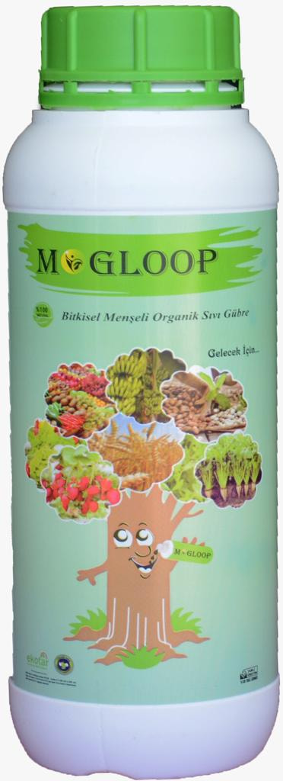
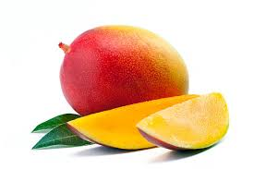
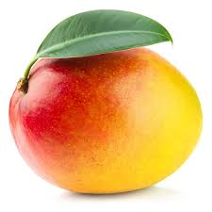
MOGLOOP PLANT-BASED ORGANIC FERTILZER

Slide 2
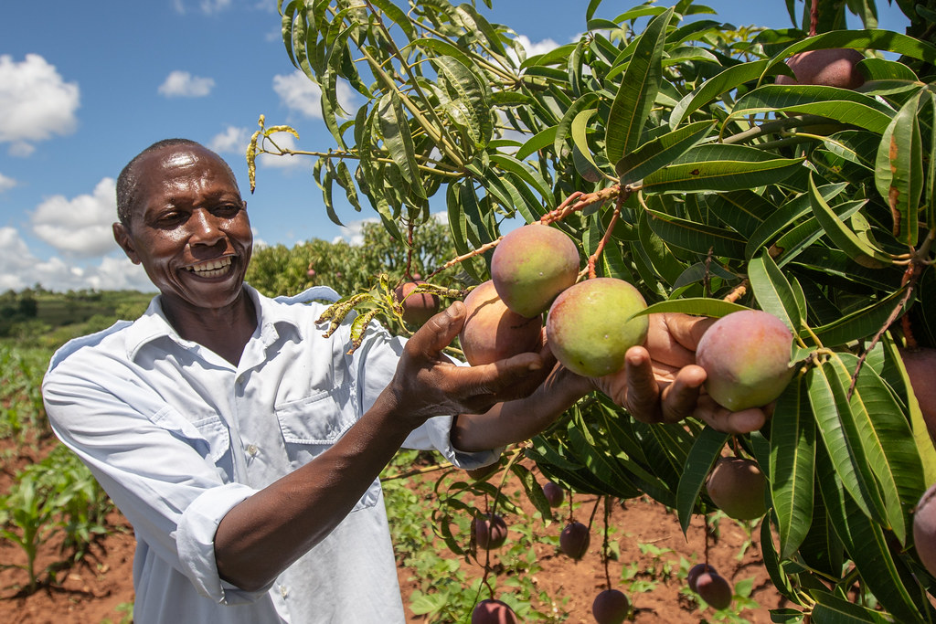
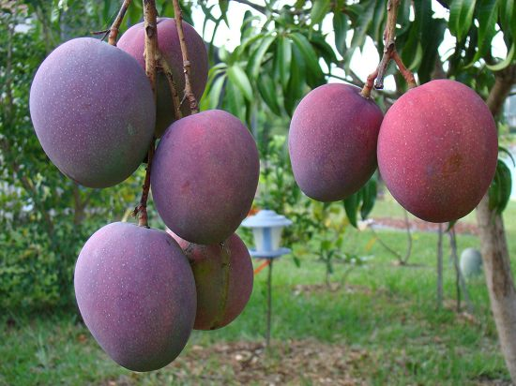
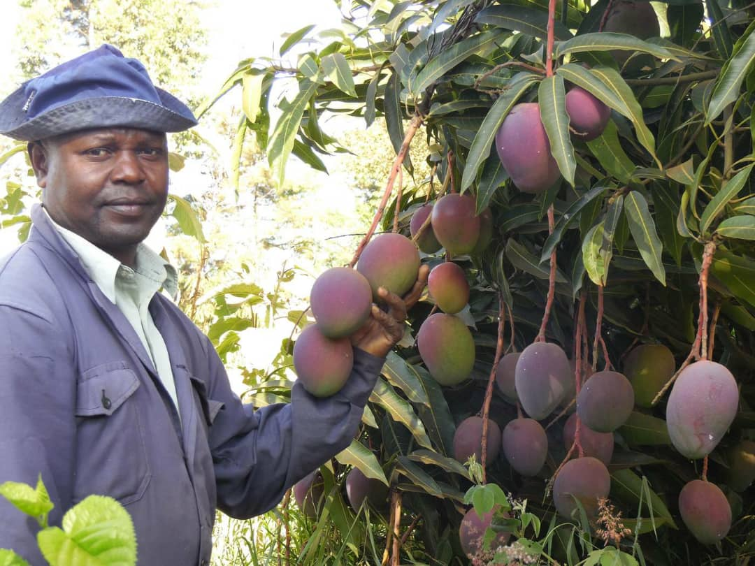
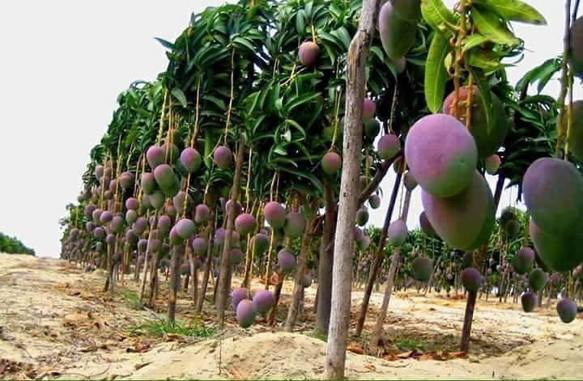
EXPERIENCE EXCELLENT QUALITY & SUPERIOR YIELD
MOGLOOP

Slide 3
TABLE OF CONTENT
01
MOGLOOP Overview
02
MOGLOOP Caution
03
MOGLOOP Content
04
MOGLOOP Protocol
05
MOGLOOP Benefits

Slide 4
MOGLOOP OVERVIEW
This product is a fertilizer containing 100% plant enzymes, microorganisms and amino acids produced by using physical methods in all production stages.
The fertilizer contains all the essential (and trace) elements needed for promoting robust plant growth, sustainable soil health, structure conservation and fertility improvement.
Harmful microorganisms cannot thrive and proliferate in areas where this organic fertilizer is used because it contains plant growth promoting rhizobacteria (PGPR).
This fertilizer has been prepared to address persistent requests from our farmers to create innovative bio-technological solutions for general problems in the natural way.

Slide 5
MOGLOOP OVERVIEW
GENERAL FARMERS’ PROBLEMS SOLVED WITH MOGLOOP
Saline soils (high salt content)
Deteriorating soil structure
Declining inherent soil fertility
Poor rooting and germination
Low crop establishment rate
Stunted vegetative growth
Pests and diseases infestation
Unstable soil pH (acidic soils)
Poor flowering and fruit formation
Low yield and poor crop quality
Short shelf life (high perishability)

Slide 6
MOGLOOP CAUTION!
The microorganisms, amino acids and enzymes are immobilized in the form of MOGLOOP enzymal fertilizer in package. For their mobilization, 1litre of the fertilizer should be mixed with at least 200litres of water!!!
Never apply to soil that is completely dry and/or weedy. Firstly, the soil should be annealed or given water before fertilizer application!!!
This fertilizer can be used by mixing with fungicide or insecticide or herbicides or inorganic fertilizers. However, it should not be mixed directly with chlorinated city water. Rest chlorinated water for at least 24hours before the fertilizer usage!!!
If the use disinfectant is required, allow at least 48hrs before and after fertilizer application. Otherwise, the effect of the fertilizer will reduce drastically!!!
We do not recommend our fertilizer as a chemical or organic drug. It works to improve plant structure and boost plant immune system on its own through natural methods!!!

Slide 7
MOGLOOP CONTENT
A. Guaranteed Content (W / W):
Total Organic Matter : 35%
Organic Carbon : 14%
Total Nitrogen : 1.5%
Water Soluble K2O : 3.5%
pH Range : 4 – 6
Binding Antibody Unit : 40/mL enzyme per 1mm
B. L-Alfa Amino Acids:
L-Aspartic Acid, L-Glutamic Acid, L-Arginine, L-Cysteine
L-Histidine, L-Alanine, L-Lysine, L-Methionine, L-Proline
L-Serine, L-Threonine, L-Tryptophan and L-Valine
C. Enzymes:
Alkaline Proteinase, Amylosine, Gluco-amylase, Xylanasa
Lipase, Lyase, Rubisco, Transglutaminase, Nitrogenase
Catalase, Lipoxygenase, Isomerase, Urease, Kitinase
D. Bacteria
Plant Growth Promoting Rhizobacteria (PGPR)

Slide 8
MOGLOOP CONTENT
EFFECTS OF AMINO ACIDS IN MOGLOOP ORGANIC FERTILIZER ON PLANTS
L-Aspartic Acid: It helps in germination; has high chelating power.
L-Glutamic Acid: It accelerates growth; has high chelating power; allows intake of other amino acids.
L-Arginine: It helps germination; increases resistance to cold.
L-Cysteine: It has high chelating power; it provides the formation of chlorophyll.
L-Histidine: It has high chelating power; it increases resistance to cold.
L-Alanine: It provides chlorophyll formation; it increases antifreeze effect in plants; it forms the constituent of antifreeze protein

Slide 9
MOGLOOP CONTENT
EFFECTS OF AMINO ACIDS IN MOGLOOP ORGANIC FERTILIZER ON PLANTS
L-Lysine: It provides chlorophyll formation, regulates nutrient uptake and increases pollen yield.
L-Methionine: It provides fruit formation, regulates nutrient uptake, promotes protein metabolism and increases root development.
L-Proline: It protects plant against stress.
L-Serine: It is auxin precursor.
L-Threonine: It accelerates growth.
L-Tryptophan: It is auxin precursor.
L-Valine: It is auxin precursor.

Slide 10
MOGLOOP CONTENT
EFFECTS OF ENZYMES IN MOGLOOP ORGANIC FERTILIZER ON PLANTS
1. Alkaline Protenase: It breaks down protein into amino acids and forms constituents of the plant.
2. Amylosine (Fungus Alpha Amylase): Prevents stress. It increases sap in the plant, makes the plant vivid and provides clarity and colour formation in the tissue. It hydrolyses starch groups into maltose.
3. Glyco-amylase (Aroma Enhancer) :it provides sugar balance in the plant and contributes to taste, smell and aroma. It breaks off the accumulation of glucose from the unreduced end of the polysaccharide chain. It can perform in low pH.
4. Xylanasa (Rooting): it is effective in cellular balance in the plant. It is also effective on the growth and development of capillary root tips and fibres in the root system. This enzyme is a complex with significant effect on hemicellulose complex containing glucan monam.
5. Lipase: It provides the fat balance in the plant. It is the enzyme derivative which hydrolyses the fats and releases the fatty acids. It plays an important role in all plants.

Slide 11
MOGLOOP CONTENT
EFFECTS OF ENZYMES IN MOGLOOP ORGANIC FERTILIZER ON PLANTS
6. Lyase: It breaks down harmful chemicals in the soil and transforms them in a way that the plant can use them. It increases the biological efficiency of the soil. Lyase enzyme can break various chemical bonds by external means such as hydrolysis and oxidation through generally forming a new double bond or ring structure.
7. Rubisco: Provides early growth. It maintains the balance of plant metabolism and provides early growth. It is a vital enzyme for photosynthesis of plants and carbon dioxide balance in the atmosphere.
8. Transglutaminase: It plays a role in the modification of proteins. It catalyses the use of water if there is no primary amine in the environment or if the amine group of lysine binds with certain agents.
9. Catalase: It makes harmful chemicals organic. It converts the harmful compounds in the plant into beneficial materials. It dehydrogenates hydrogen peroxide in plant metabolism and it is an enzyme which plays an important role in plant metabolism.
10. Nitrogenase: It converts the nitrogen in N2 form in the atmosphere to the form that the plant will use for various purposes such as ammonia and nitrate.

Slide 12
MOGLOOP CONTENT
EFFECTS OF ENZYMES IN MOGLOOP ORGANIC FERTILIZER ON PLANTS
11. Lypoxygenase: It prolongs the shelf life of the plant. The plant colour, taste, aroma and allure increase.
12. Isomerase (Aroma Enhancer): It increases the degree of sweetness in fruit. It is an isomerase that catalyses the conversion of glucose into fructose.
Urease: It converts nitrogen to the form the plant can use. It catalyses the hydrolysis of urea to carbon dioxide and ammonia. Nitrogen is very important in the growth of plants.
14. Kitinase: It makes the root membrane thicker. It provides endurance of bacteria that it supports and reproduces against fungus and fungal species. It provides thickness on body shell, leaves, fruit surfaces and shell thickness. It prevents the transmission and living of fungal species.

Slide 13
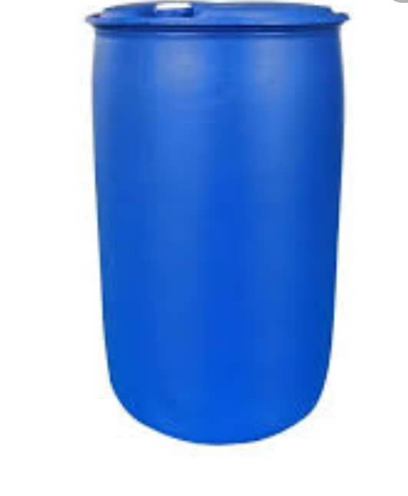
MOGLOOP PROTOCOL
ROUTIINE CROP TREATMENT OF NORMAL HEALTHY PLANTS
Rinse 200litre barrel with clean non-chlorinated water.
Fill the barrel with 100litre of with clean non-chlorinated water.
Add 500ml of MOGLOOP organic fertilizer slowly to the clean water.
Stir continuously in order to obtain a uniform MOGLOOP solution.
Add 100litre more of water to fill the barrel and stir continuously.
That is, mix half (0.5)litre of MOGLOOP with 200litres of clean water.
Alternatively, mix one (1.0)litre of MOGLOOP with 400litres of clean water
1LITRE MOGLOOP + 400LITRES WATER

Slide 14
MOGLOOP PROTOCOL
ROUTIINE CROP TREATMENT OF MILDLY-INFESTED PLANTS
Rinse 200litre barrel with clean non-chlorinated water.
Fill the barrel with 100litre of with clean non-chlorinated water.
Add 1litre of MOGLOOP organic fertilizer slowly to the clean water.
Stir continuously in order to obtain a uniform MOGLOOP solution.
Add 100litre more of water to fill the barrel and stir continuously.
That is, mix one (1.0)litre of MOGLOOP with 200litres of clean water.
1LITRE MOGLOOP + 200LITRES WATER

Slide 15
MOGLOOP PROTOCOL
ROUTIINE CROP TREATMENT OF SEVERELY-INFESTED PLANTS
Rinse 200litre barrel with clean non-chlorinated water.
Fill the barrel with 100litre of with clean non-chlorinated water.
Add 2litres of MOGLOOP organic fertilizer slowly to the clean water.
Stir continuously in order to obtain a uniform MOGLOOP solution.
Add 100litre more of water to fill the barrel and stir continuously.
That is, mix two (2.0)litres of MOGLOOP with 200litres of clean water.
2LITRES MOGLOOP + 200LITRES WATER

Slide 16
MOGLOOP PROTOCOL
MOGLOOP DOSAGE PER UN IT AREA FOR NORMAL HEALTHY PLANTS
Normal healthy perennial tree crops: 1litre MOGLOOP:400litres water per acre per round
Normal healthy horticultural crops: 1litre MOGLOOP :400litres water per hectare per round
Normal healthy cereals & legumes: 1litre MOGLOOP :400litres water per hectare per round
Normal healthy roots & tuber crops: 1litre MOGLOOP :400litres water per hectare per round

Slide 17
MOGLOOP PROTOCOL
MOGLOOP DOSAGE PER UN IT AREA FOR MILDLY-INFESTED PLANTS
Mildly infested perennial tree crops: 1litres MOGLOOP:200litres water per acre per round
Mildly infested horticultural crops: 1litres MOGLOOP:200litres water per hectare per round
Mildly infested cereals & legumes: 1litres MOGLOOP:200litres water per hectare per round
Mildly infested roots & tuber crops: 1litres MOGLOOP:200litres water per hectare per round

Slide 18
MOGLOOP PROTOCOL
MOGLOOP DOSAGE PER UN IT AREA FOR SEVERELY-INFESTED PLANTS
Severely infested perennial tree crops: 2litres MOGLOOP:200litres water per acre per round
Severely infested horticultural crops: 2litres MOGLOOP:200litres water per hectare per round
Severely infested cereals & legumes: 2litres MOGLOOP:200litres water per hectare per round
Severely infested roots & tuber crops: 2litres MOGLOOP:200litres water per hectare per round

Slide 19
MOGLOOP PROTOCOL
MOGLOOP TREATMENT PROTOCOL SCHEDULE
Treatment schedule for perennial tree crops: 60days post-harvest; before flowering; after fruit setting
Treatment schedule for horticultural crops: At transplanting; before flowering; after fruit setting
Treatment schedule for cereals & legumes: Just after planting; before flowering; at grain filling
Treatment schedule for roots & tuber crops: Just after planting: before flowering; after tuber initiation.

Slide 20
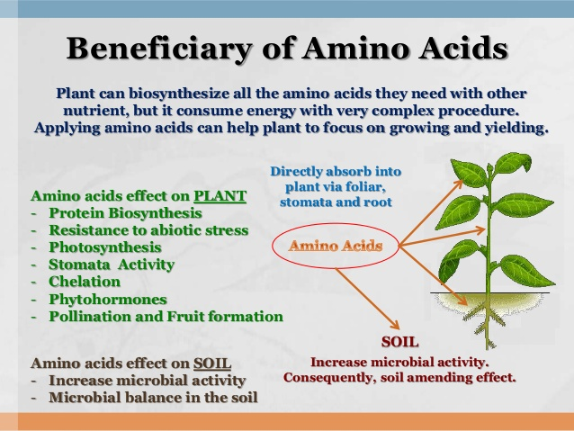
PRODUCT CONTENT
MOGLOOP BENEFITS
EFFECTS OF AMINO ACIDS ON SOIL HEALTH, PHOTOSYNTHESIS & PLANT GROWTH

Slide 21
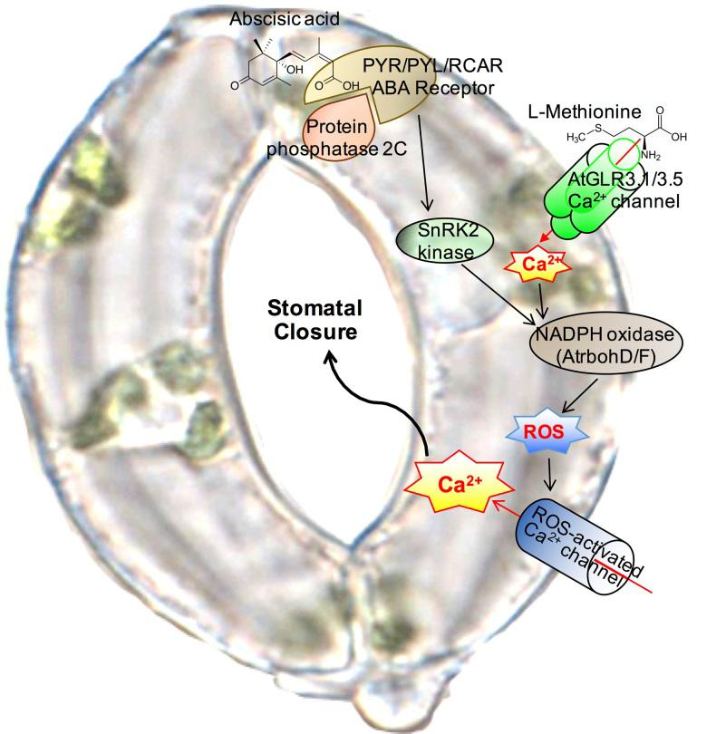
MOGLOOP BENEFITS
EFFECTS OF AMINO ACIDS ON STOMATA OPENING & CLOSURE

Slide 22
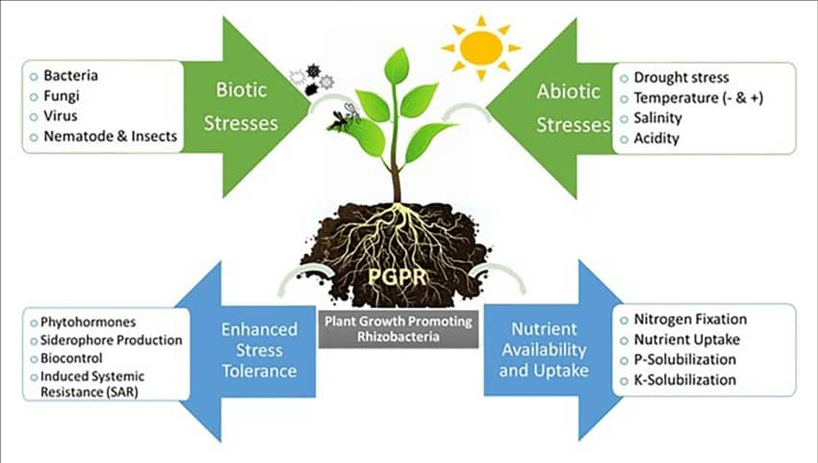
MOGLOOP BENEFITS
EFFECTS OF PLANT GROWTH PROMOTING RHIZOBACTERIA (PGPR) ON PLANTS

Slide 23
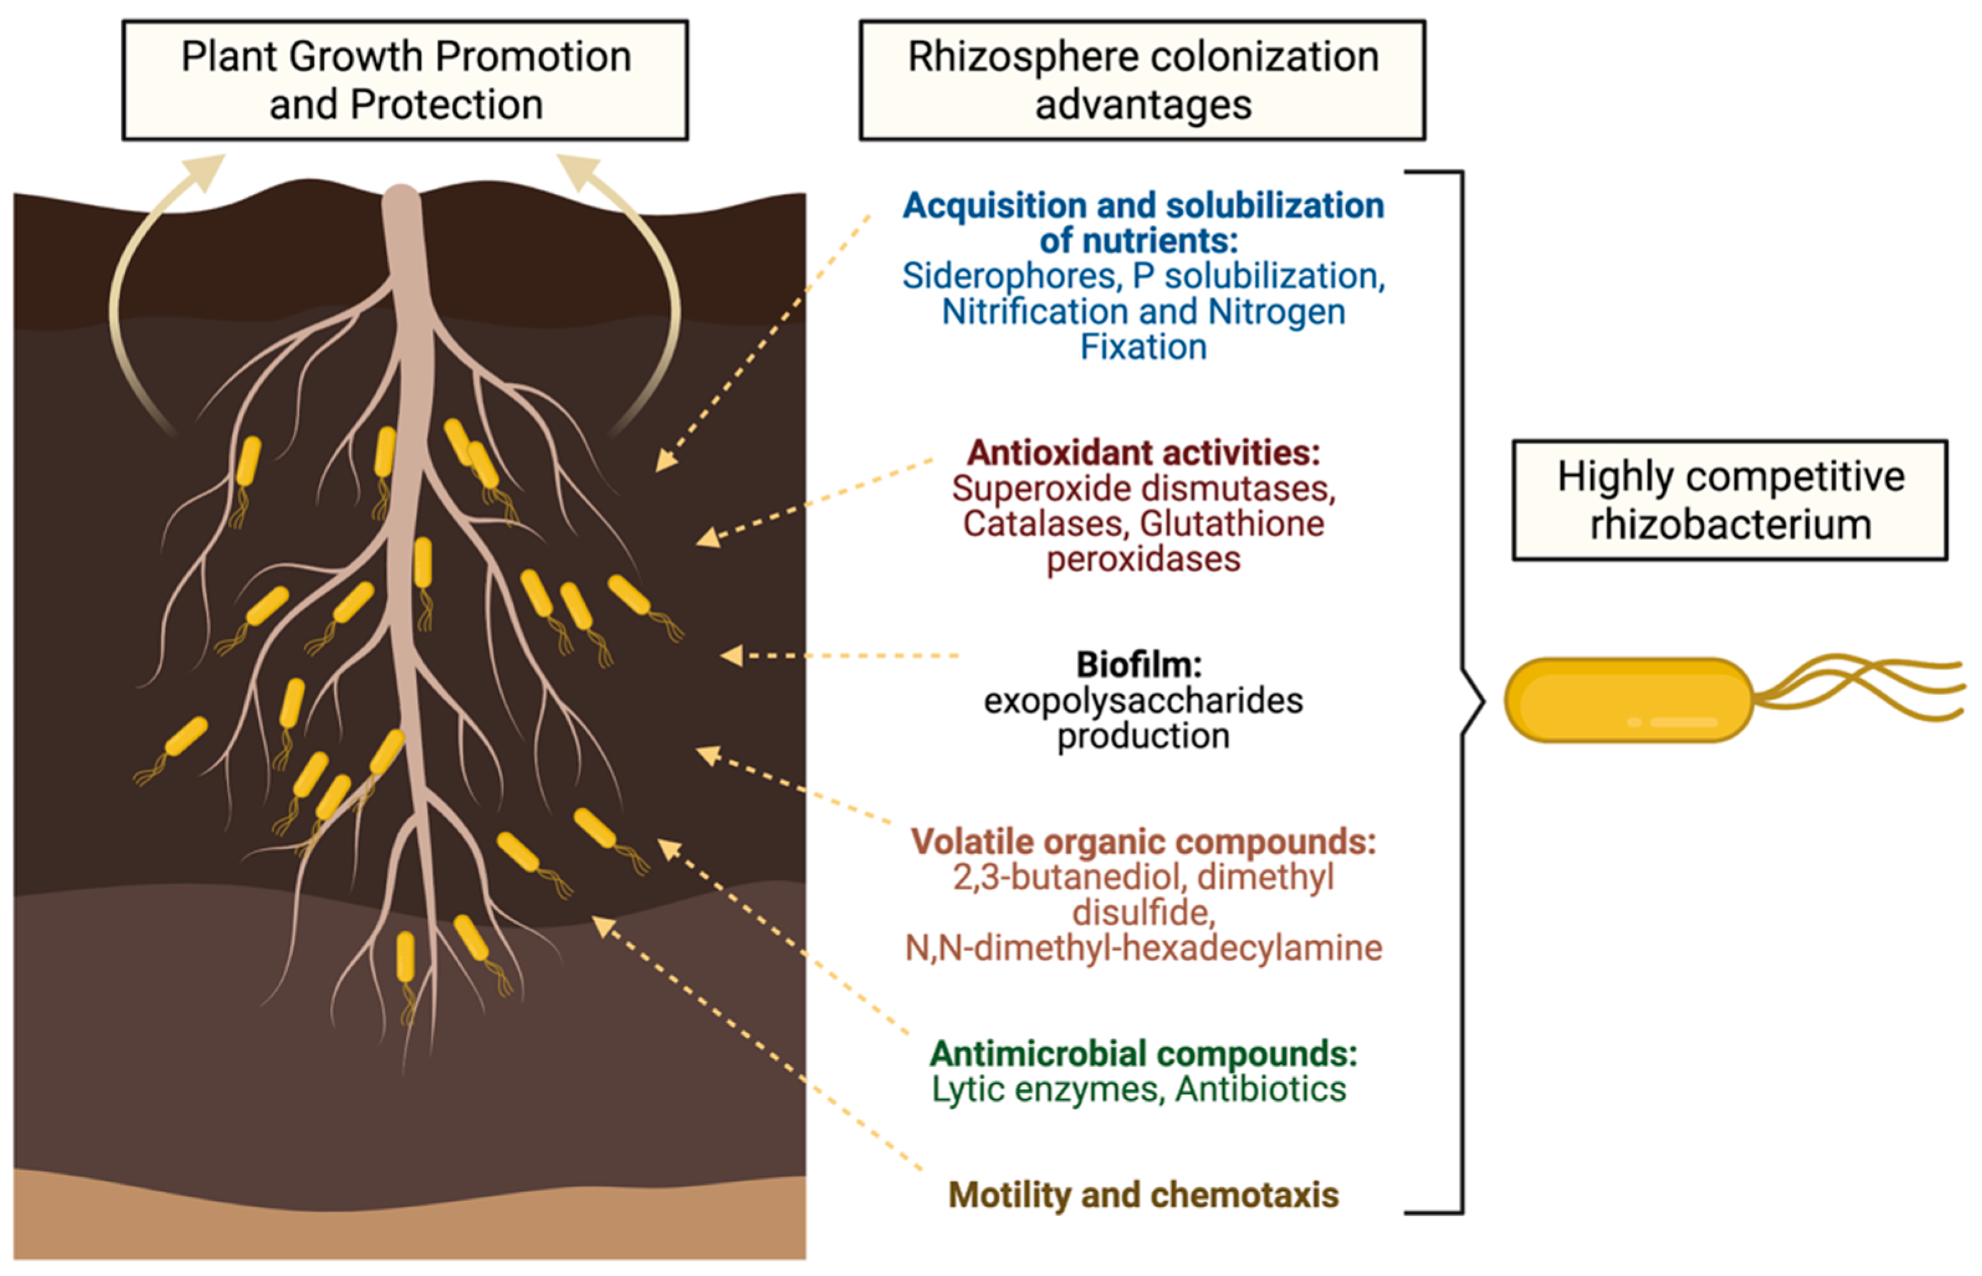
MOGLOOP BENEFITS
EFFECTS OF PLANT GROWTH PROMOTING RHIZOBACTERIA (PGPR) ON PLANTS

Slide 24
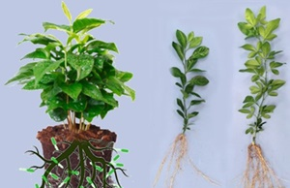
MOGLOOP BENEFITS
EFFECTS OF PGPR ON SOIL HEALTH & ROOT MASS PROLIFERATION

Slide 25
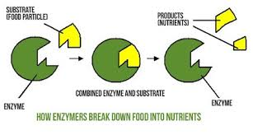
MOGLOOP BENEFITS
HOW ENZYMES BREAK DOWN FOOD INTO NUTRIENTS

Slide 26
MOGLOOP BENEFITS
KEY BENEFITS OR ADVANTAGES OF USING MOGLOOP ON PLANTS
Early and high germination rate; early and superior rooting and root mass proliferation.
Vigorous plant growth; enhanced plant health and structure; boosted immune system.
Improved tolerance to harsh climatic conditions and high resistance to pests and diseases.
Improved photosynthetic activities, prolific flowering, fruit initiation, formation and bulking.
Improved quality, wholesomeness, yield and longer post-harvest shelf life characteristics.
Improved soil health, fertility and structure; efficient breakdown and uptake of soil nutrients.

Slide 27
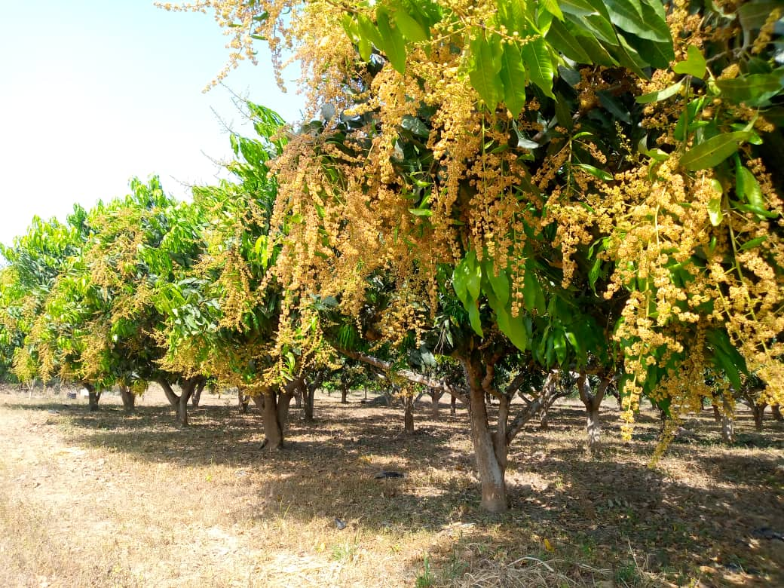
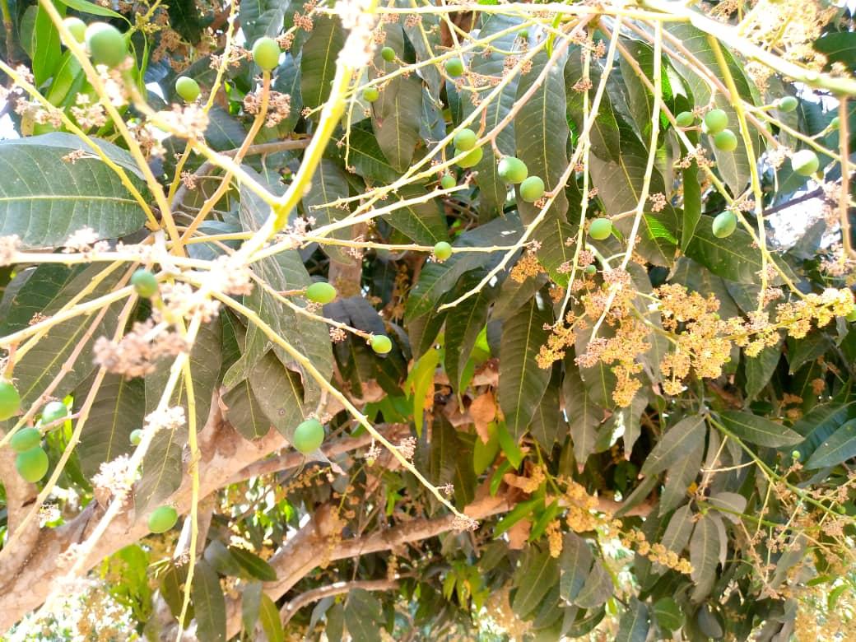
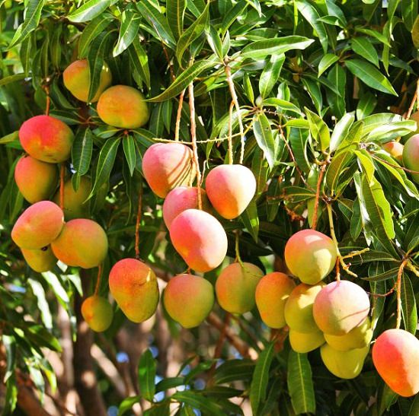
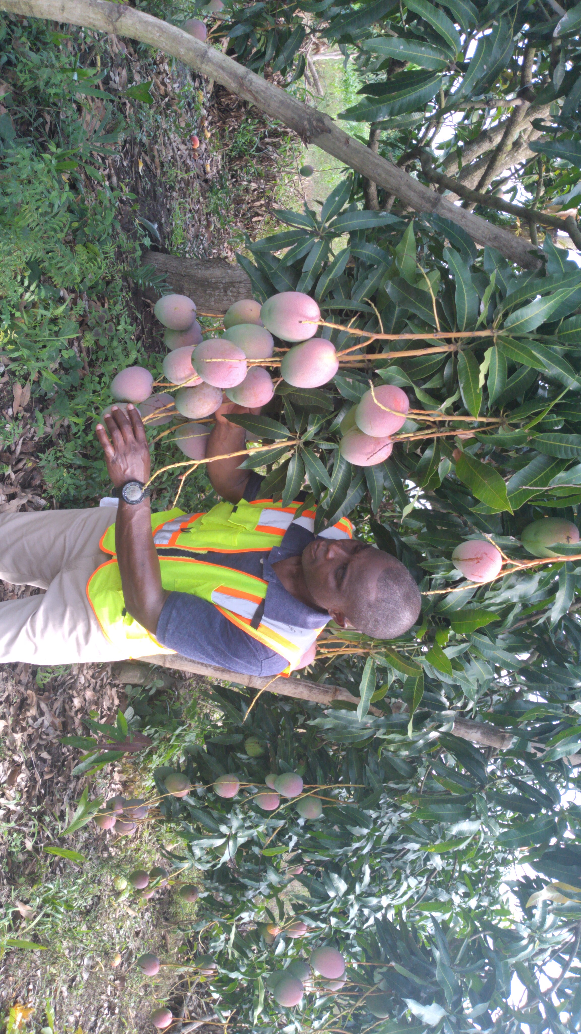
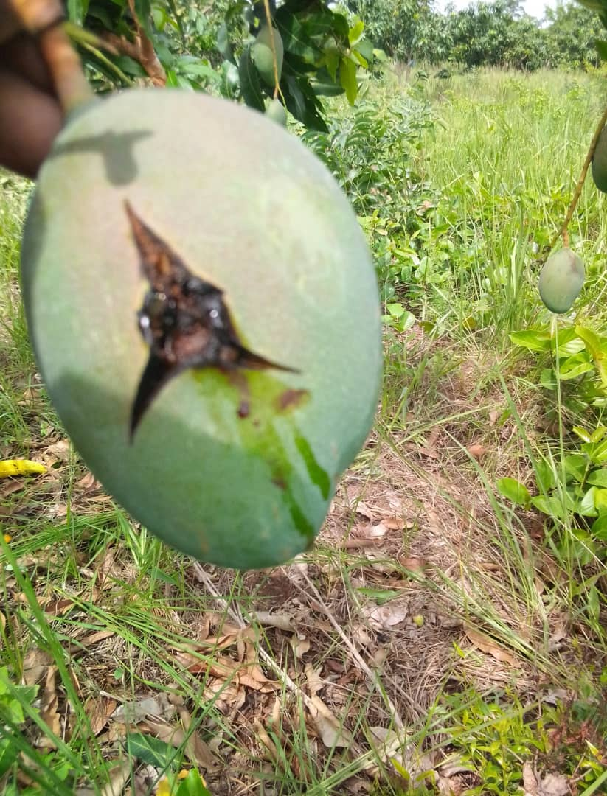
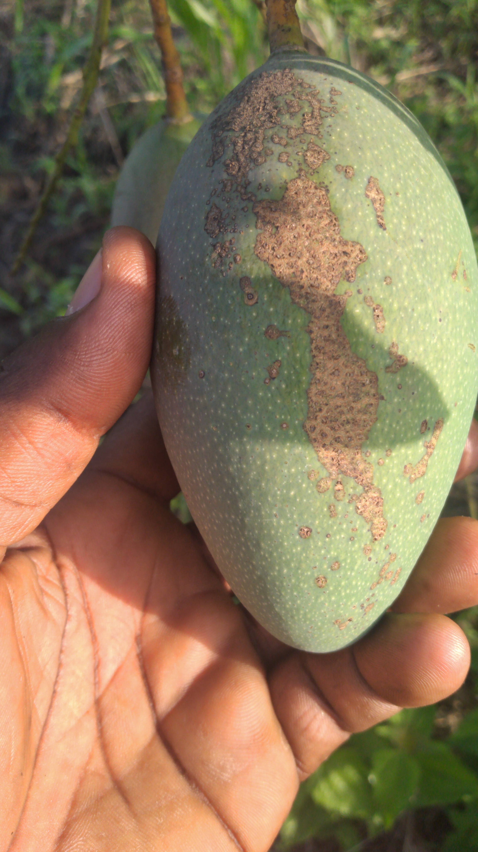
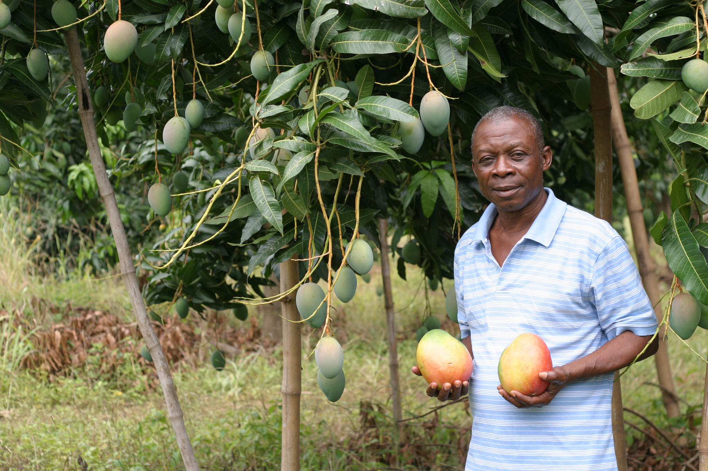
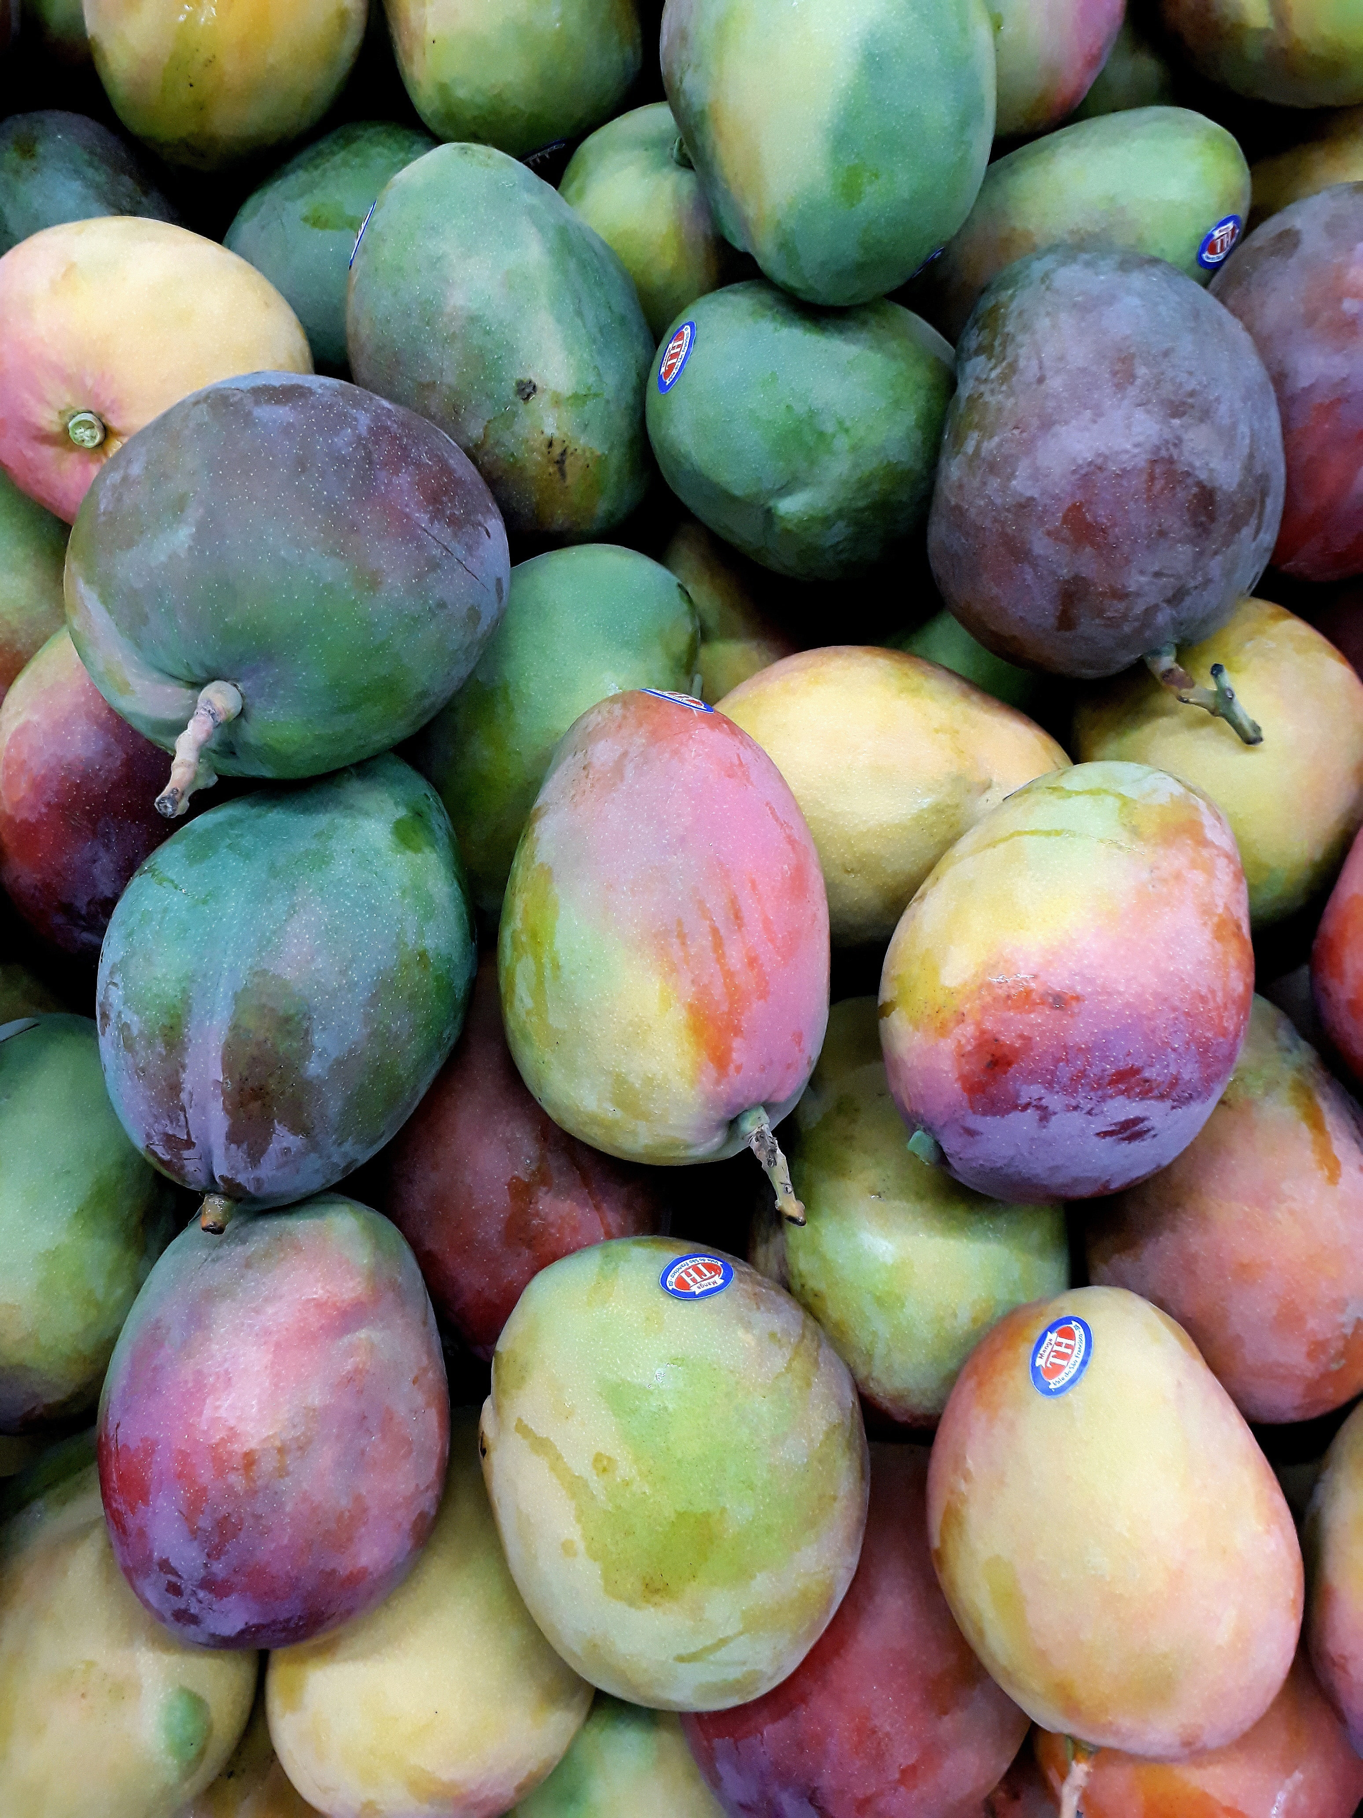
MOGLOOP BENEFITS
KEY MOGLOOP FIELD RESULTS ON MANGO
Prolific blossoming Superior Fruit Bud Initiation Excellent Quality & High Yield
BBS Anthracnose Post-MOGLOOP treatment M & E
Healthy & Export Packaging Quality Fruits

Slide 28
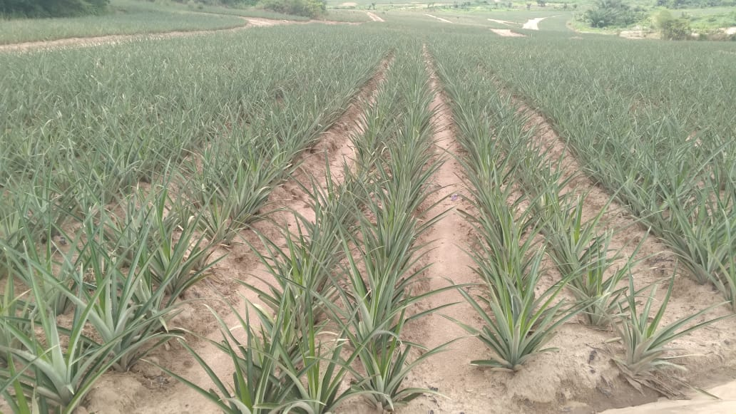
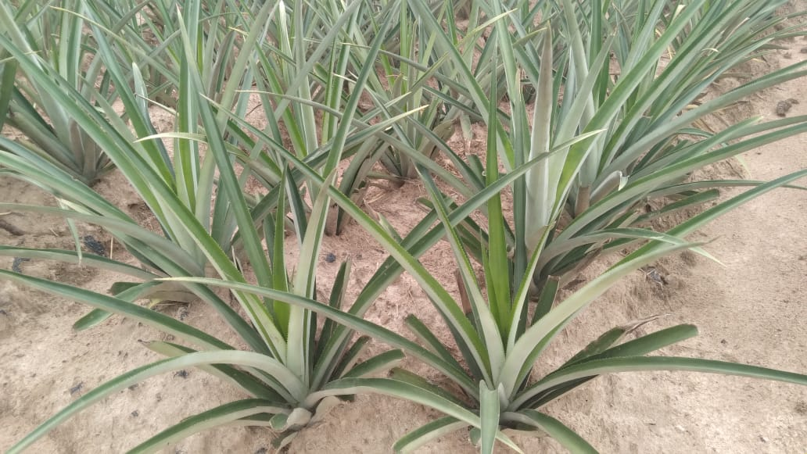
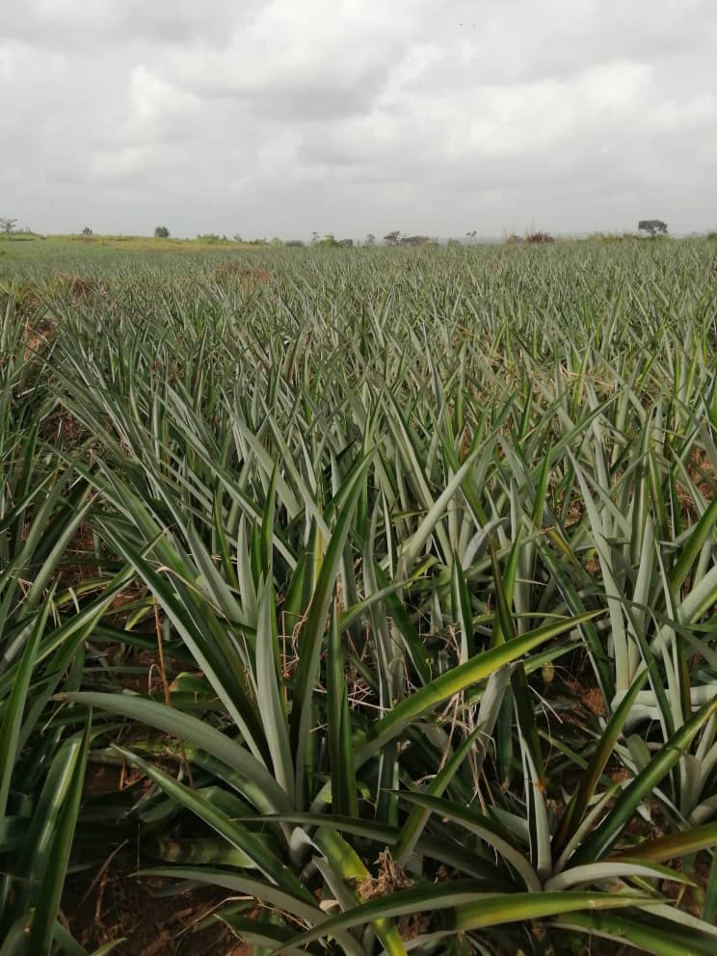
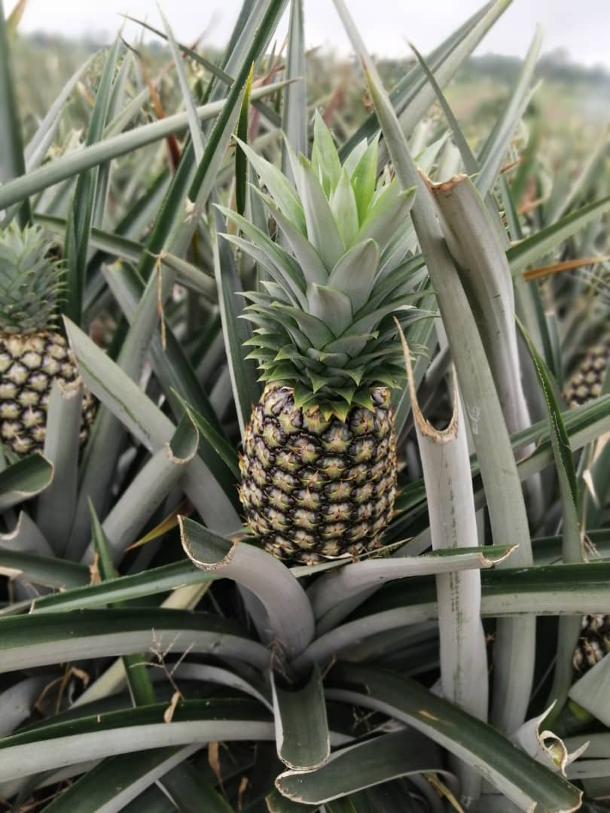
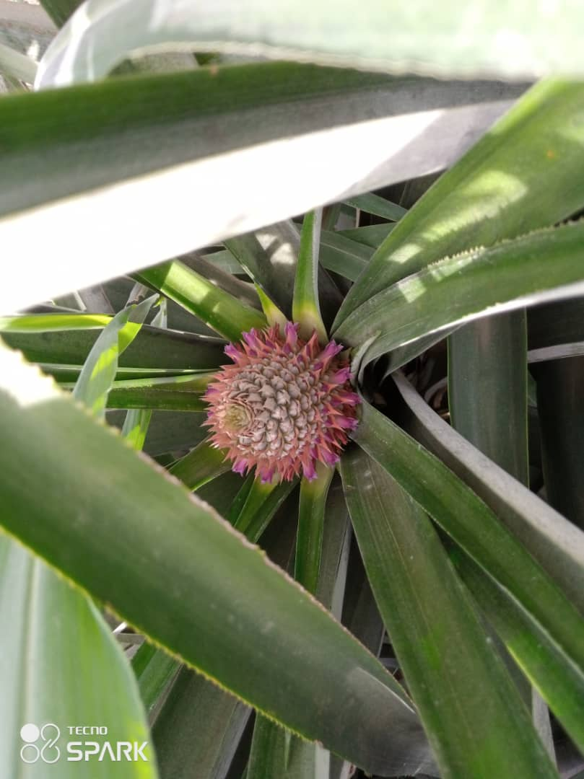
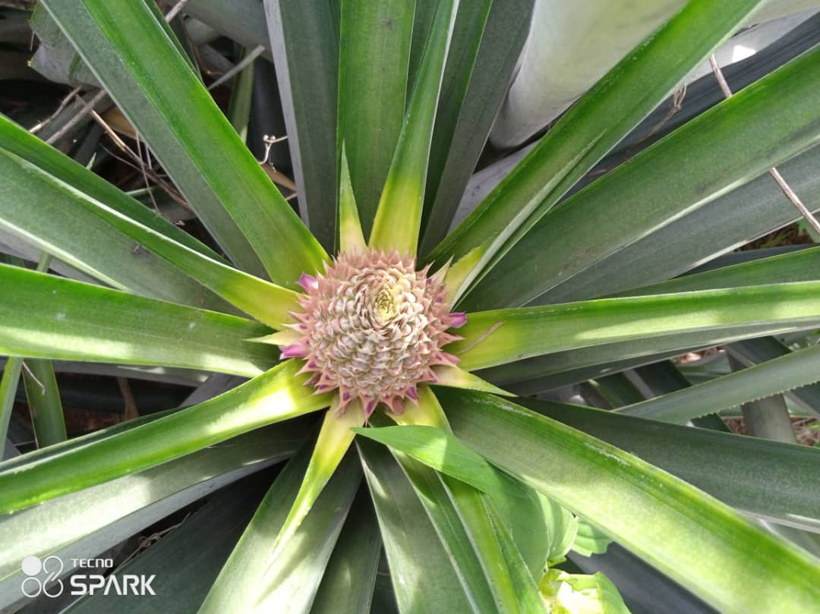
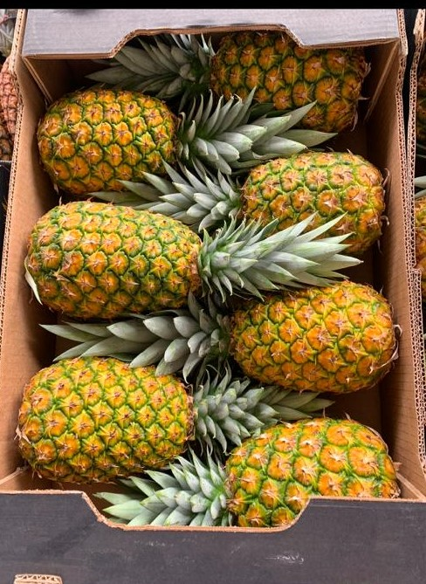
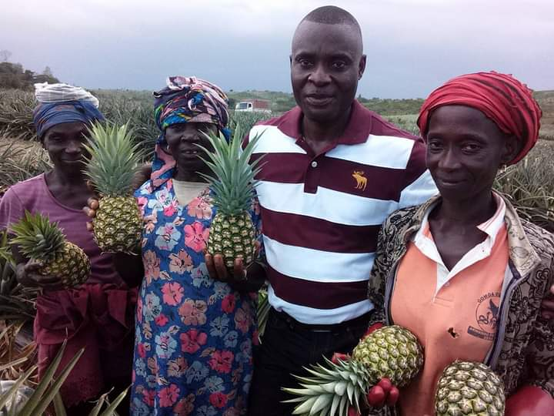
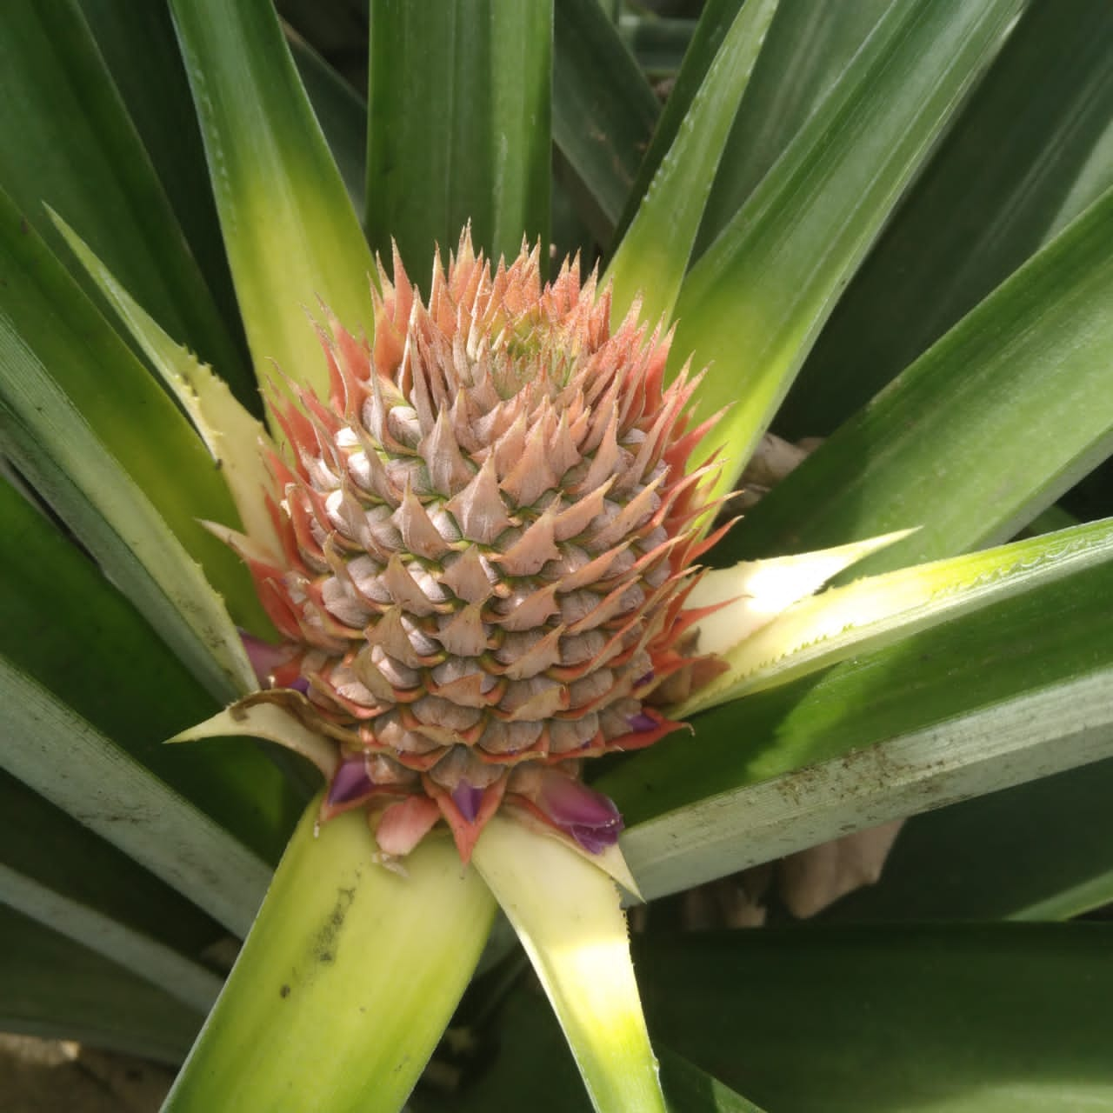
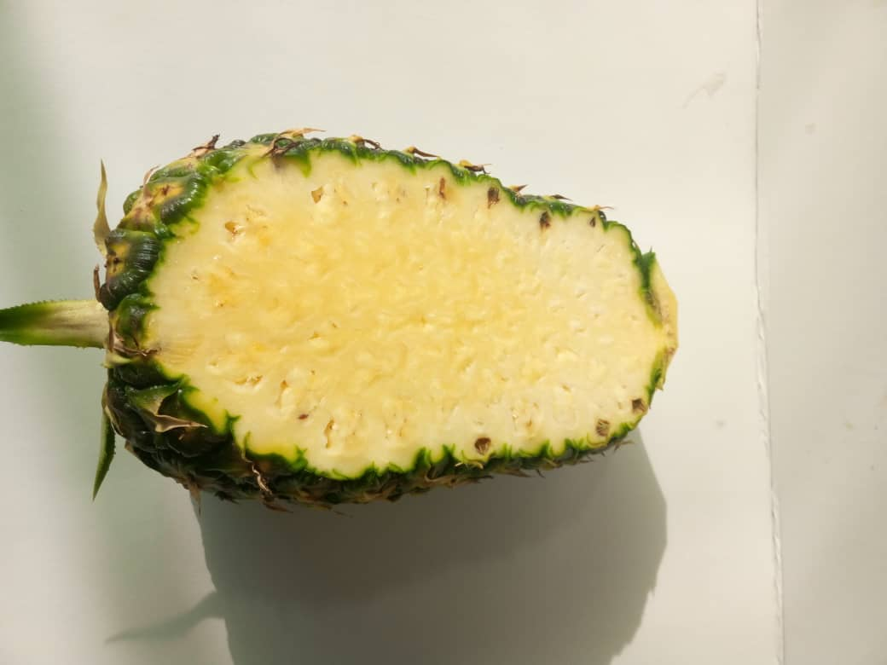
MOGLOOP BENEFITS
KEY MOGLOOP FIELD RESULTS ON PINEAPPLE
High Establishment Good Drought Tolerance Healthy Green Foliage Uniform Fruit Bulking Size
Healthy & Vigorous Flower Initiation after Forcing
Uniform Flowering after Forcing High Internal Fruit Quality Export Packaging Quality Farmers Happy with Quality & Yield

Slide 29
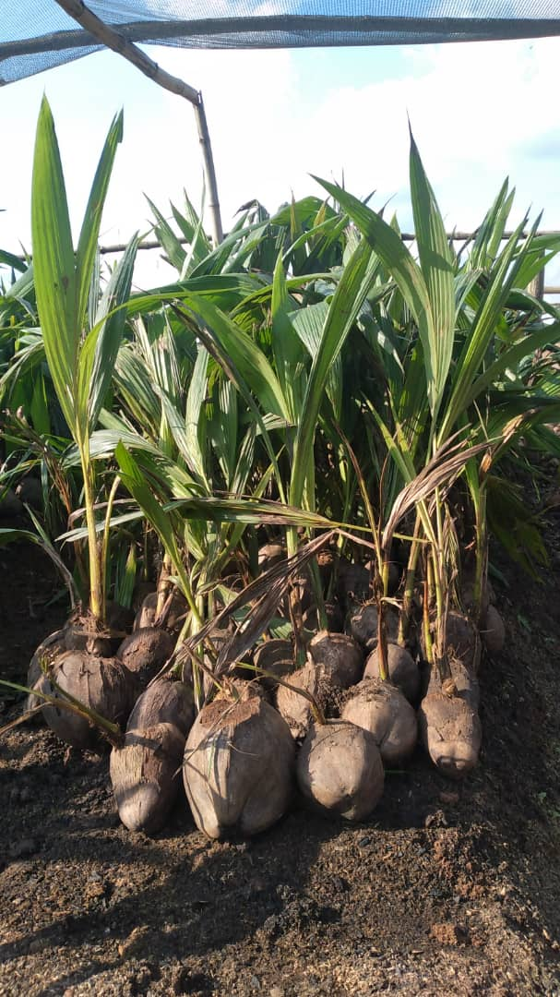
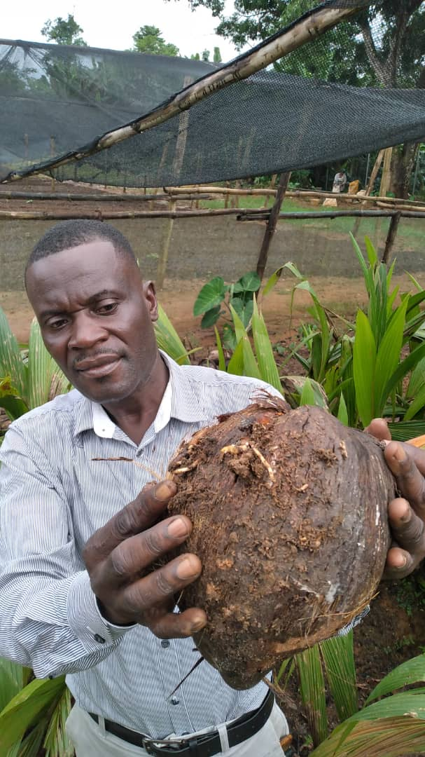
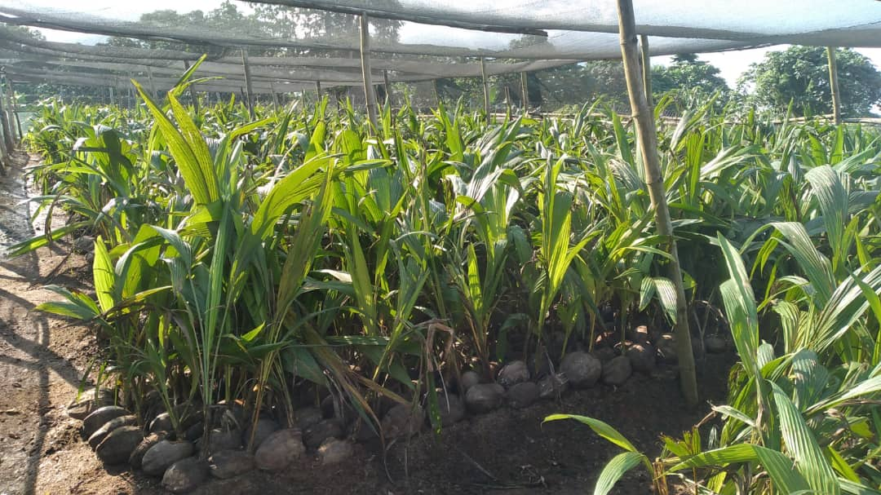
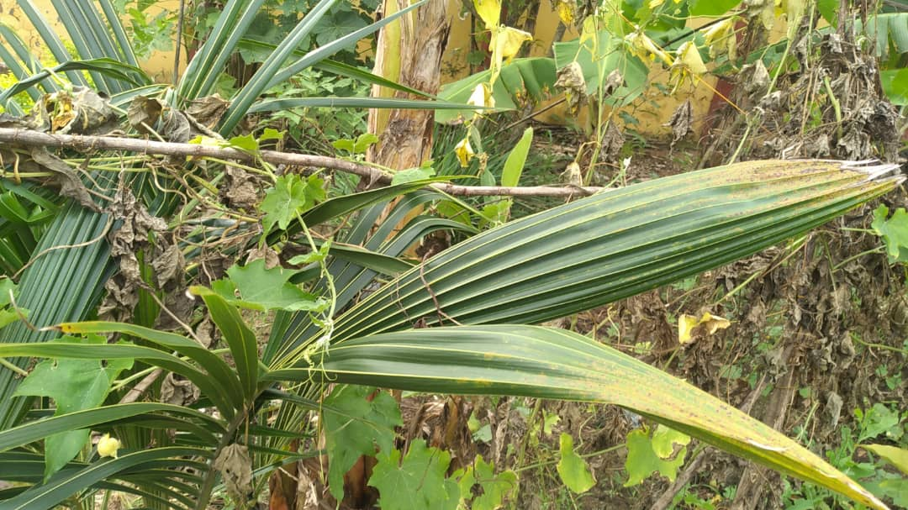
MOGLOOP BENEFITS
KEY MOGLOOP FIELD RESULTS ON COCONUT (BEFORE MOGLOOP)
Pale Green Leaves with Yellow Tips Dry Nuts with Flaccid Roots Necrotic Leaves

Slide 30
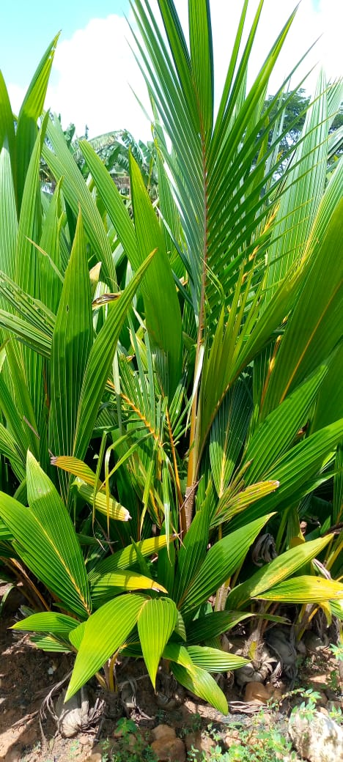
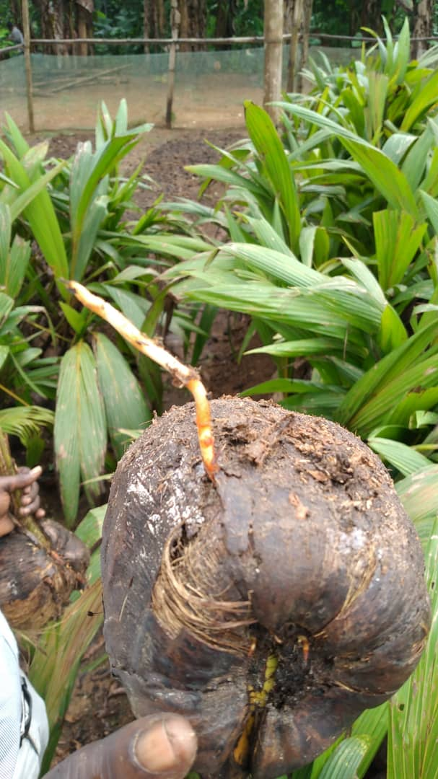
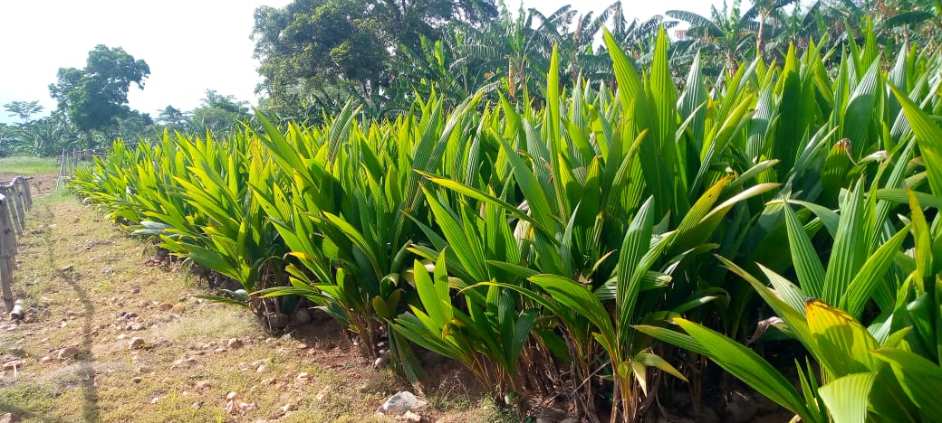
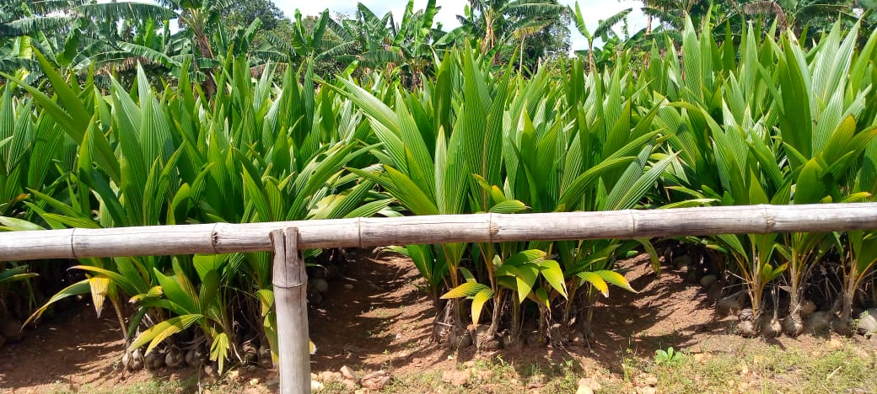
MOGLOOP BENEFITS
KEY MOGLOOP FIELD RESULTS ON CONDITIONING OF COCONUT SEEDLINGS
Well Conditioned Seedlings with Green Foliage & New Root Emergence Healthy & Robust Seedlings with Green Foliage Ready for Transplanting

Slide 31
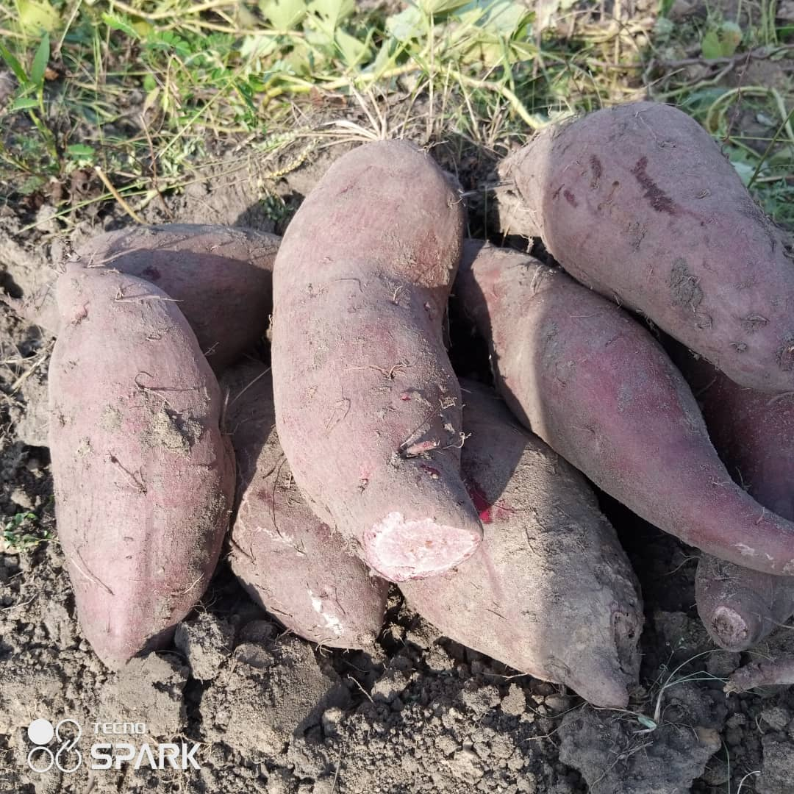
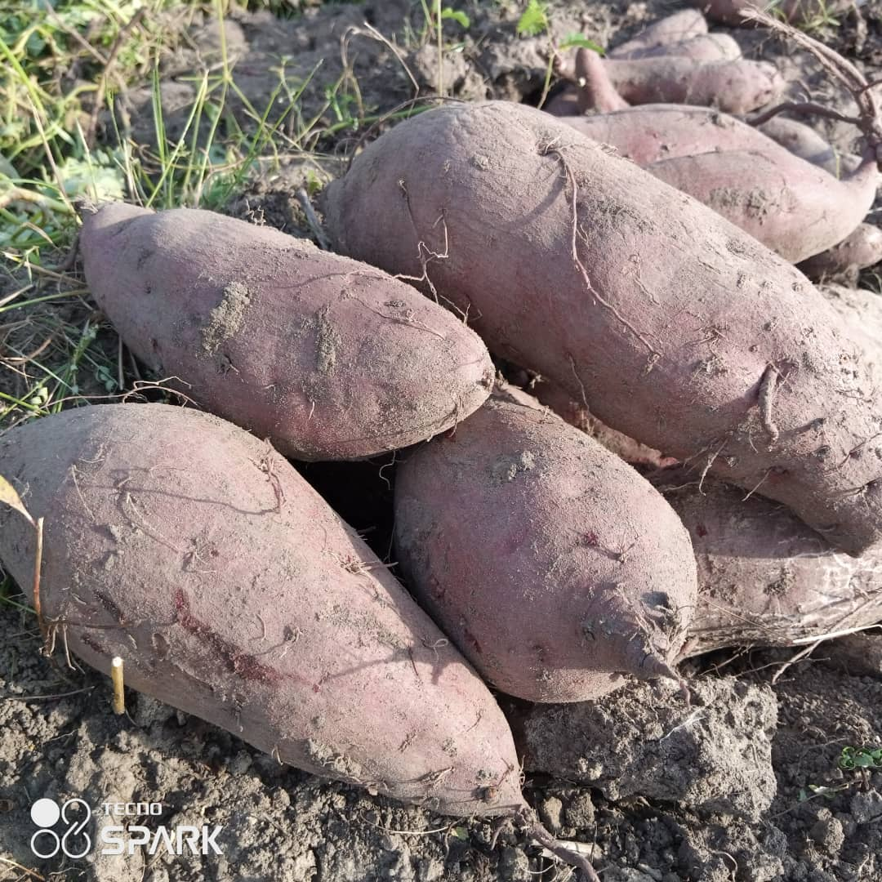
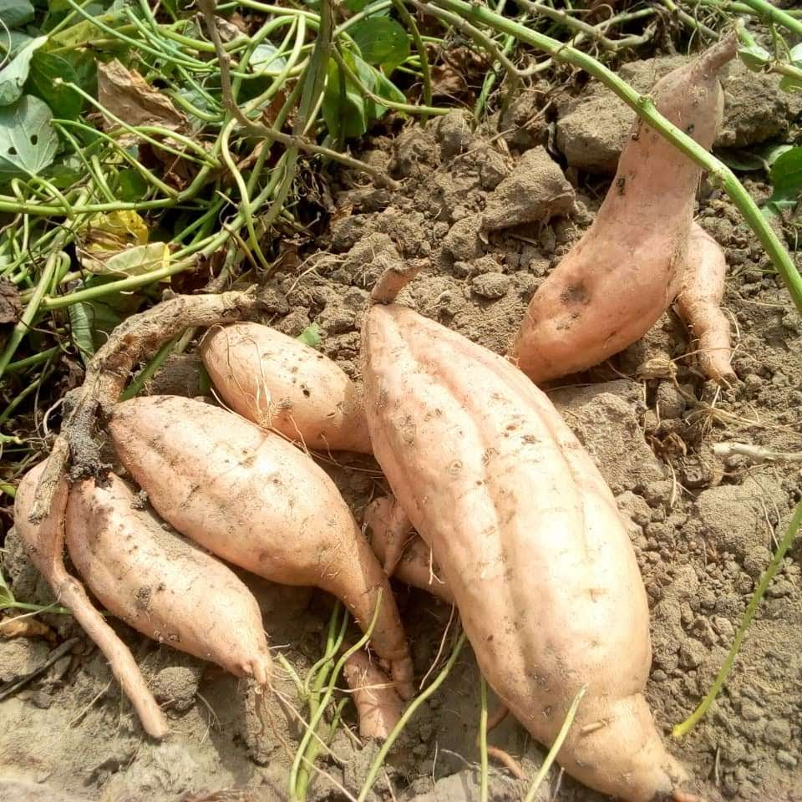
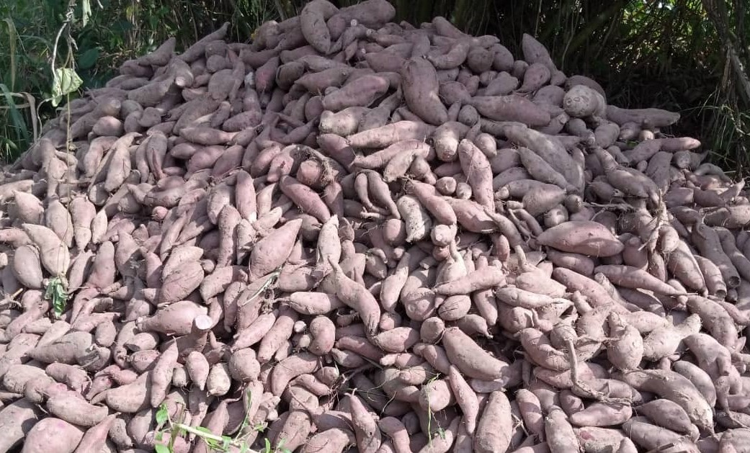
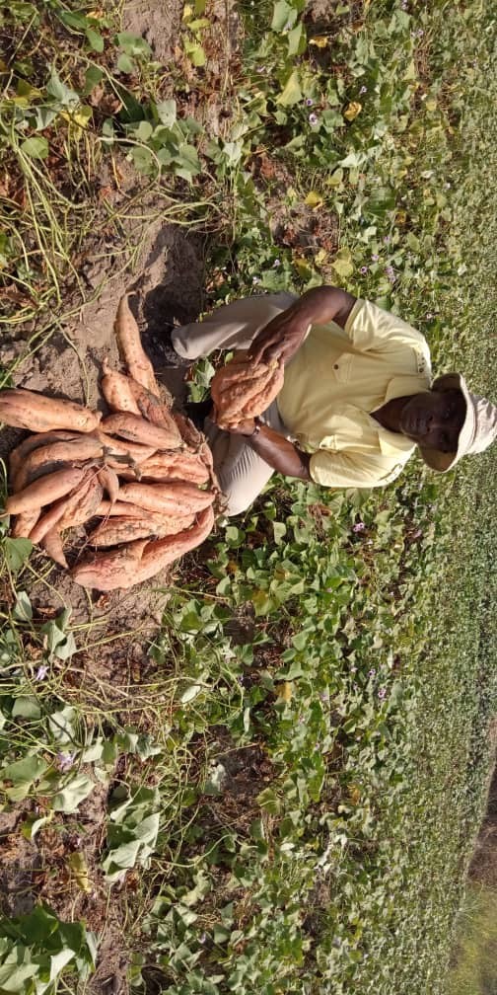
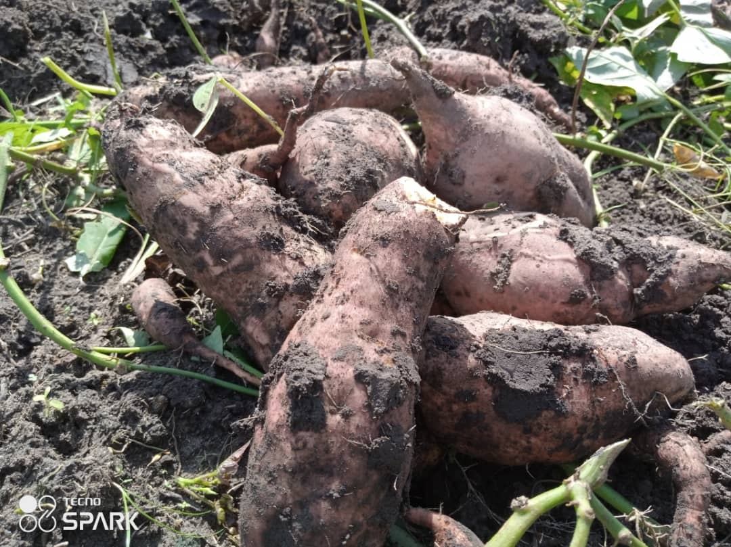
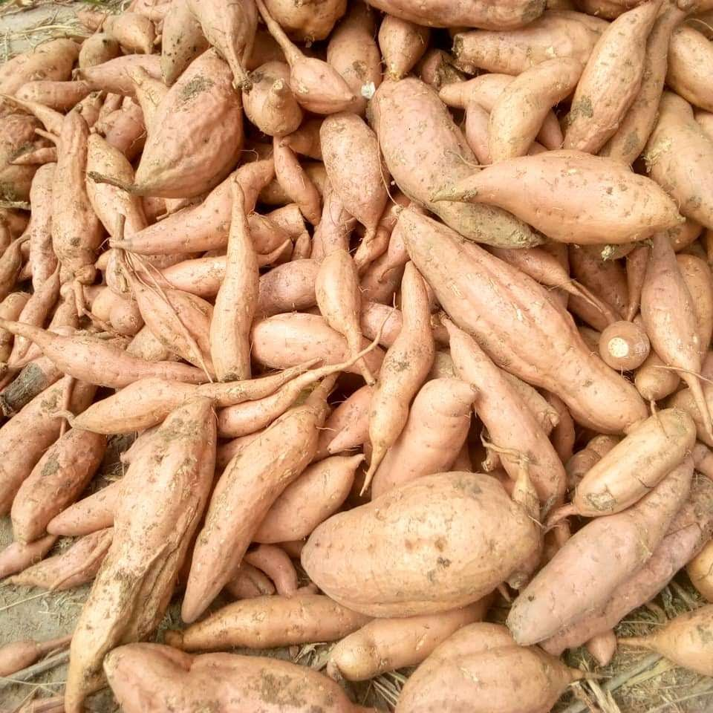
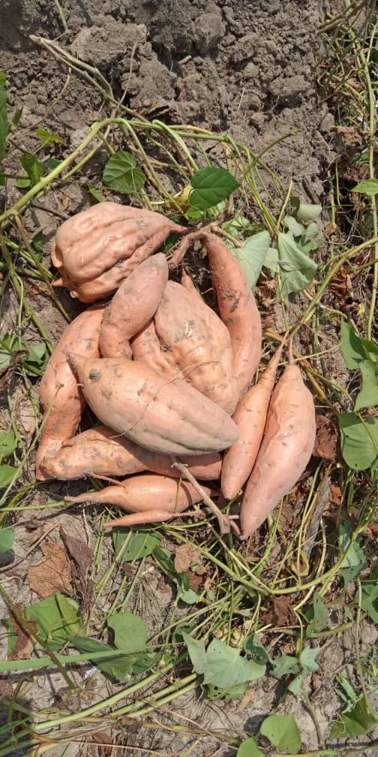
MOGLOOP BENEFITS
KEY MOGLOOP FIELD RESULTS ON SWEET POTATO
Purple Flesh SP: Superior Yield, High Quality Wholesome Tubers
Orange Flesh SP: Superior Bulking & High Yield Per Stand High Yield Per Stand Wholesome Skin & Export-Style Quality

Slide 32
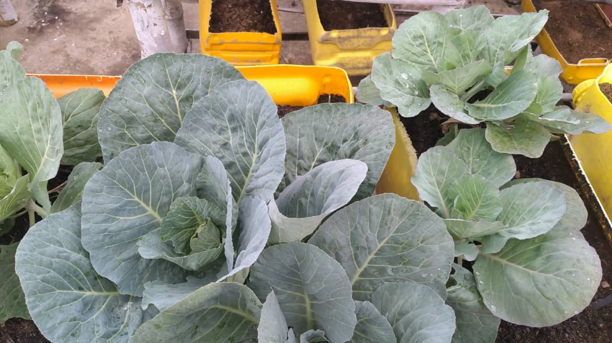
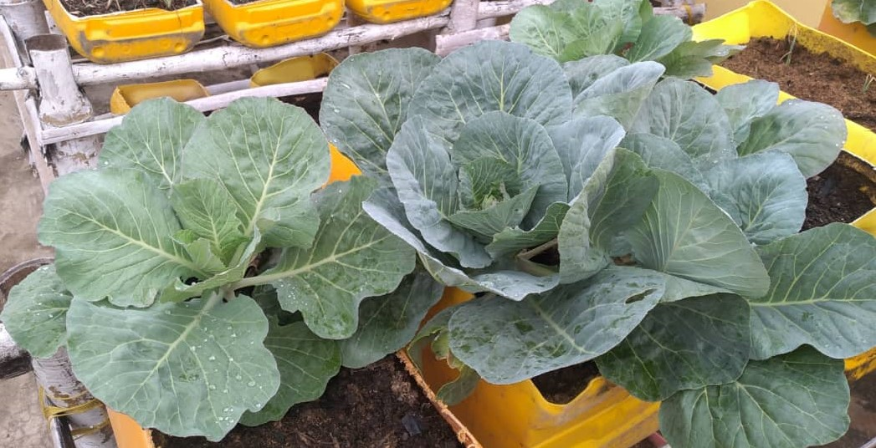
MOGLOOP BENEFITS
KEY MOGLOOP FIELD RESULTS ON CABBAGE
MOGLOOP
CONTROL
CONTROL
MOGLOOP
Superior and More Vigorous Foliar Growth and Better Crop Health Status of MOGLOOP-Treated Cabbage

Slide 33
MOGLOOP BENEFITS
KEY MOGLOOP FIELD RESULTS ON ONION
Very High Germination & Establishment Vigorous Early Vegetative Growth Pattern
Good Drought Tolerance and Vigorous Bulking of Onion Bulbs on Marginal Gravelly Sandy Loam Soil

Slide 34
MOGLOOP BENEFITS
KEY MOGLOOP FIELD RESULTS ON EGGPLANT
Very High Establishment & Early Rooting
Monitoring of Post-MOGLOOP Fruit Bud Initiation
Prolific Fruit Formation & Bulking; Healthy Fruit Status; High Yield & Export-Style Quality

Slide 35
MOGLOOP BENEFITS
KEY MOGLOOP FIELD RESULTS ON SQUASH
MOGLOOP (Very High Establishment) Prolific Flowering & Fruit Initiation Very High Yield
CONTROL (Choanephora Fruit Rot)
MOGLOOP (Disease Resistance Observed)
MOGLOOP (Wholesome Export-Style Quality)

Slide 36
MOGLOOP BENEFITS
KEY MOGLOOP FIELD RESULTS ON GINGER
Robust Stem Growth Uniform Establishment & Vigorous Growth Pattern
Early Rhizome Formation at 8WAP Post-MOGLOOP Monitoring of Rhizomes Early Bulking of Healthy Rhizomes at 14WAP

Slide 37
MOGLOOP BENEFITS
KEY MOGLOOP FIELD RESULTS ON MAIZE
Uniform Crop with Very High Establishment Vigorous Formation of Healthy Cobs
Post-MOGLOOP Monitoring of Cobs Superior Grain Filling & Grain Yield Vigorous Formation & Bulking of Healthy Cobs

Slide 38
MOGLOOP BENEFITS
KEY MOGLOOP FIELD RESULTS ON RICE
Very High Germination High Establishment & Uniformity Vigorous and Robust Tillering Healthy Pre-flowering Status
Superior Grain Filling of Paddy Rice Uniform Grain Drying Harvesting of High Yield & Top Quality Grains

Slide 39
MOGLOOP BENEFITS
KEY MOGLOOP FIELD RESULTS ON COWPEA
Uniform Crop with Very High Establishment Formation of Vigorous and Healthy Canopy Post-MOGLOOP Monitoring of Pod Filling
Uniform and Vigorous Pod Formation and Grain Filling of Healthy Cowpea High Yield & Top Quality Cowpea Harvest

Slide 40
MOGLOOP BENEFITS
KEY MOGLOOP FIELD RESULTS ON GROUNDNUT
Uniform Crop with Very High Establishment Sustained Vegetative Growth Phase Flowering of Healthy Groundnut at 5Weeks
Prolific Pod Formation and Pod Filling of Healthy Groundnut High Yield and Excellent Grain Quality

Slide 41
Thank You!
RICHARD NINKYI BAIDOO
(CHIEF TECHNICAL CONSULTANT)
COTTON-WEBLINK PORTFOLIO LTD

