Slide 1
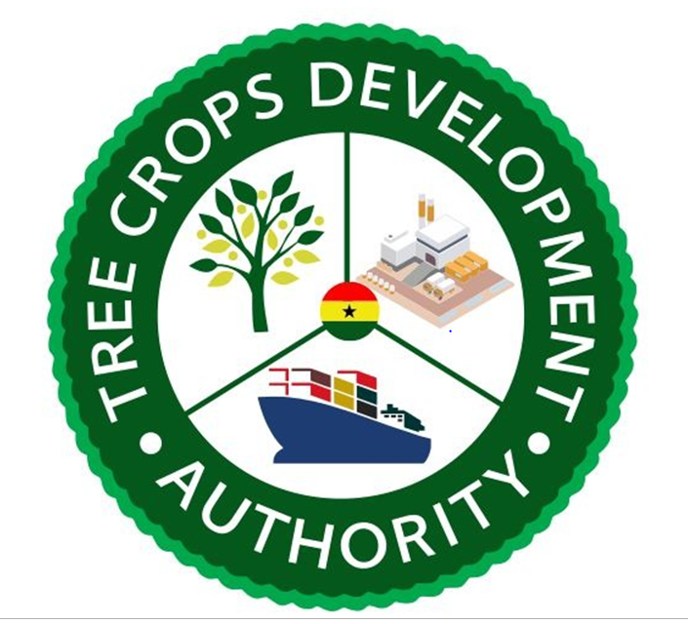
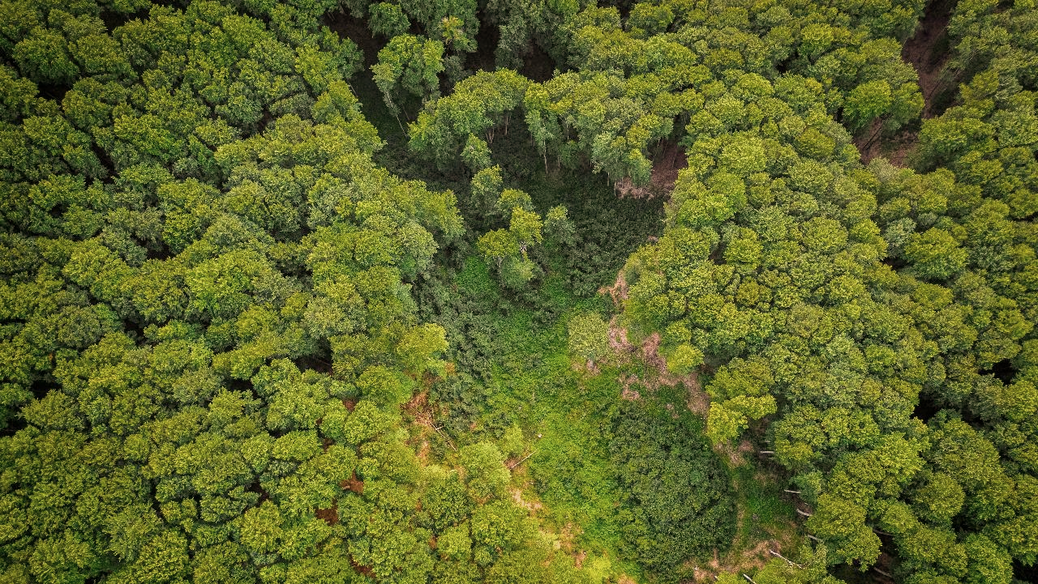
TREE CROPS DEVELOPMENT AUTHORITY
Presentation: Overview of the Mango Industry and the Way Forward
Presented by:
Forster Boateng
Deputy CEO , Operations
July 5, 2022

Slide 2
Table of Contents
Introduction
Ghana Mango Industry – General overview &
structure
Way Forward

Slide 3
1.0 Introduction

Slide 4
Introduction
Background | Ghana has been reliant on cocoa as a major cash crop and source of foreign exchange earnings for well over a century. The amount of land suitable for cocoa production has decreased significantly as a result of deforestation, climate change, and other human-caused environmental destruction
Importance of the Tree Crop subsector | The tree-crop subsector has tremendous economic diversification potential as for an inclusive and sustainable transformation
Our Learning | Underdeveloped tree crops sub-sector in Ghana. Uncompetitive sub-sector on a broad scale across value chains. Ghana, on average, falls behind its African neighbours and Global Tree Crop Producers in terms of competitiveness and efficiency of the same value chains.
3

Slide 5
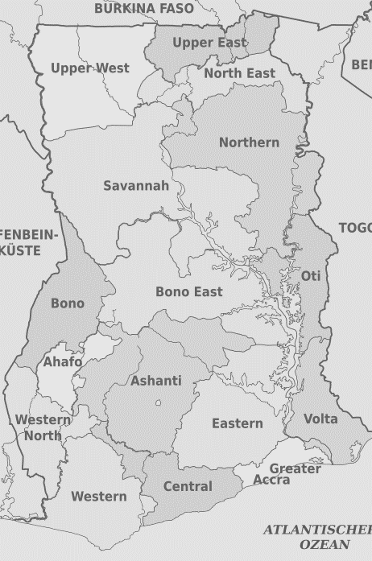
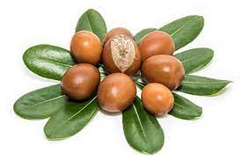
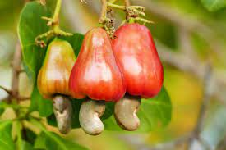
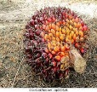
Geographical distribution of the targeted tree crops
An Analysis of the Sugar Value Chain in Ghana
5

Slide 6
2.0 The Mango Industry

Slide 7
The Mango Industry – General overview & structure
One of the best-paid tropical fruits grown for export and one of important crops in tropical and subtropical regions of the world (Krishnan, Nailwal, Shukla, & Pant, 2009).
Global production is estimated at over 15 million MT
Annual production in West Africa is estimated at over 1.5 million MT
(4% of global production)
7
Notes:
Developed to support the strategy

Slide 8
Sub regional production
Country | Production Volume (MT)
Nigeria | 875,000
Senegal | 131,000
Ghana | 99,358
Mali | 57,846
Cote d’Ivoire | 50,672
(Source : FAOSTAT 2017)
An Analysis of the Sugar Value Chain in Ghana
8

Slide 9
The Ghana Situation
It is a USD 200million industry with a potential to hit a USD 2billion in the next decade (Nimrod 2022)
Annual production is estimated at 100,000 tons (Arnoldus and Clausen 2019)
Ghana exports 1,500 tons of fresh mango annual in comparison to Cote d’Ivoire.
Ghana has professional orchards and farm sizes are relatively larger than Cote d’Ivoire
9
Notes:
Developed to support the strategy

Slide 10
Challenges
Low yields (averge 10t/ha) in comparison to Senegal and South Africa (15-22 tons/ha)
Low planting density (130 trees/ha against recommend 160)
Low farmer training and application of GAP
Pest and diseases (ie. BBS has reduced orchard production in recent years.)
Low market access and information
Price Volatility : Farm gate price for mango in Ghana is much higher compared to neighbouring countries - A challenge for processors.
10
Notes:
Developed to support the strategy

Slide 11
Challenges
Non adherence to quality standards
Poor postharvest handling and storage practices
Limited access to finance.
11
Notes:
Developed to support the strategy

Slide 12
3.0 Way Forward

Slide 13
TCDA was established by Act of the Parliament 2019 (ACT 1010) as a body corporate with perpetual succession to regulate and develop in a sustainable environment; production, processing, and trading of Tree Crops.
An Analysis of the Sugar Value Chain in Ghana
13

Slide 14
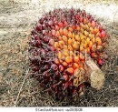
TCDA Vision, Mission, and Mandate
Vision | A highly developed, diversified, value-added, globally competitive and sustainable tree crop sector in Ghana
Mission | To facilitate the development and well-being, through research, capacity building and excellent services, of the selected tree crop industries with a view to achieving a long-term commercial productivity and sustainability, while providing a higher contribution to the national economy of Ghana.
Mandate | To regulate and create a conducive environment for the growth and development of tree and industrial crops in Ghana with consequential benefits to the economy of the country.
Mandated Crops
3

Slide 15
TCDA’s Strategic Focus Areas
SF 2: Production and Value Chain Support
SF 1: Research
SF 3: Capacity Building
SF 4: Licensing and Regulation
15

Slide 16
Creating a traceable tree crop supply chain and market system
Licensing and regulatory services
Research
Value Chain Actors
Capacity Building Organizations
16
Notes:
Currently Ghana has a lot of tree crop actors, but they are not all necessarily formalized, structured or part of a traceable system. Efforts to formalize and organize are value chain/ i.e. tree crop specific. What TCDA needs to do is to strengthen and structure the current system so that all 6 target tree crops are part of a structured, transparent, traceable system. But it needs to be optional – actors need to see the value add to “come in from the cold” if you will and join in these efforts. Actors need to see the social, economic and environmental benefits - the business benefits – of working together. Working together costs time and money and takes effort. But working together is the only way to really reap rewards and put Ghana on the tree crop map, both for domestic consumption and exports. So, we need to be more efficient and effective, reaching thousands of producers with inputs and services, to serve hundreds of processors and markets, and feed millions of people – and that is the key to the strategy.

Slide 17
Strategic Interventions
Challenges | Strategic Interventions
Low Productivity | Invest in demand driven research through co-investment with VCAs and Research Institutions to enhance farmers access to quality planting materials Research to improve ISFM, IPM, Postharvest.
Low access to finance | TCDA will work with GEPA, Eximbank, private equity investors, buyers, carbon credit providers and local banks to develop credit models to increase access to credit and insurance products for VACs
Low access to Market and Information | Strategic Investment to support a traceability system with accurate data on both input and output markets. Facilitate investors’ roundtable on market opportunities in the sector: set this as a platform to facilitate investment
Non-adherence to quality Standard | Strengthen the institutional capacity of the respective VCAs including their umbrella institution (ie. FAGE) to establish transparency and accountability system for internal control and monitoring.
17

Slide 18
Trade & Investment Support
1. Promoting and attracting new Investment in all the value chains.
2. Facilitate investors’ roundtable on market opportunities in the sector: set this as a platform to facilitate investment
Institutional Capacity Strengthening and Coordination
1. Study tours and Experiential learnings
2. Skills and Technology Transfer
3. Sector Coordination
Digitalization Platform
Phase I: Registration of VCAs, issuance of licence and permits for resource mobilization
Phase 2: GPS location of farms, Traceability, Market and Payment
Phase 3: Carbon Trading Tracking and
Our Delivery Approach.
Data and Analytics Support
Data/Analytics for evidence policy formulation and decision making
An Analysis of the Sugar Value Chain in Ghana
18

Slide 19
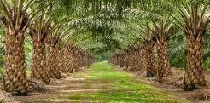
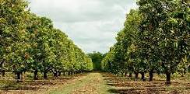
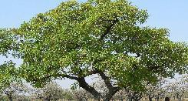
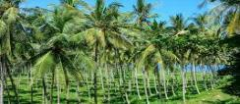
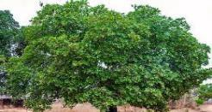
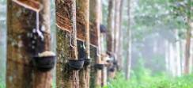
What does success look like?
By contributing to the tree crop
sub sector, TCDA will seek 3 key impact goals
Increased production and productivity
TCDA’s
contribution
as a regulator and facilitator, orchestrating a functional tree crop market system
Competitive and sustainable tree crop sector in Ghana
Increased household income and foreign exchange earnings
Enhanced resilience of value chain actors
19
6
8

Slide 20
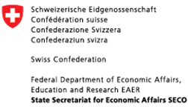
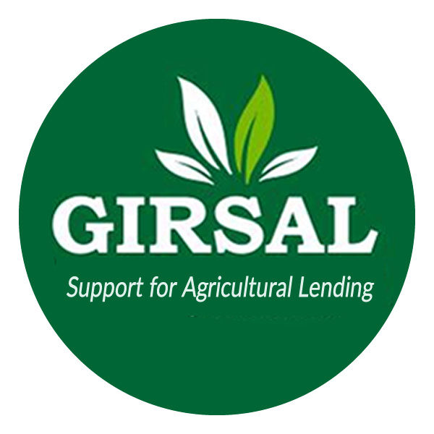
Potential Partners

Slide 21
Thank You

