Slide 1
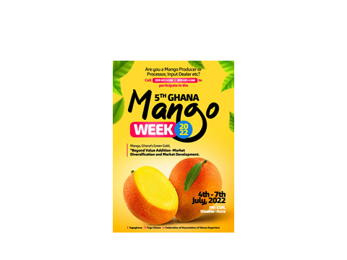
MARKET DIVERSIFICATION OF MANGO
GEORGE AGBOZO
SUNYANI GREENFIELD COOPERATIVE MANGO PRODUCERS ASSOCIATION.

Slide 2
WHAT IS MARKET?
A market is the sum total of all the buyers and sellers of a particular product in the area under consideration
It can also be said to be the group of individuals or organisations that make up the pool of actual and potential customers for their goods and services

Slide 3
THE WORLD MANGO MARKET
The global processed mango products market size was estimated at USD 16.55 billion in 2018 and is projected to register a growth rate of 6.4% during the forecast period.
Increase in consumption of mango and mango-based products coupled with rising preference for naturally sweet fruit-based ingredients is anticipated to drive the growth.

Slide 4
THE EUROPEAN MARKET
The consumption of mangoes in Europe is rising despite difficulties in sourcing
Mangoes are commonly imported from developing countries.
Finding a reliable supply is one of the major issues to maintain stability in the mango market.
Total European mango imports increased to nearly 400,000 tonnes in 2018, 38,000 tonnes more than the year before
Consumers are getting the taste for mangoes, mainly thanks to the fibreless mango varieties and improved ripening practices.
Still, the mango consumption is mostly supply driven and mainly influenced by external factors such as available volumes, quality, price, consumption in origin countries and the promotion of competing local fruits in Europe.

Slide 5
GHANA’S MANGO
Cultivated land | 81,000 ha (2018)
Production Volumes | 100,000 tons
Yield | 12-15 tons/ha
Sales Local Market | 70%
Exports | 30%
The 30% represents Dried | 19% (51%)
Fresh Cuts | 6,5% (37%)
Whole | 2% (12%)
Share of world market exports | 2,4%
World Market Ranking in Mango Export | 11th

Slide 6
COUNTRY | 2010 | 2011 | 2012 | 2013 | 2014 | 2015 | 2016 | 2017 | 2018 | 2019 | 2020
United Kingdom (UK) |  |  | 60 | 141 | 1766 | 1889 | 135 | 4669 | 4301 | 4302
Netherlands |  |  | 122 | 96 | 224 | 144 | 169 | 1895 | 1754 | 1640
Switzerland |  |  |  | 0 | 392 | 516 | 40 | 592 | 760 | 1104
France |  |  |  | 4 |  | 176 |  | 822 | 890 | 938
Italy | 8 |  | 41 | 60 | 180 | 174 |  | 554 | 523 | 463
Germany |  |  | 1 | 22 | 155 | 155 | 20 | 328 | 490 | 327
United Arab Emirates (UAE) |  |  | 62 | 2 | 26 | 4 |  | 30 | 63 | 145
Belgium |  |  | 55 | 35 | 52 | 116 | 31 | 165 | 159 | 114
Israel |  |  |  |  |  |  |  | 39 | 109 | 103
Kuwait |  |  | 12 | 51 | 47 | 46 |  | 32 | 60 | 46

Slide 7
BUT THERE ARE CHALLENGES
Some major factor obstructingmarket growth:
Seasonal cultivation of mangoes.
Diseases (BBS)
Pest (Fruit flies)
High cost of production (inputs & labour)
Fuel prices and freight charges
Low quality of fruits
Limited variety etc
Competition in the export market (lower prices)
Low processing capacity
Limited range of processed export products

Slide 8
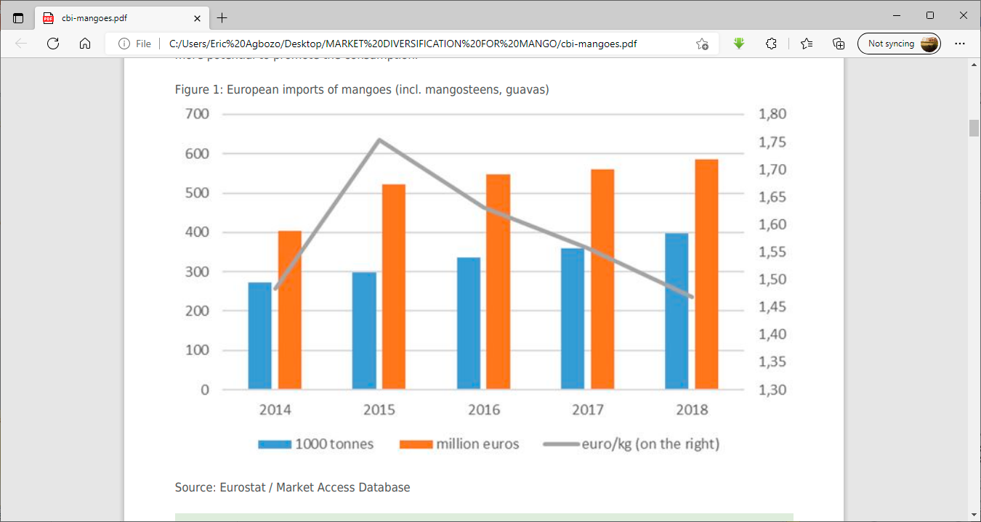

Slide 9
NEED FOR DIVERSIFICATION
The challenges above justifies the need for the industry to start considering the issue of market diversification as a means of:
sustaining the industry and its exports as well as
increasing the revenues of all the value chain players.

Slide 10
WHAT IS MARKET DIVERSIFICATION?
Market diversification is a strategy in which an organization seeks growth (or reducing risk) by adding products and markets of a kind unrelated (or related) to its existing products and markets.
Among successful market farms, there is a trend toward diversification and away from specialization. As growers gain Diversification-strategies-for-market-farms experience, they tend to add:
new crops and
New markets and
extend their seasons.
They find ways to maximize income from everything they grow and put all their land to good use.

Slide 11
VARIOUS FORMS OF DIVERSIFICATION
1. Diversity in Crop Choice
Deciding on which crop to grow
2. Diversity in Variety Selection
differences in how varieties respond to heat, cold, insect and disease pressure, and other environmental factors.
3. Diversity Across Time
Succession cropping is an important component of diversification. You can have several successions of a crop by planting several varieties with different days to maturity.
4. Geographic Diversity
You may be able to split production between two separate pieces of land
5. Marketing Diversity
you could open up new possibilities for scheduling and crop selection by selling into different markets.
6. Enterprise Diversity
have ancillary enterprises to help the bottom line and, often, to provide employment year-round for valuable workers

Slide 12
DIVERSIFICATION IN MANGO FARMER
New crop variety (time & variety)
Different/new location (move to northern Ghana)
New enterprise/linkages
Go into processing
Establish cold rooms to hold mango

Slide 13
DIVERSIFICATION FOR MANGO PROCESSERS
Apart from expanding current capacity (production, holding facility) in the 3 traditional products
Processers can add to the 3 traditional products by moving into new product areas
Strategically partner with farmers for processing
Promote the consumption of mango and its processed products
Try new export markets
Venture into mango butter (as a byproduct)

Slide 14
Mango float
Dried packaged fruit
Mango puree
Mango concentrate
Mango juice
Mango nectar
Mango flavoured ice cream
Mango preserves and jams
Mango pickle
Mango seeds

Slide 15
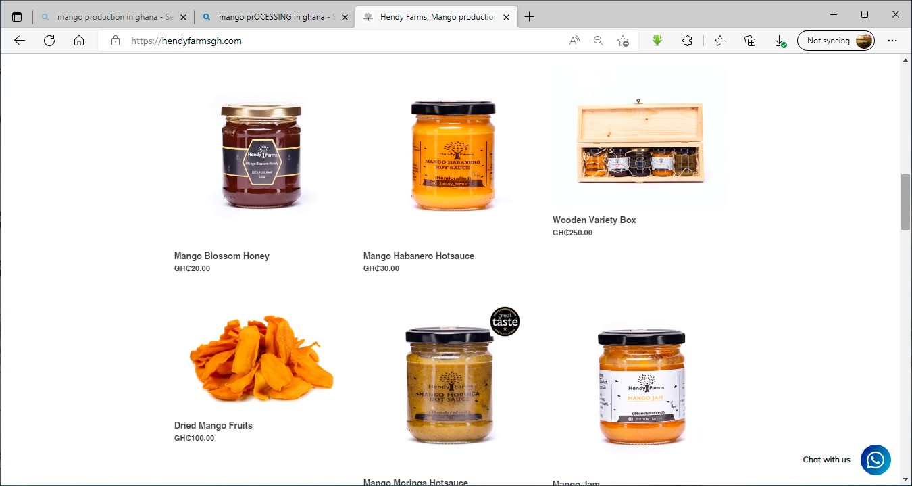
HENDY FARMS

Slide 16
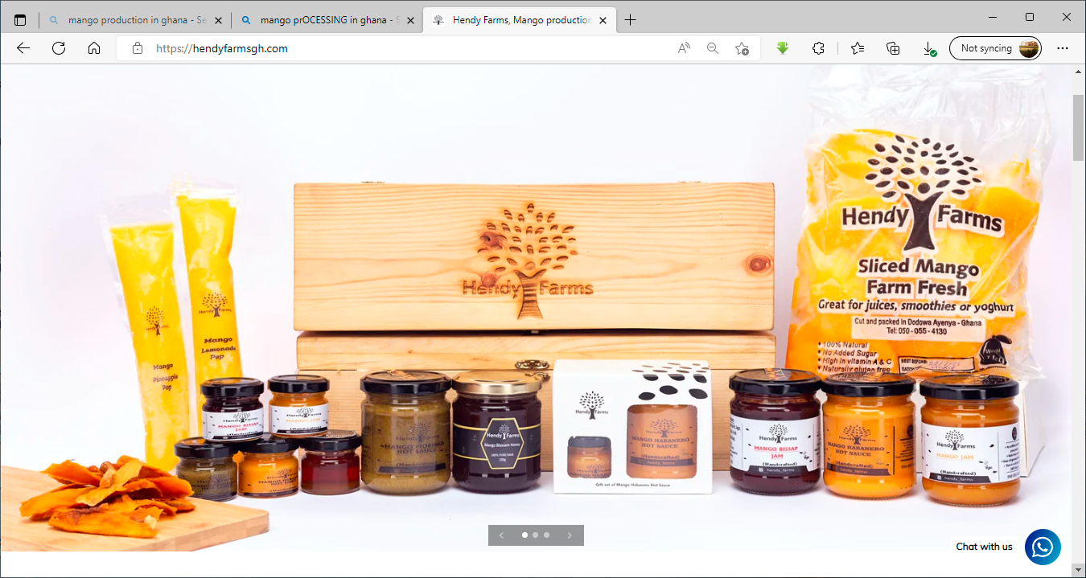
HENDY FARMS

Slide 17
MANGO BUTTER
Mango butter is a sweet smelling soft butter extracted from kernels of the mango.
Mango butter is similar to shea and cocoa butters in consistency but differs in fatty acid content.
Mango butter is rich antioxidants, vitamin A and E.
The natural form of mango butter is semi-solid and non-greasy, and it is used as a moisturizer for hair and skin as well as an ingredient in cooking.

Slide 18
Mango butter markets | UK, USA
Global market capacity | 5060 tons
Growth rate | 4,33% (2015)
Global sales | 4220 tons (2015)
Sales | USD 28m (2019)
Projected sales in 2024 | Usd 34m (2024)
Sales growth rate | 4,66%
Uses Cosmetic Industry | 45,98%
Food Industry | 16,98%
Pharmaceutical Industry | 27,33%
Growth rate over the next 5 yrs | 3,5%

Slide 19
THANK YOU FOR YOUR ATTENTION

Slide 20
Handbook of Mango Fruit: Production, Postharvest Science, Processing Technology and Nutrition
Editor(s):Muhammad Siddiq, Jeffrey K. Brecht, Jiwan S. Sidhu
First published:2 June 2017
Print ISBN:9781119014355 |Online ISBN:9781119014362 |DOI:10.1002/9781119014362
© 2017 John Wiley & Sons Ltd

