Slide 1
PGS – more than certification

Slide 2
Definition
Organic Agriculture is a production system that sustains the health of soils, ecosystems and
people.
It relies on ecological processes, biodiversity and cycles adapted to local conditions, rather than the use of inputs with adverse effects.
Organic Agriculture combines tradition, innovation and science to benefit the shared environment and promote fair relationships and a good quality of life for all involved."

Slide 3
The Principles of Organic Agriculture
Health - Organic Agriculture should sustain and enhance the health of soil, plant, animal, human and planet as one and indivisible.
Ecology - Organic Agriculture should be based on living ecological systems and cycles, work with them, emulate them and help sustain them.
Fairness - Organic Agriculture should build on relationships that ensure fairness with regard to the common environment and life opportunities.
Care - Organic Agriculture should be managed in a precautionary and responsible manner to protect the health and well being of current and future generations and the environment.

Slide 4
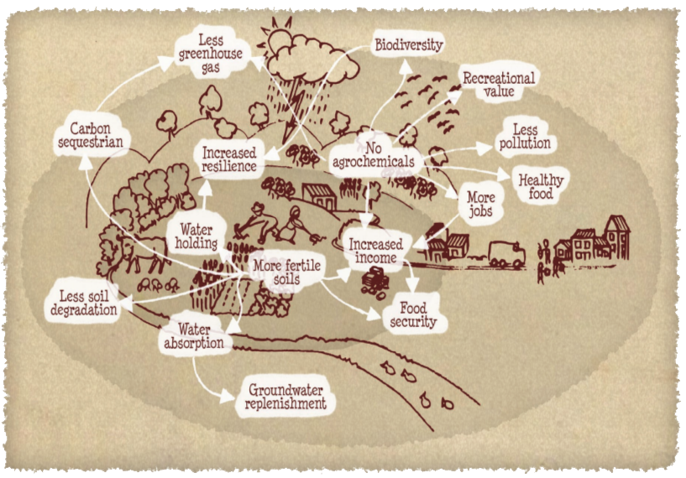
The benefits of Organic Agriculture
(Organic World Foundation)
Notes:
When looking closer at an organic agricultural system, we see a very complex and sophisticated system. With short and long term benefits for the environment, animals and humans.
Looking a bit closer at the different parts we …

Slide 5
Definition
“Participatory Guarantee Systems (PGS) are locally focused quality assurance systems.
They certify producers based on active participation of stakeholders and are built on a foundation of trust, social networks and knowledge exchange.”
PGS is an alternative to third party certification.
A tool for the development of local organic markets.

Slide 6
Why PGS?
Match production and demand of organic products and develop the local organic market.
Provide a credible guarantee for organic products to local consumers.
Respond to a need for ethics by involving stakeholders in the organic certification system
Reduce the cost of certification for organic producion.

Slide 7
PGS versus 3rd party
Third party certification | PGS
Professional | Voluntary to professional
Independent from stakeholders | Participatory (stakeholder involvement)
In accordance with international norms | Following general PGS international principles but locally adapted
Gives access to international markets (with right channels) | Access mostly to local, regional or unregulated markets
Most common guarantee system in government organic regulations | Not recognized in many government organic regulations
Deals only with certification | Combines with other functions, e.g. capacity building, marketing, etc.

Slide 8
PGS elements
Shared vision
Trust
Horizontality
Transparency
Participation
Learning process

Slide 9
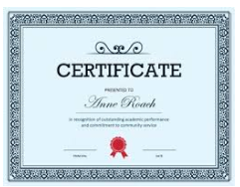
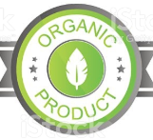
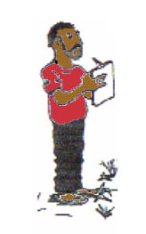
A producer follows an organic standard
A certificate proofs that the farmer passed the verification process
A verification system confirms that the producer complies with the organic standard
A label allows consumers to identify the organic products in the market

Slide 10
Go to pgs-ghana.bio, click on Apply
Fill-in the form.
Make payment and Submit the form.
Join the regional group and say your pledges
Host and complete site-visit.
Get your PGS certification!

