Slide 1
CONTROL OF MANGO BACTERIAL BLACK SPOT DISEASE IN GHANA: CURRENT OPTIONS AND FUTURE PROSPECTS
PRESENTER: JOSEPH O. HONGER
18TH MANGO ROUNDTABLE VIRTUAL MEETING: NOVEMBER, 2020

Slide 2
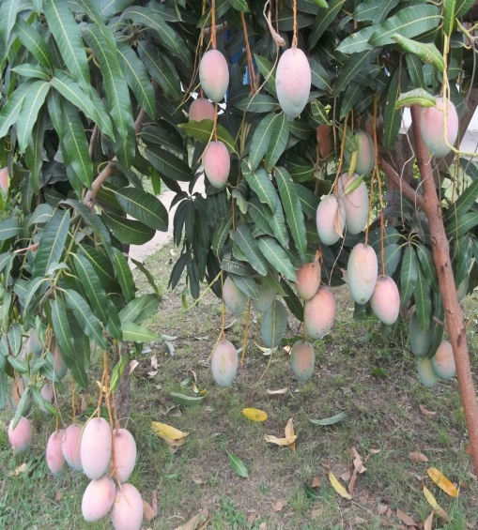
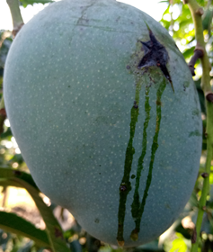
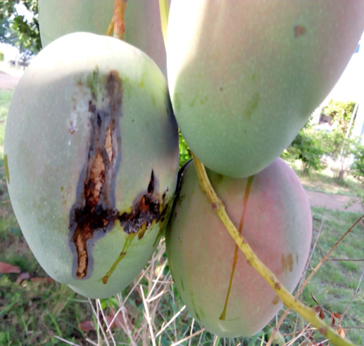
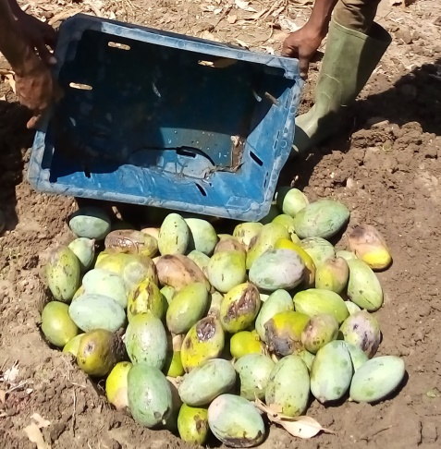
INTRODUCTION
Mango (Mangifera indica) production in Ghana is currently under threat by the bacterial black spot disease.
The disease caused by a bacterium, Xanthomonas citri pv mangiferaeindicae, causes premature fruit drop and blemishes on mature fruits. In highly infectsed fields, 80% of the mature fruits could be lost.
The disease has been reported in all the major mango growing areas of the country.
Since 2011, farmers have tried a wide range of chemicals ranging from copper based to organic reagents against the disease, with no success

Slide 3
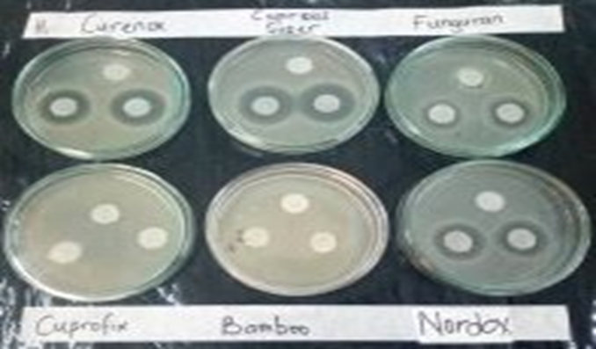
INTRODUCTION
Since 2019, MOAP has sponsored several trials to evaluate some selected copper based fungicides for their ability to control the disease
Another biological stimulant, Bion (acibenzolar-S-methyl) was also combined with some of the fungicides to determine its effect.
The trials were carried out in the Manya Krobo area, Wa and Sawla.
Selected copper based fungicides were applied at 2 weeks intervals beginning at fruit set and ending at maturity. Keitt was the predominant variety used in the trial.
Results from these field trials serve the
basis for the current recommendations
for the control of the disease

Slide 4
Results from trials in the Lower Manya Krobo District.

Slide 5
Results from trials in Wa and Sawla
The results showed that
Curenox+Bion, Curenox only
and Nordox only gave better
results in all the three farms
used for the trial.
This corroborates the findings
in the Lower Manya Krobo
district both in the minor
season of 2019 and the
major season of 2020.

Slide 6
OTHER OBSERVATIONS
Early maturing varieties such as Haden, Kent and Tommy Atkins fruits are least destroyed, when fruits survive abscission at the early stage, compared to Keitt.
Trees that are prunned of excess foliage of the previous season, shows reduced damages of fruits. In other cases, all fruits on such trees may escape the disease.
Other mango cultivars that can escape the disease all year round may exist. For example, Brooks may be one such variety.
Absence of disease in a particular period of the production season may not signal the eradication of the disease form the farm.
Not all fruits abscising at the early stage of maturity are doing so because they were infected with the bacterium.
Of the several copper based fungicides, majority are not effective against the disease. Almost all the systemic non-copper based fungicides are not effective against the bacterium, but can be useful in the control of competing fungal species such as Colletotrichum gloeosporioides and Lasiodiplodia theobromae. These can predispose the fruits to the bacterial infection

Slide 7
CURRENT OPTION FOR THE CONTROL OF BBS
Proper pruning of mango trees and removal of prunned materials
Bi-weekly application of either Curenox or Nordox only or in combination with Bion.
Prompt harvesting of fruits not more than 2 weeks after last application of copper based fungicide.

Slide 8
FUTURE PROSPECTS
Investigation into and inclusion of early maturing varieties of mango, with marketable qualities, into the Ghanaian mango production system.
Area wide approach and or harmonisation of control practices among farmers in a geographical area.

Slide 9
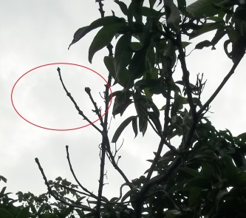
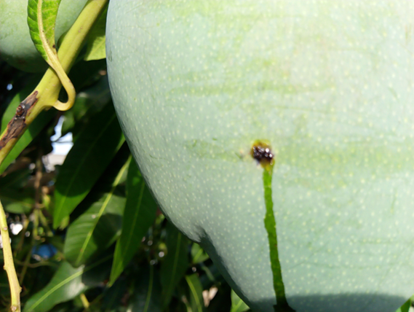
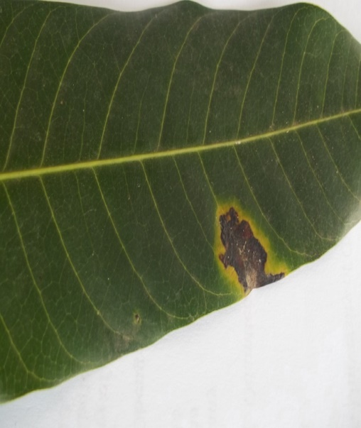
END OF PRESENTATION
Thanks for listening

Slide 10
ACKNOWLEDGEMENT
MOAP-ACCRA
Pannhausen, C., Karl, H., Anku-Gbetanu and Awu, J.E.
MOAP-WA
Andrew and Soale L.

