Slide 1
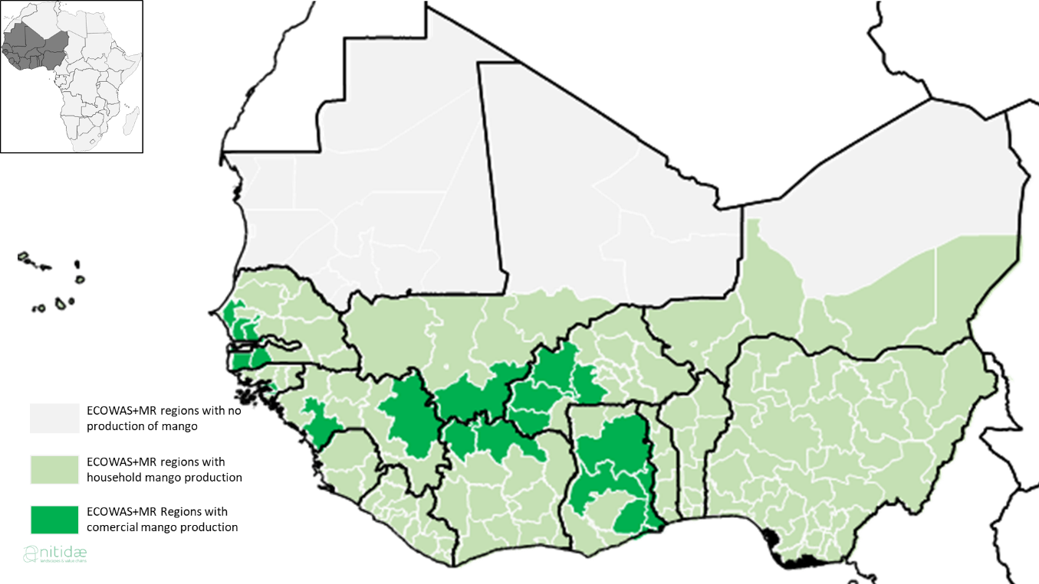
MANGO GROWING AREAS IN WEST AFRICA

Slide 2
STATUS OF THE MANGO INDUSTRY IN WEST AFRICA
BY
VICTOR AVAH

Slide 3
MANGO GROWING COUNTRIES
GHANA
BURKINA FASO
COTE D’VOIRE
MALI
SENEGAL

Slide 4
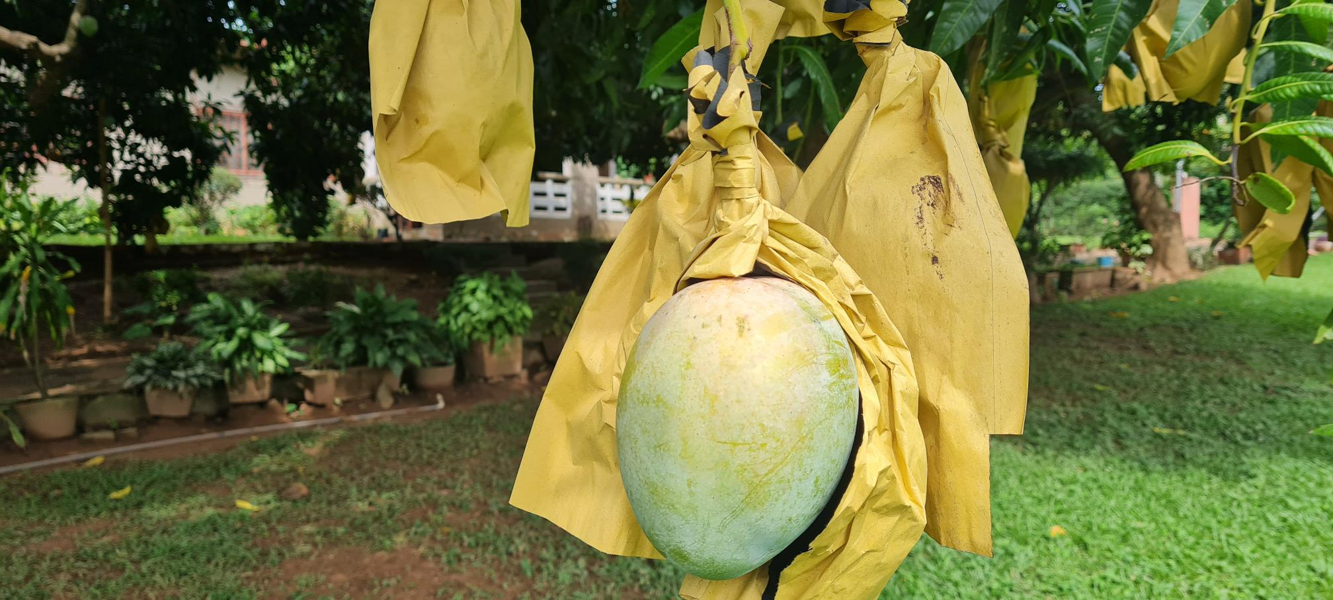
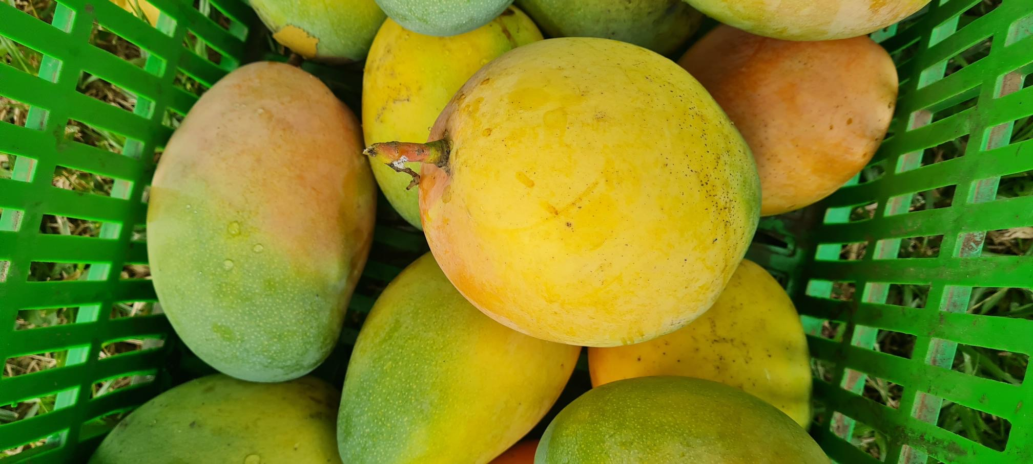
Almost all of the commercial production is concentrated between the 750 mm and 1500 mm isohyet lines, which correspond to semi-arid Sahelo–Sudanese climate. With less rain, mango trees can hardly survive and, when they do, they produce very little fruits.
With more than 1,500 mm, commercial production is possible, but varieties adapted to humid weather are needed, which are not very popular in the international market.

Slide 5
In 2019 the Food and Agriculture Organization (FAO) estimated world mango production to be 60 million tons .
ECOWAS production is estimated to be 2.38 million tons, accounting for approximately 4% of global production
While ECOWAS production represents less than 4% of global production, its market share in the international trade of mango is much bigger, with approximately 5% of the exports of fresh and dry mango.

Slide 6
The main subsector of the mango value chain in terms of value is the export of fresh mango. Export of fresh mango out of West Africa experiences continuous growth due to a dynamic international demand
Côte d’Ivoire is the leader in the fresh exports of mango in ECOWAS, with approximately 39,000 tons exported, representing more than 70% of its marketed production.
Indeed, Côte d’Ivoire seems specialized in fresh exports compared to other ECOWAS countries, where this use represents only 40% (Senegal and Mali), or lower than 10% (Burkina Faso and Ghana).

Slide 7
The domestic market can be considered as a complementary/secondary market, but not as a major opportunity due to the generalized overproduction, which leads to a market saturation every year, especially during harvesting period.
However, regional markets can be interesting outlets for off-standard mangoes.
Indeed, mango-processing countries such as Ghana or Burkina Faso import a minor, but significant part of Côte d’Ivoire’s exported mangoes (15%), and it can go as high as 50% for Mali.

Slide 8
Ghana and Burkina Faso import fresh mango from the other ECOWAS countries to process and export them as dried mango in their specific markets: the United Kingdom and the Netherlands for Ghana, and Germany and France for Burkina Faso.
Accra and Bobo Dioulasso have become clusters for processed dried mangoes thanks to their rapidly improving infrastructure and network of processing facilities.
The main challenges for dried mango companies are linked to the high competition for raw material, high turnover of qualified employees, lack of market for lower-quality products and maintenance of machinery:

Slide 9
The shortening of the mango harvesting season in each country due to the fruit fly, and low management of the orchards are creating a supply stress for processing facilities.
That is why one key to success is to strengthen supply strategy by developing strong partnerships with producer cooperatives, as well as prospecting towards neighbouring countries with different harvesting periods.
With the emergence of the dried mango subsector, a lot of opportunities are appearing for qualified middle management or technicians.
This is a threat to companies, which can experience high turnover. Securing human resources with incentives and good working conditions can be the only way to mitigate this risk.

Slide 10
Mango in Côte d’Ivoire
Côte d’Ivoire is the largest mango exporter in West Africa. The country has built a strong tropical fruit sector, with exportation of three main fruits: banana, pineapple and mango.
In 2020, Abidjan was the only port in West Africa with a dock dedicated to fruit exportation, with two berths of 350 metres, cold stores, and stocks of reefers through which 250,000 tons of fresh fruits are exported every year.
Mango cultivation is spread all over the country, but commercial production is concentrated in the northern regions.

Slide 11
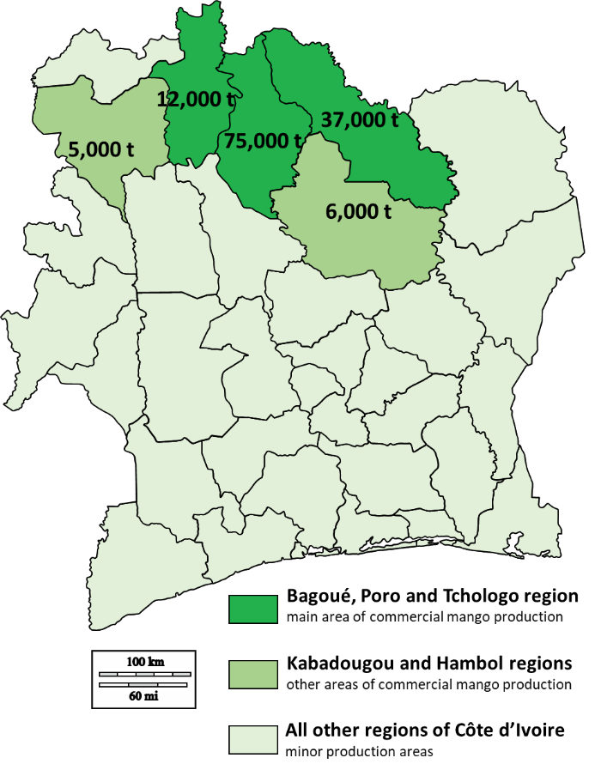
MAP OF MANGO GROWING AREAS IN COTE D’IVOIRE

Slide 12
The mango season is from March to July. The production period is the same in all production areas for the same variety, with the exception of Denguélé, where production is a few weeks later than in other production areas.
The main variety grown in both the medium and big plantations is Kent.Keitt and Amélie varieties are also present in most plantations, and the Brooks variety is cultivated mainly by farmers selling in the local market.

Slide 13
Most mango production is small scale. These producers are organized in 16 mango cooperatives active in the production areas. These cooperatives regroup approximately 3,050 producers.
The last census listed 305 individual producers. Large-scale commercial farms are few: there are currently four producer exporters (Ranch du Koba, Vidalkaha, Verger du Bandama , and Centre de sèchage de Farako ), with acreages of 50–350 ha (average of 300 ha).

Slide 14
Mango in Senegal:
Mango production in Senegal is estimated to be 125,000–130,000 tons.
The main production areas are Casamance and Niayes (respectively 40% and 30% of annual production).
Mango is also cultivated in other regions such as Sine-Saloum (10%), central zone (15%) and Saint-Louis (5%).
It is estimated that the mango sector generates a direct income to 25,000 people in Senegal. Smallholders own 70% of mango areas, and these small-scale orchards average 1–10 ha. Farmers’ investment and management of these plots are minimal.

Slide 15
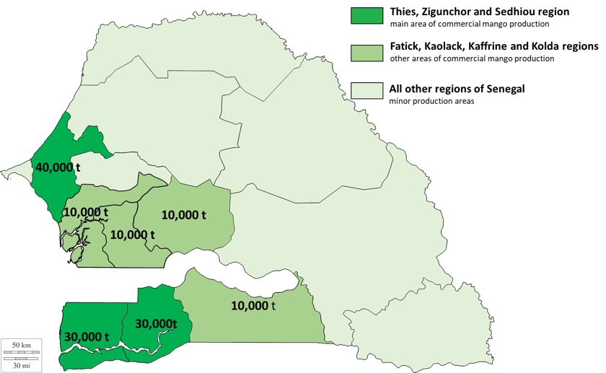
MANGO GROWING AREAS IN SENEGAL

Slide 16
The main production season runs from May to August, with a peak in June and July. Senegal is a semi-arid tropical zone and there is a net alternation between dry and rain season.
Kent and Keitt are the varieties most cultivated and sought after, but Tommy Atkins, Zill and Valencia varieties are also cultivated in smaller proportion.
Forty companies are active in fresh mango exports, of which 10 are producing–exporting companies and 30 are just exporters.

Slide 17
The processing sector is less developed.
Dakar is the main national market for fresh mango and mango products. There is great local demand for fresh mango and traders cannot meet it, especially in the north of the country.
Wholesalers focus their supply on the main cities, and remote areas are supplied by retailers and local traders.
Fruit fly remains one of the main challenges for the sector, as it decreases the exportable season and mango quality.
Along with good practices to decrease fruit fly pressure (pruning, weeding and lesser density of mango plots), local stakeholders are investing in locally available technology to control pests, such as hot water treatment (MAF RODA ) and the biopesticide Spinosad.

Slide 18
Mango in Mali:
Mango is the largest fruit crop in Mali, with approximately 100,000 hectares cultivated by more than 5,000 commercial mango farmers.
According to the IFM, only 5%–15% of the production, estimated to be 350,000 tons, is commercialized.
This low number is partly due to post-harvest losses (more than 35%), but also to the lack of outlet leading to unharvested mangoes lying under the trees

Slide 19
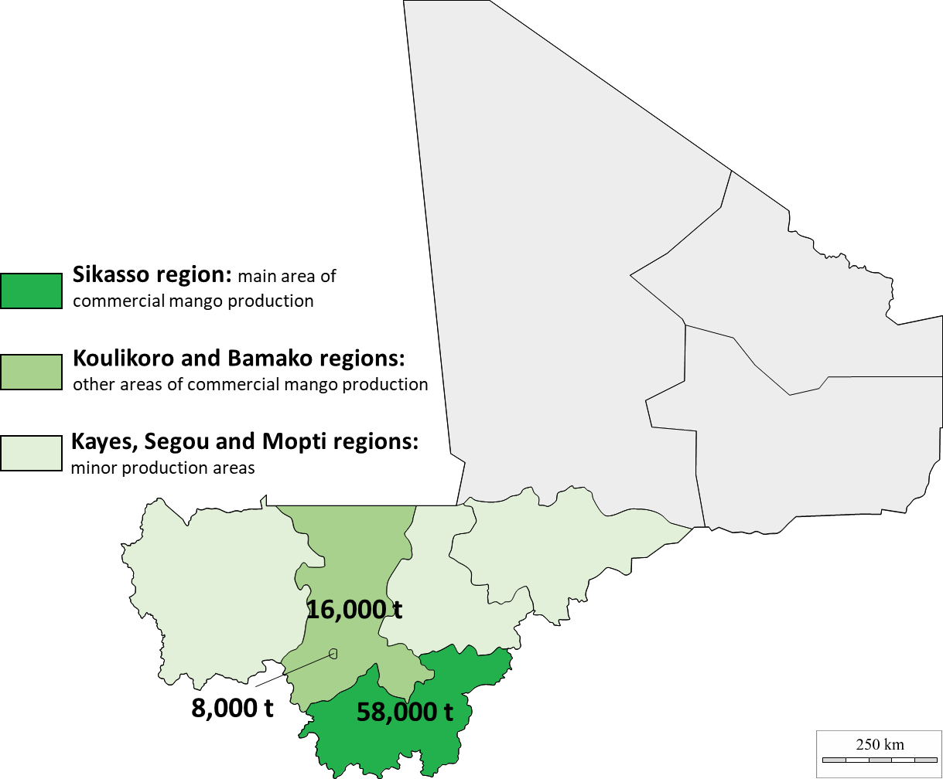
MANGO GROWING AREAS IN MALI

Slide 20
Producers are mostly smallholder farmers with diversified crops, for whom mango represents an essential source of income, as it comes during the dry off season.
Production is generally ensured by traditional orchards of 2–3 ha with an average planting density of 200 trees per ha. These plantations are mostly rain fed.
Only a handful of commercial and professional orchards exist, of 20–100 ha, with a high planting density of 400 trees per hectare and drip irrigation in some cases.

Slide 21
Sikasso is Mali’s mango production stronghold, bordered by Burkina Faso and Côte d'Ivoire. In 2019, Sikasso generated 69% of the national production (58,000 tons), followed by Koulikoro at 19% (16,500 tons) and Bamako (surroundings of the capital) at 9% (8,300 tons).
Mali’s mango production season is parallel or follows just after Côte d’Ivoire, between March and July, in all the producing regions
Amélie is the earliest variety and starts production in March/April, followed by Kent in April/May and KeithKeitt in May/June.
There is also a small production window of local varieties from February to May, and even in December for some of them, although most local varieties do not meet export quality standards.

Slide 22
Mango in Burkina Faso
According to APROMAB , the mango sector generates a turnover of more than 15 billion FCFA per year. Mango remains the top fruit in Burkina Faso and constitutes 56% of national fruit production. In 2017, mango was the 7th export product from Burkina Faso.
An estimated 33,700 ha, spread over eight provinces, are cultivated with mango trees, of which 1,255 ha are industrial orchards. Annual mango production is 150,000–250,000 tons/year in the last five years, and relies mostly on small-scale producers (15,000–20,000 farmers).

Slide 23
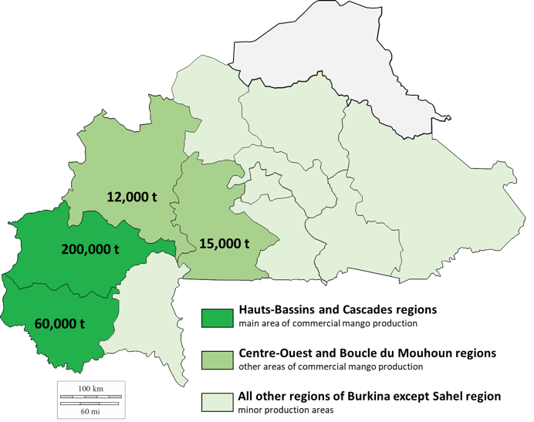
MANGO GROWING AREAS IN BURKINA FASO

Slide 24
In addition, the mango value chain includes 14 international exporters, 76 drying units, an industrial processing unit (DAFANI ) and five pack houses. The value chain generates approximately 2,000 jobs outside producers.
Mango is mainly produced in the western regions of Burkina Faso: Boucle du Mouhoun (12,000 tons), Cascades (60,000 tons), Centre-Ouest (15,000 tons) and Hauts-Bassins (200,000 tons). The provinces of Kénédougou and Houet in Hauts-Bassins, followed by the Comoé in Cascades, are the main producing provinces.

Slide 25
Mango varieties produced and exported from Burkina Faso include Kent, Amélie, Brooks, Keitt, Valencia, Lippens and Springfels.
In Hauts-Bassins and Cascades, the leading producing regions, the Lippens variety is the most widely cultivated (more than 35% of the acreage), as it is very appreciated by local consumers and is suitable for drying
Mango harvesting in Burkina Faso is late February to early August. Amélie is an early, relatively small variety with a green/green-yellow skin. The harvest period for the Amélie variety is from the end of February to April, when Kent exports start. Kent is a larger variety, partially red when ripe, with a long shelf life.

Slide 26
Burkina Faso is the leader in West Africa’s dried mango sector, and generated 11.6 billion FCFA in 2020 (2,900 tons exported in 2020).
However, the mango puree/juice industry has the greatest growth in the Burkinabè mango sector in recent years. It generated 4.32 billion FCFA in 2020, just behind fresh mango export (4.8 billion FCFA).
Juice/pulp processing is led by a few industrial units (DAFANI.SA, DELICIO , and Twillium Industries) and local artisanal units (Eva, Agrodéogracias , and Dioma ).

Slide 27
The main export destinations for fresh mango (mostly Amélie and Kent) are Western Europe (France, the Netherlands, Germany, Belgium and England) and West Africa (Niger and Ghana).
Export of fresh mango is mid-February (with early variety Amélie) to June (with late variety Keitt).
.

Slide 28
Dried mango exports are April to December thanks to the construction of dried mango reconditioning centres and cold rooms.
While Burkina Faso is a net exporter of dried mango, it should be noted that it imports 150 tons to 200 tons of dried mango from Mali and Côte d'Ivoire to be reconditioned and re-exported, making this country and the city of Bobo Dioulasso the main mango cluster in the region

Slide 29
Mango in Ghana:
Mango is one of the key products of Ghana’s fruit sector, alongside pineapple, citrus and banana. The mango value chain is estimated at $28 million, representing 7% of the total revenue generated from the horticulture industry.
Mangoes are produced in three main areas: the southern belt (Eastern, Greater Accra and Volta Regions, where the export-oriented mango cultivation first started), the middle belt (Bono East, Bono and Ashanti Regions) and the northern belt (Northern, Upper East and Upper West Regions, where commercial orchards have taken root since the early 2,000 ).

Slide 30
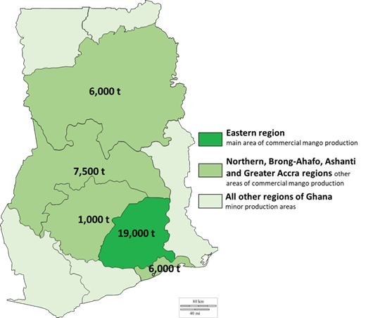
MAP OF MANGO GROWING AREAS IN GHANA

Slide 31
Approximately 81,000 ha are under mango cultivation in Ghana. Though large orchards are established, small-scale familial producers are still the main mango producers in Ghana.
There are approximately 2,000–3,000 mango producers, and medium-scale farms (12–40 ha) and commercial farms (more than 40 ha) dominate the production.
The average yield is 12–15 tons/ha. Farmers introduced to good practices and favourable climatic conditions are able to produce 5–6 tons per acre

Slide 32
Mango producers in the southern belt have two harvesting seasons, and there is only one harvesting season in the middle and transition belts.( Tis is changing)
The short harvest season is November to February and the main harvest season is April to August. Two dominant mango varieties are cultivated in Ghana – Keitt (approximatively 80% of mango production) and Kent (10%)
Approximately 70% of annual mango production goes to local markets and supermarkets in regional capitals, consumed fresh or sold to local processors, which is the most important local outlet.

Slide 33
On the total annual exports, dried mango accounts for the largest share (51%), followed by fresh cuts (37%) and whole fruits (12%).
The main destinations for exported mango (dried, cut and whole) are the United Kingdom and the European Union (Germany, the Republic of Italy, and France). Switzerland and the Lebanese Republic are also important destinations.

Slide 34
The Ghanaian mango sector’s key competitive advantages are:
i) geographical proximity to the European and Middle East markets;
ii) the two harvesting seasons in the southern belt that gives the opportunity to supply EU markets when international offer is weak;
iii) the harvest season starts two weeks earlier than in neighbouring countries, giving an edge on the international market; and
iv) Ghana has efficient infrastructures for mango exports.

Slide 35
The mango sector’s biggest challenges are:
i) lack of financial resources, which hinders the mango processing/export sector’s capacity to invest in production activities, renew international certification and meet export quality standard; and
ii) pests and diseases (fruit fly and black bacterial spot disease), as it is costly to keep them under control.

Slide 36
THANK YOU FOR YOUR ATTENTION

