Slide 1
INCIDENCE OF MANGO BACTERIAL BLACK SPOT DISEASE IN GHANA AND MATTERS ARISING
JOSEPH O. HONGER (PhD)
UNIVERSITY OF GHANA
MANGO WEEK CELEBRATION, 2022

Slide 2
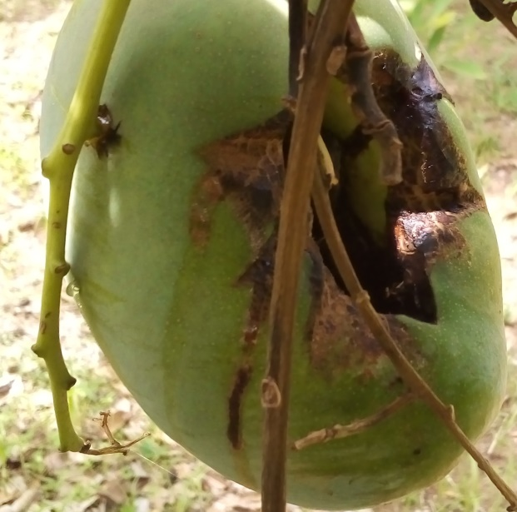
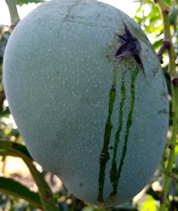
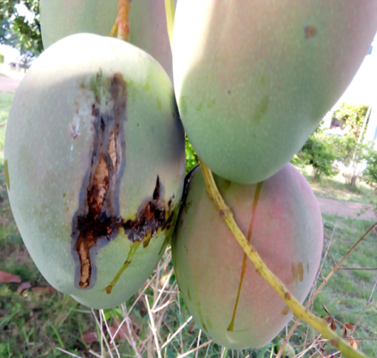
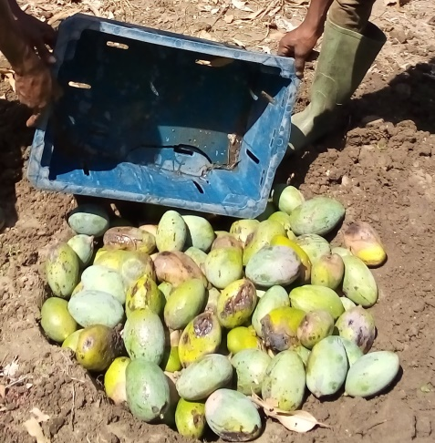
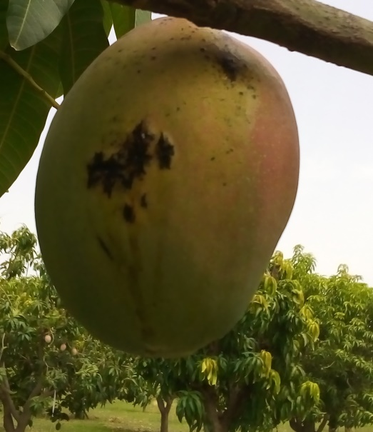
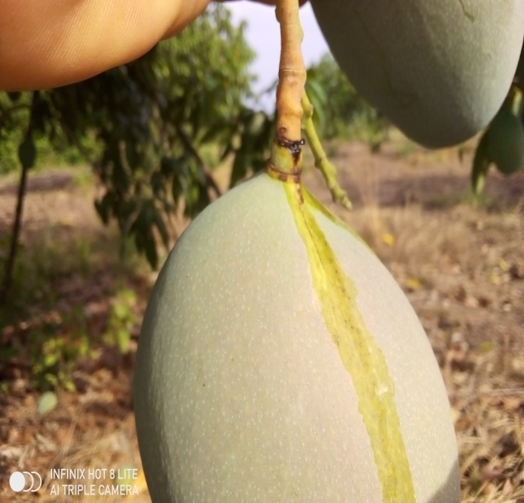
BBS- THE MOST DAMAGING DISEASE OF MANGO FRUITS IN GHANA

Slide 3
THE PREVALENCE OF BBS IN GHANA
BBS was reported first in a mango plot in Tamale in 2010 and 2011, It was described as occurring with high prevalence and that the environment in the country was conducive for the disease (One of the driest places in Ghana).
The destructive nature of the disease may have hit farmers the hardest by 2017 in the Brong Ahafo Region. Loss estimates ranged from 90 to 100%
By 2018 farmers in the Coastal savannah zone were also hit with the same destruction including the Eastern, Volta and Greater Accra Regions
It was believed that lack of knowledge about the cause and epidemiology of the disease contributed to its high prevalence rate in Ghana

Slide 4
THE PREVALENCE OF BBS IN GHANA
Within the same period, the impact of the disease is also being felt in Wa and Sawla
Survey in the Kpong and Somanya areas of the coastal savannah this major season gave an impression that the disease was reducing in severity. However, with the advent of continuous rainfall, most of the fruits that escaped the disease were infected.
Reports from Brong Ahafo, Wa and Sawla indicate the disease is still a threat as it was in the initial stages
Interview with some farmers shows that many are getting the information on what to do to combat the disease
-there are some positive signs that the disease will soon be brought under
control

Slide 5
WHY IS THE DISEASE PROLIFERATING IN GHANA
Poor knowledge of the disease symptoms and epidemiology both in the past and presently
In the past, early detection and institution of quarantine measures were ignored. These could have prevented the rapid spread of the disease
Currently, misinformation about the causes/epidemiology of the disease means important measures such as
- proper tree pruning
- rapid weed control
- Insect control
-Are not being done properly
Currently, in their desperation, farmers are buying and using all sorts of active ingredients, which are less effective against the bacteria but allow the bacteria to proliferate due to the water being used to mix and apply those active ingredients

Slide 6
WHY IS BBS PROLIFERATING IN GHANA Poor knowledge of the disease symptoms and epidemiology both in the past and presently
Once the disease enters the farm, it cannot be eradicated.
The disease may not be noticed at the early stages of fruit development but may appear suddenly to destroy fruits nearing maturity.
The disease may not occur in a farm with a previous history, in a particular season, even without any chemical applications, but may ravage the same farm, the following season.
If nearby farms have the disease, there is a high probability that its also in your farm.
-if farmers are not aware of these facts they are almost always taken
by surprise by the disease

Slide 7
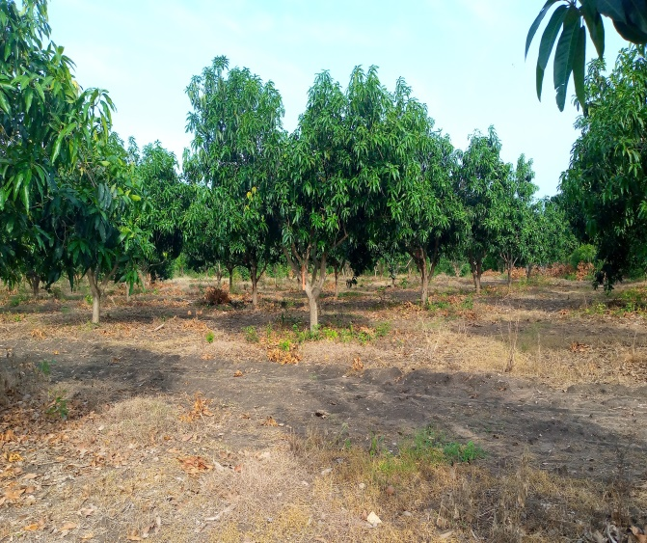
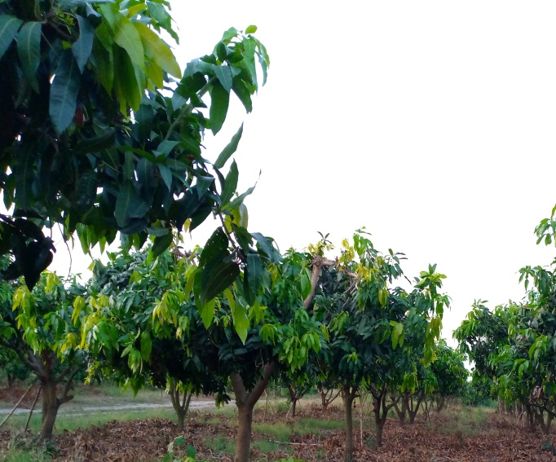
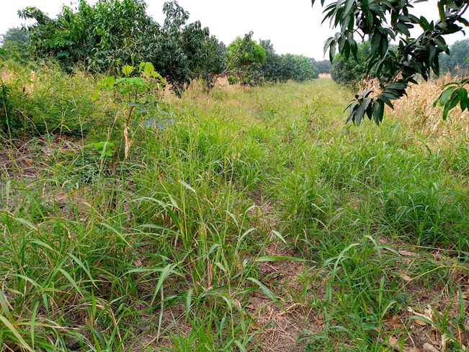
WHY BBS IS PROLIFERATING IN GHANA
Poor cultural practices
-Keeping weeds down throughout the season is key (Herbicide restrictions?).
-Pruning trees to reduce density of foliage is essential
-Combining these with proper insect control can reduce fruit destruction by 50%

Slide 8
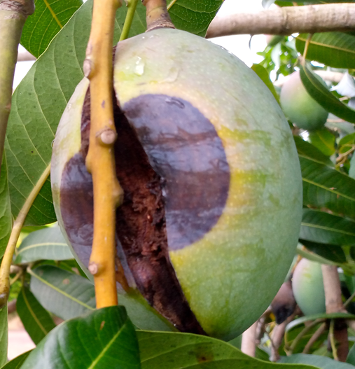
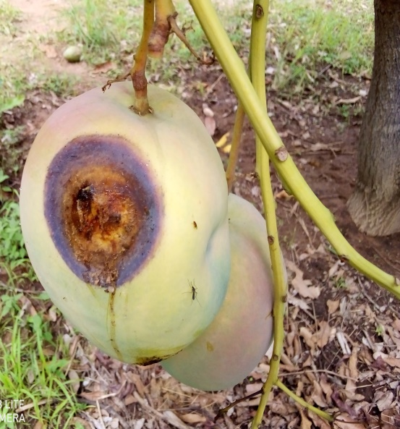
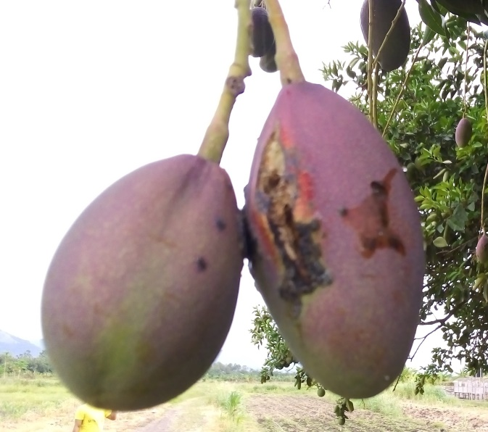
-While there is always the bacterium on the fruits, it can only cause the disease
if enters the fruits through natural wounds (lenticels) or mechanical wounds.
-Poor control of insects
-Poor pruning of fruit stalk and fruits
-Absence of wind breaks to reduce the abrasive actions of the wind

Slide 9
WHY IS BBS PROLIFERATING IN GHANA
The weather
-High Temperatures
-High Humidity
-Rainfall during the fruiting season
The cultivars
-Keitt the predominant cultivar is highly susceptible
-Kent, Haden, Tommy Atkins, Julie are less susceptible but not popular
The cultural practices
-Poor selection of plant protection products
-Poor application methods
-Delayed harvesting
-all favour the proliferation of BBS in Ghana

Slide 10
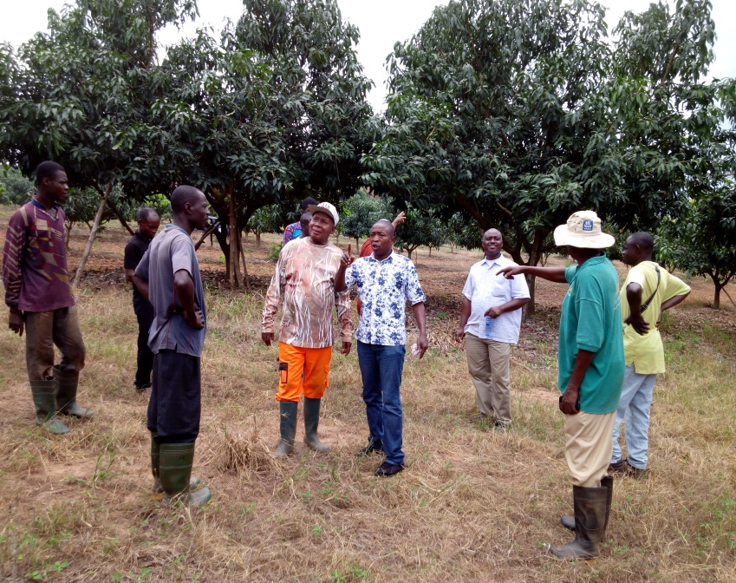
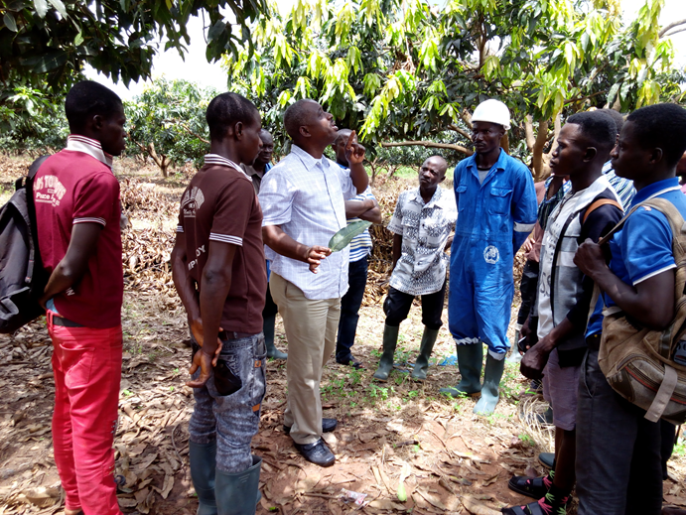
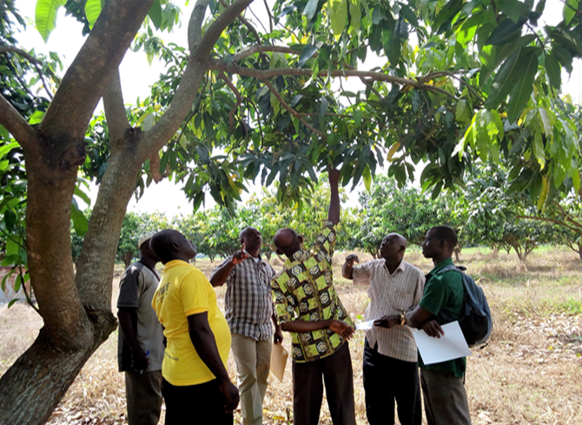
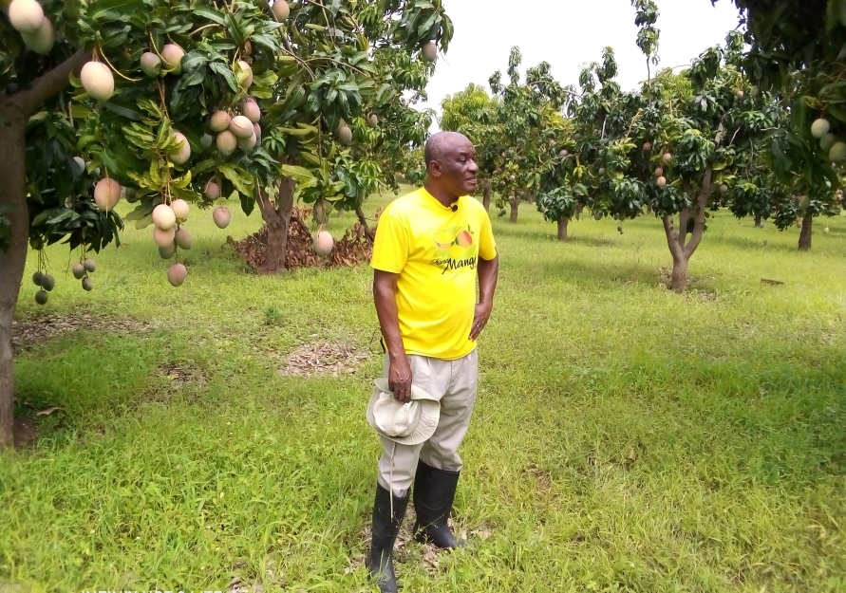
IMPACT OF BBS IN GHANA
Huge sums of money spent on educating farmers

Slide 11
IMPACT OF BBS
Increased cost of production
-Actigard @ GHS780 for 640 trees
-Coprous Super at GHS 75 for 177 trees
(Repeated applications needed at least 6 times per season)
Massive reduction in number of marketable fruits
-Percentage immature fruit drop =10%
-Percentage fruit drop near maturity=40
- Percentage fruit drop after maturity=20
- Blemished fruits at maturity = 10-30%
(If the disease strikes you can potentially get 20% of your fruits that
developed to harvest)

Slide 12
IMPACT OF BBS
Exposure of farmers to dangerous chemicals
-Repeated use of copper based fungicides can be harmful
-First time, an antibiotic was approved for use on mango
-Mango farmers experimenting with antibiotics approved for treating
human disease
-Experimenting with several actives which have no basis for bacterial
control
Negative consequences for mango industry
-Some mango farms are being sold for residential buildings
-Some farmers in the coastal savannah have stopped mango production in
the major season
-Some mango farms have been abandoned serving as a breeding place for the
spread of infections

Slide 13
WAY FORWARD
Explore alternative markets
- Emerging markets for immature fruits. Take advantage to reduce the
density of fruits on the tree
- Do not allow the fruits to remain on the trees after reaching maturity
Practice IPM
- Do not allow weeds to overgrow in the field at any point in time
- Control all insect types properly in the field from fruit set to maturity
- If you induced flowering with Paclo only, include potassium foliar
fertiliser in your pesticide application schedule
- Apply Actigard+Coprous super in a preferable, 2 weeks intervals
beginning from flower initiation

Slide 14
WAY FORWARD
Seek information from the right sources
-talk to plant pathologists with knowledge of bacterial diseases
- Consult relevant and current publications on the disease
-Note; the disease epidemiology is not as simple as that caused by a fungus
Protect yourself and workers from excessive use of Pesticides
-though copper is allowed in organic production systems, it is equally as
dangerous as other active ingredients
Brace yourself for any eventualities
- Irrespective of the control measure you will institute, you are likely to
lose some of your fruits. Therefore be moderate in your expectations
when controlling BBS.

Slide 15
CONTROL OF MANGO BACTERIAL BLACK SPOT DISEASE IN GHANA
THE SEARCH FOR THE MAGIC BULLET

Slide 16
IS MANGO BACTERIAL BLACK SPOT CONTROLLABLE?
Previously, bacterial diseases affecting tree crops are considered uncontrollable and control measures prescribed are thought to give the farmers a peace of mind
Control of citrus canker was based on destroy and re-plant
Now came the advent of antibiotics, with its attendant problems
Current focus is on copper based fungicides
Current information points to Copper + biostimulant (Acibenzolar-S-methyl) eg. Actigard

Slide 17
Field trials to develop effective control measure against BBS in Ghana
On site experiments
Copper based fungicides available in Ghana as at 2001at recommended rates were initially selected for laboratory evaluation:
- Funguran
- Kocide
-Champion
-Caldo
All of these fungicides were promising as they prevented the bacteria from growing in plates
In the field trials, the results were not encouraging, with the number of healthy fruits at harvesting on the treated trees sometimes being less than what was obtained on the control (non-treatment) trees. At this point, farms that were not applying anything were getting more healthy fruits than those applying these fungicides.

Slide 18
Field trials (Cont’d)
The next experiment involved two products (Oxolinic acid, a antibiotic) and Nordox, submitted to EPA for registration for the control of BBS.
Oxolinic acid was evaluated to be used either as a protected spray or curative spray. In both instances, the product gave good results.
Nordox, also applied at bi-weekly intervals gave good results.
However, due to the fact that these trials were not repeated, it could not be vouched whether the same results could be obtained all the time
-There was therefore the need to keep on searching for the ‘magic
bullet’

Slide 19
The search for the magic bullet
Literature review later showed that Copper oxychloride in combination with a plant bio-stimulant, known as acibenzolar-S-methyl was being used to effectively control BBS in some parts of Ghana.
Two of the oxychlorides (Coprous super and Curenox) and the biostimulant, Bion, were acquired and evaluated in the field, with the help of MOAP of GIZ.
The treatments were first evaluated in Lower Manya Krobo district after which they were repeated in the same farm and two other farms in the same area as well as farms in Sawla (Savannah region), and Wa (Upper west region).

Slide 20
The following conclusions were drawn from the study
Coprous super and Curenox when combined with Bion and applied at bi-weekly intervals resulted in between 68.3 to 79.1% clean fruits.
-This means any of these treatments could suffice for profitable production of mango.
Among the treatments, Coprous super+Bion results in better control of the disease after treatments have ended.
-This means the combination is the best alternative
As the mature fruit remain in the tree after maturing, the percentage of harvestable fruits could drop drastically by more than 10% within two weeks.
-delay in harvesting can be detrimental to the farmer.
In areas such as Wa and Sawla, there was higher number of clean fruits on the non-treatment control plots (21.6 – 55.0%) compared to the coastal savannah (10.6-20.4)
The trees were smaller and the vegetation (weeds) very sparse
-rigourous cultural practices needed to complement the fungicidal applications in the
coastal savannah zone

Slide 21
Is Coprous super+Bion, the magic bullet?
This combination gave good results both at crop maturity and at delayed harvesting
However, a representative from EPA Ghana raised a query about the use of Bion which was not a registered product in Ghana as at the time of the trials.
Actigard (acibenzolar-S-methyl) is the same product as Bion but with different trade name. The mode of application and action of the two products are the same, but Actigard was registered.
To confirm whether the Actigard can perform the same as Bion or not, it was used in another validation trial

Slide 22
ACTIGARD TRIALS
OBJECTIVE
- Validate the efficacy of Actigard (Acibenzolar-S-methyl), a registered
biostimulant in combination with Copper based fungicides for the control
of BBS.
-To evaluate the importance of GAP on the control of BBS in Ghana
TREATMENTS EVALUATED
-Actigard (2.5 g/15 l) +Coprous super (45 g/15 l)+Spreader
-Actigard (2.5 g/15 l) +Copper Oxide (30 g/15 l)+Spreader
- Coprous super (45 g/15 l)+Spreader
-Copper oxide (30 g/15 l)+Spreader
-Non treatment control
Treatments application
All farms were weeded once, prior to the commencement of treatments applications
The trial was replicated in 5 farms (1 on station and 4 on farm)

Slide 23
ACTIGARD TRIALS
All five treatments were evaluated in each farm
The number of applications ranged from 3 to 6
Treatment applications were done according to the recommendation by manufacturer
- 1st application at floral buds initiation
- 2nd application at fruit set
- 3rd-6th at 28 days intervals
From fruit set to maturity, number of fruits that dropped due to the disease, those that were infected on the tree at maturity and those that were clean were determined and percentages were calculated.

Slide 24
ACTIGARD TRIALS: SUMMARY OF FINDINGS
There were differences in the performance of the treatments in the different locations
Since the cultural practices were left for farmers, it was conjuctured that the performance of the treatments correlated positively with the results obtained.
The farm that controlled weeds to the barest minimum and controlled insects with protein bait and sticky traps from the beginning to the end of the trial had the best results. Incidentally, the farm had the least number of applications (4 times), including the first one.
The lowest results were obtained from farms where weed growth was so rapid that the control could not match up.

Slide 25
Performance of Coprous super+Actigard
Percentage of clean fruits at maturity
Treatments | Farm 1 | Farm 2 | Farm 3 | Farm 4
Coprous super | 69.5 | 68.9 | 54.7 | 42.5
Copper oxide | 67.3 | 65.7 | 55.6 | 44.3
Coprous super+Actigard | 79.8 | 77.5 | 61.0 | 47.9
Copper oxide+Actigard | 77.6 | 78.9 | 60.6 | 43.5
The Coprous super+Actigard gave good control of the BBS in most of the farms used in the
trial
The poor results from Farm 4 can be attributed to the constant rainfall in the area with its
attendant rapid weed growth
The first application timing is critical and must be adhered to

Slide 26
RECOMMENDATIONS FOR BBS CONTROL
Combine the application of Coprous super and Actigard applications with:
-good weed control
-good insects control regime during the production season.
In applying the Coprous super+Actigard ensure that the first application is before flowering starts. This is critical.
Until a better alternative is found, the magic bullet is a bouquet/cocktail of Coprous super+Actigard+Good Agronomic Practices.

Slide 27
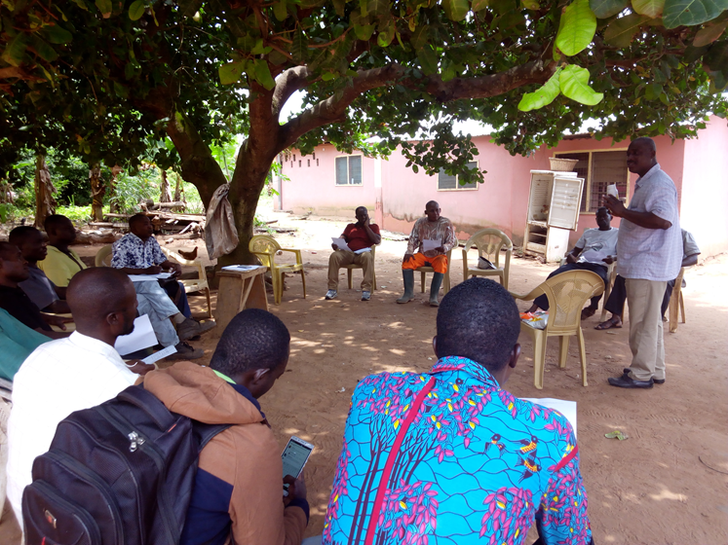
END OF PRESENTATION
THANK YOU

