Slide 1
MY STORY
MARKET DIVERSIFICATION
5th Ghana Mango Week
RITA BROBEY
6TH JULY 2022

Slide 3
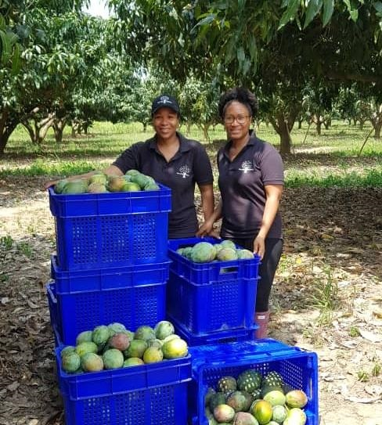
HENDY FARMS
Challenging the status quo of African agriculture for generational growth.
Reducing post harvest loss through innovation
Inspiring youth into agribusiness
Producing jams, hot sauces, dried mango & frozen mango
Building a globally recognisable Ghanaian brand
Climate smart agriculture
Sustainable production

Slide 4
HENDY FARMS
MARKET DIVERSIFICATION
The farm and our mangoes (raw material) is always at the core
Increase sales and revenue
Multiple revenue streams
Green mango (fresh and processed)
Fresh mango
Shelf stable products for new markets
Contract manufacturing
Farm tours
Mango seed kernel

Slide 5
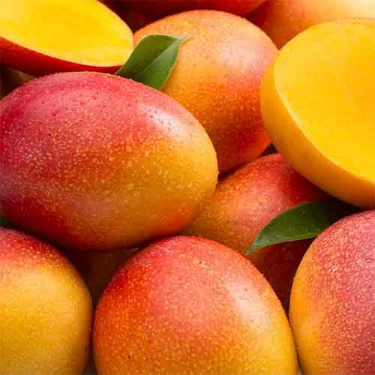
HENDY FARMS
MARKET DIVERSIFICATION
The farm and our mangoes (raw material) is always at the core
Bringing farm to consumer (creating value building our brand)
Delivery via website orders
Social media
Traceability and convenience

Slide 6
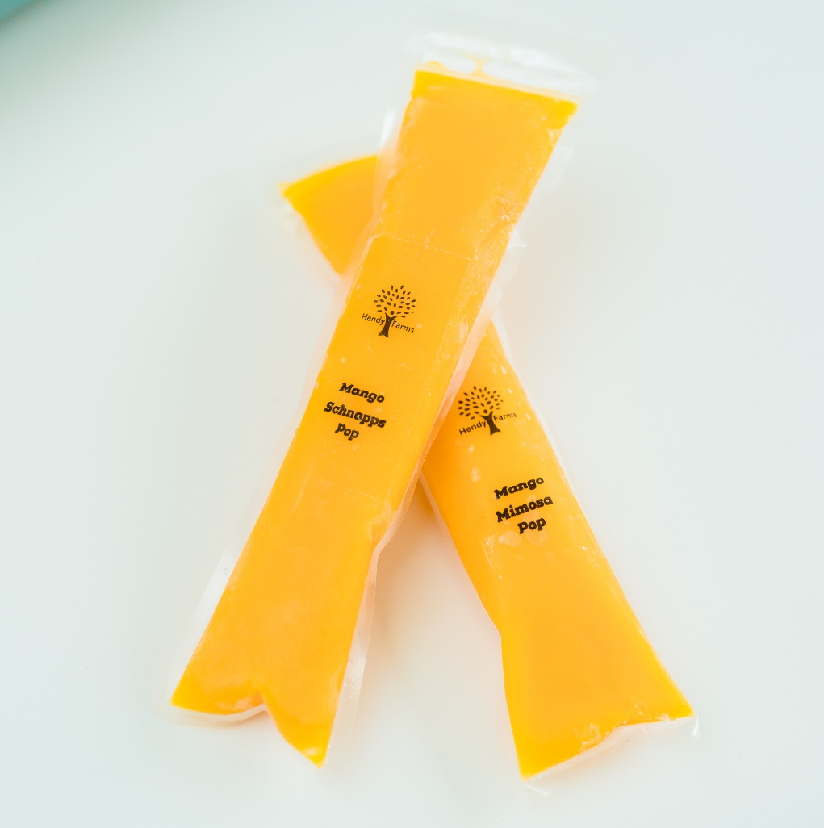
HENDY FARMS
MARKET DIVERSIFICATIONIVERSIFICATION
The farm and our mangoes (raw material) is always at the core
Understand the market demands and trends
Dried, puree, frozen, canned, condiments, preserves, powders , IQF
Innovate or die (partnerships)

Slide 7
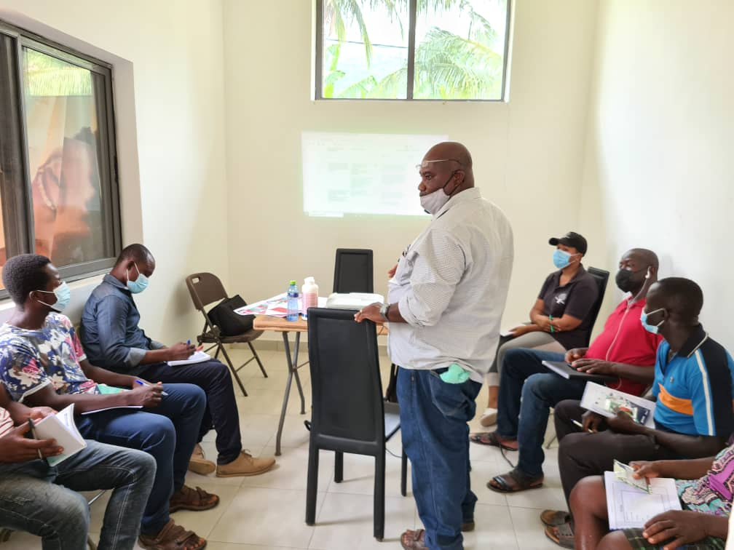
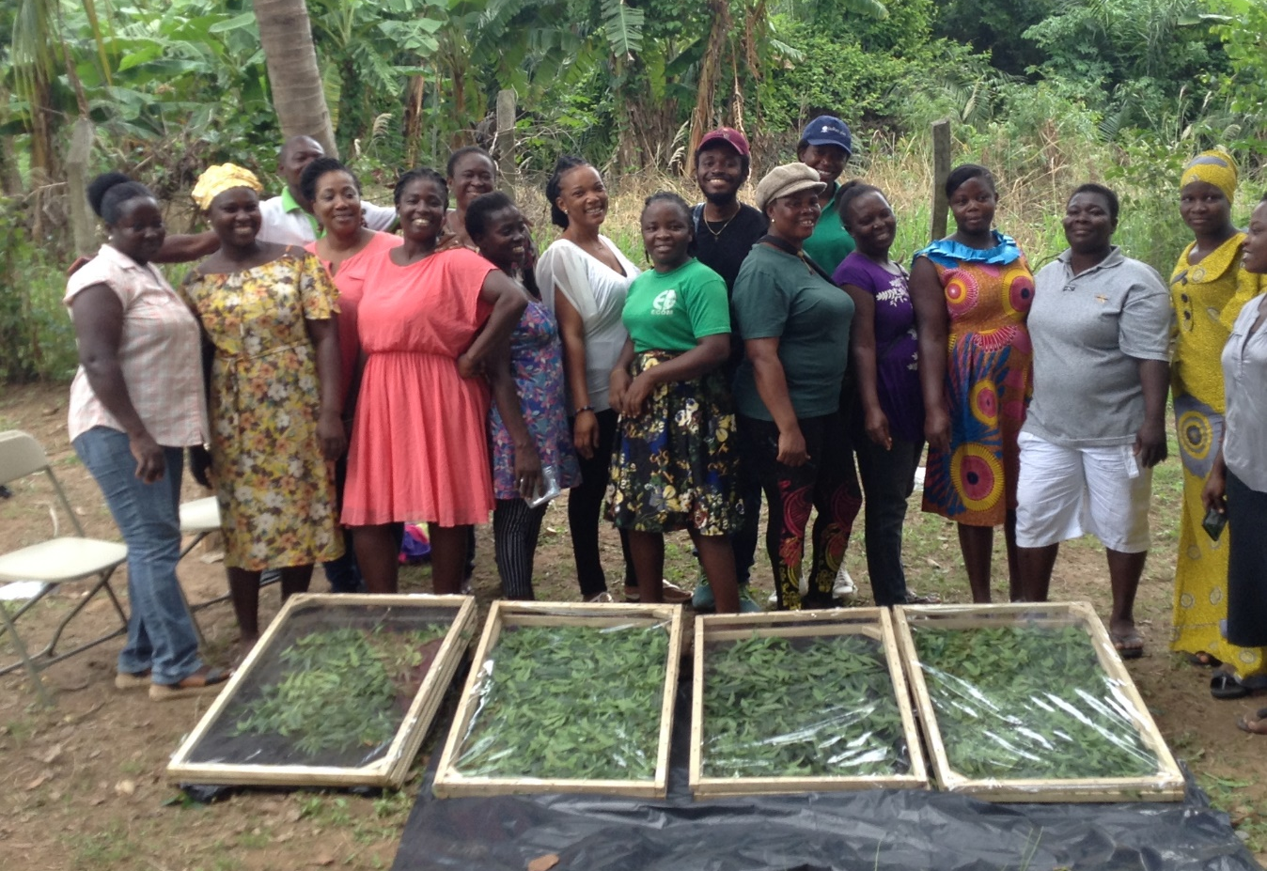
Training and Support for Farmers
Farmers training on Global GAP & Solar drying methods

Slide 8
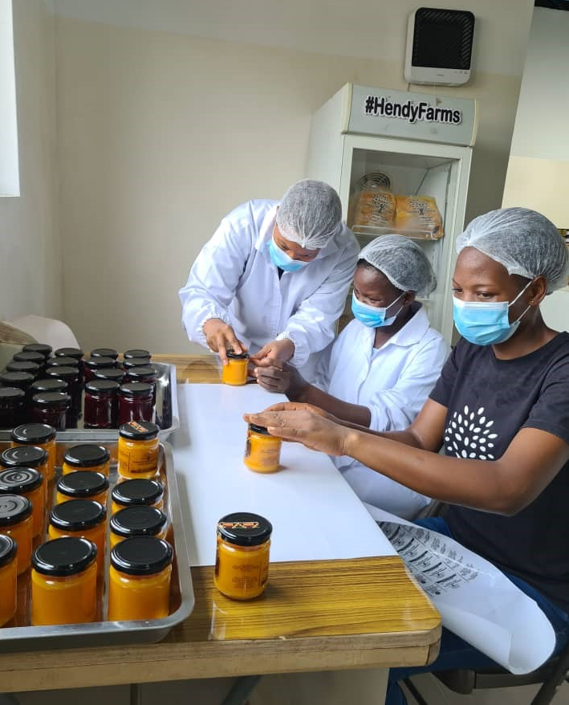
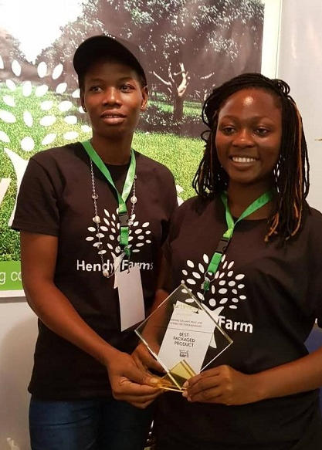
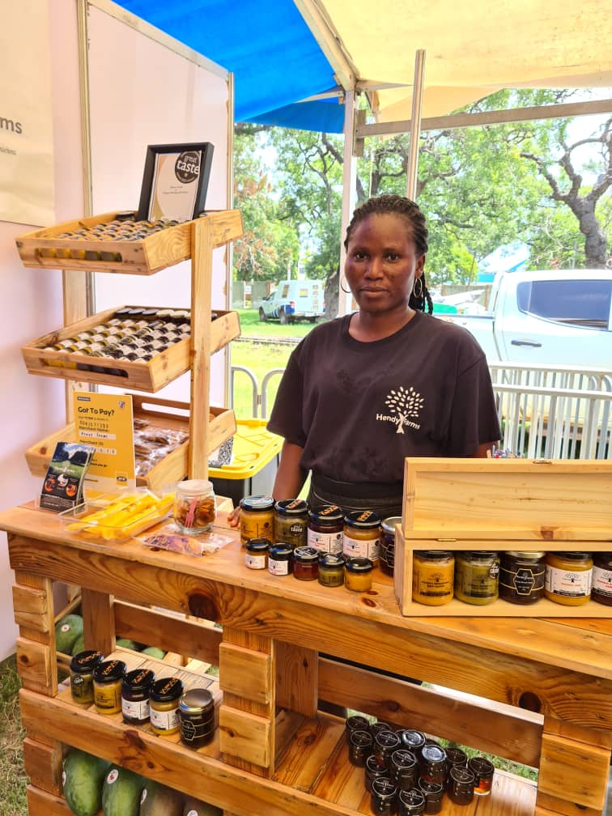
Training for processing in agribusiness
Fruit processing sales & marketing

Slide 9
Thank You
www.hendyfarmsgh.com
ritabrobey@hendyfarmsgh.com
info@hendyfarmsgh.com
+233 50 055 4129, +233 50 055 4130
Hendy_farms
Hendy_farms

