Slide 1
THE AFRICAN CONTINENTAL FREE TRADE AREA (AfCFTA)
EVANS MENSAH FREEMAN
SENIOR INDUSTRIAL PROMOTION OFFICER
MULTILATERAL, REGIONAL & BILATERAL TRADE
MINISTRY OF TRADE & INDUSTRY
26TH NOVEMBER, 2020
17TH FEBRUARY 2020 ALISA HO17TEL

Slide 2
Outline of Presentation
State of Play of the AfCFTA
The AfCFTA Agreement
Benefits to MSMEs
What Government is already doing

Slide 3
What is the AfCFTA ?
The African Continental Free Trade Area (AfCFTA) is a Duty-free, Quota-free Single Market covering the entire African Continent - made up of 55 countries, with a total population of 1.2 billion and a combined GDP of USD 2.5 trillion.
It creates the world’s largest Free Trade Area, second only to the World Trade Organisation (WTO) in terms of the number of member states.

Slide 4
Main Objectives of the AfCFTA
To expand intra-African trade through better harmonisation and coordination of trade within the continent;
To develop regional value chains to support industrialisation;
To enhance the competitiveness of the private sector in Africa to support economic transformation and job creation; and
To attract investment into Africa with strong regional and local content

Slide 5
Main Objectives of the AfCFTA
To develop regional value chains to support industrialisation;
To enhance the competitiveness of the private sector in Africa to support economic transformation and job creation; and
To attract investment into Africa with strong regional and local content

Slide 6
The Journey So Far
The AfCFTA legally came into force on 30th May, 2019 (30 days) after 22 Members States have ratified the AfCFTA and deposited their instrument of ratifications with the AU Commission.
Apart from Eritrea, 54 out of 55 Member States of the AU have signed the AfCFTA.
30 of these Member States have ratified and deposited their Instruments of Ratification with the AU Commission.

Slide 7
The Journey So Far
The Operational Phase of the AfCFTA was launched in July 2019.
Ghana was selected to host the Secretariat of AfCFTA in July 2019.
The Secretariat will be operational by March 2020.
The Secretary General of AfCFTA was selected on 10th February 2020
Trading is scheduled to start by 1st January, 2020.

Slide 8
The Journey So Far
The following Instruments were unveiled to support the Operational Phase of the AfCFTA at the AU Assembly Extraordinary Summit in Niger on 7th July 2019:
Adopted the agreed AfCFTA Rules of Origin (RoO)
Dashboard of the Africa Trade Observatory;
AfCFTA Trade in Goods password-protected Dashboard;
Pan-African Digital Payment and Settlement System;
Continental Online Non-Tariff Barriers (NTB) Mechanism for reporting, monitoring and elimination of NTBs; and
AfCFTA Web-based and Mobile-based Application for Business.

Slide 9
The Journey So Far
The following Instruments were unveiled to support the Operational Phase of the AfCFTA at the AU Assembly Extraordinary Summit in Niger on 7th July 2019:
Adopted the agreed AfCFTA Rules of Origin (RoO)
Dashboard of the Africa Trade Observatory;
AfCFTA Trade in Goods password-protected Dashboard;
Pan-African Digital Payment and Settlement System;
Continental Online Non-Tariff Barriers (NTB) Mechanism for reporting, monitoring and elimination of NTBs; and
AfCFTA Web-based and Mobile-based Application for Business.

Slide 10
SUPPORT FROM REGIONAL FINANCIAL INSTITUTIONS IN AFRICA
The African Export Import Bank (Afreximbank) will provide three (3) Regional Financial Instruments to support AfCFTA:
AfCFTA Adjustment Facility to manage the adverse effects of revenue losses and stimulate investments to support trade and economic growth
The Pan-African Payment and Settlement System (PAPSS) is a centralized payment and settlement infrastructure to reduce the costs and time variability of cross-border payments for intra-African trade and commerce payments.
The Africa Customer Due Diligence (MANSA) Repository Platform to serve as a single source of centralized database for conducting customer due diligence checks on counterparts in Africa; Financial Institutions, Corporates, and SMEs
Additional financial Instruments are expected to be developed and provided for the successful implementation of the AfCFTA

Slide 11
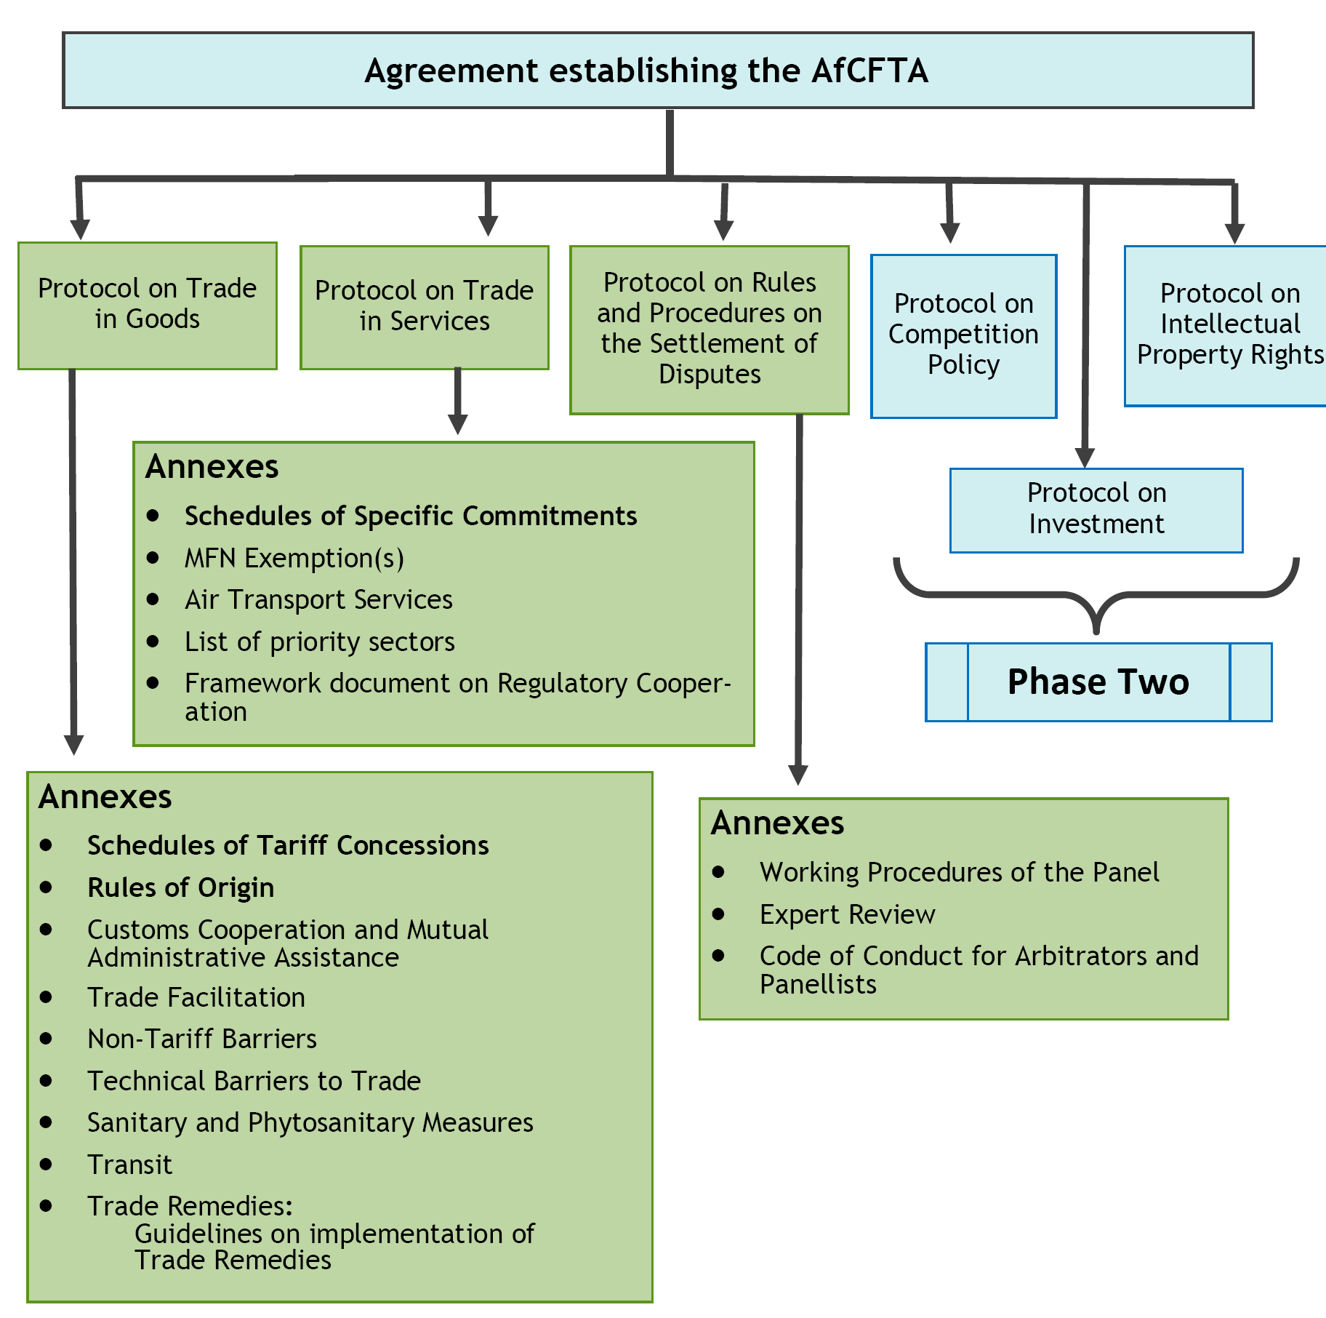

Slide 12
Protocol on Trade in Goods
90 % tariff liberalisation commitment for the continent has been adopted as the level of ambition for Trade in Goods for both Developing Countries (DCs) and Least Developed Countries (LDCs).
7% for sensitive and 3% for excluded products have been allocated.
In the long run, the time frames for the general tariff liberalisation, sensitive and excluded products are 10 years for DCs and 13 years for LDCs subject to request and offer negotiations, for all State Parties to phase down this category of products.

Slide 13
Protocol on Trade in Services
The scope of Trade in Services negotiations will cover all service sectors as well as all modes of supply defined under the WTO General Agreement on Trade in Services (GATS) and there shall be no a priori exclusion of any service sector or mode of supply of services in the negotiation.
Five (5) Priority Services Sectors, namely: Transport, Communication, Financial, Tourism and Business Services for the 1st round of negotiations have been adopted.
Member States may liberalise more sectors based on the principles of variable geometry and reciprocity.

Slide 14
Protocol on Rules and Procedures for Settlement of Disputes
Protocol on Rules and Procedures for Settlement of Dispute is designed to ensure that the AfCFTA Dispute Settlement process is fair, transparent, consistent and accountable.
Its functions are similar to the WTO Dispute Settlement Body, which has stipulated timelines for the completion of cases and for the issuance and adoption of reports
There are provisions in the Protocol on Initial consultations by State Parties; Establishment of Dispute Settlement Panels; Composition of Panels; Third Parties Interest; Procedures for Panel; Appellate Body Composition; and Appeal Procedures.

Slide 15
Phase II Negotiations
The Second Phase (Phase II) of AfCFTA Negotiations will cover
three (3) areas that will further deepen the AfCFTA:
Investment – Provisions on promotion, facilitation and protection to galvanise the investment needed to restructure Africa’s economies.
Competition Policy - Provisions to enable fair competition and market outcomes that stimulate industrialisation, competition and development.
Intellectual Property Rights - Provisions can incentivize increased innovation, ensure a level playing field and support trade

Slide 16
EXPECTED BENEFITS OF THE AfCFTA
The benefits of the AfCFTA are as follows:
It will significantly boost intra-African trade from 12 %, which is the lowest as compared to intra-EU trade, intra-Asian Trade and intra- North American trade which stands at 68%, 53% and 46% respectively.
It will increase intra-African Trade by as much as $35 billion per year, or 52% above the baseline by 2022.
Consequently, imports from outside the Continent could decrease by $10 billion per year, whereas Agricultural and Industrial exports would increase by $ 4 billion (7%) and $ 21 billion (5%) above the baseline respectively (UNECA, 2014).
At the firm level, it addresses the challenge of a business operator exporting goods to an African counterpart with an average rate of protection of around 12.4% compared to 8.4% when exporting overseas.

Slide 17
EXPECTED BENEFITS OF THE AfCFTA
In addition:
It will enable small and medium-sized enterprises in Africa boost growth by facilitating access to regional markets, as stepping stones for expansion into other markets outside Africa.
It will ensure that African companies operating in Africa enjoy better terms of trade in Africa, and have preferential market access to the continental market.
It will stimulate the development of regional value chains;
increase the rate of diversification and transformation through industrial sub-contracting and partnerships; and
reduce venerability of external shocks;
promote competition; and boost employment opportunities.

Slide 18
Benefits to Firms
Lower or no tariffs and free access to markets and market information
Removal or reduction in tariff restrictions and other barriers on intra-African trade.
Opportunity to set up in other African Countries
Increase in intra-Africa trade especially for MSMEs in the agriculture chain.

Slide 19
Benefits to MSMEs
Easy access to cheaper raw materials and intermediate goods.
Improve the conditions of regional value chains and access to global value chains.

Slide 20
Challenges faced by MSMEs
Low productive capacity
Access to affordable credit
Lack of trade or market information
Difficulties accessing markets (high tariffs & standards)
Poor Infrastructure

Slide 21
WHAT IS GHANA ALREADY DOING TO HARNESS THE BENEFITS?
Enhancing Industrial Productive Capacity –
One District One Factory (1D1F) Initiative
Strategic Anchor Industries Initiative
One Region One Park (Industrial Parks & Special Economic Zones)
SME Development
Standards
Trade Facilitation -
Customs Management Reforms
Implementation of the WTO Trade Facilitation Agreement

Slide 22
WHAT IS GHANA ALREADY DOING TO HARNESS THE BENEFITS?
Trade-related Infrastructure:-
Port Expansion Project,
Roads,
Airports
Railways
Access to Finance -
Stimulus Package for Local Industries
EXIM Bank Financing Facility and other Banks have pledged to support the iniatives
FINTECH
Banking Reforms

Slide 23
WHAT IS GHANA ALREADY DOING TO HARNESS THE BENEFITS?
Trade Information -
The Ghana Commodity Exchange
The Electronic Trade Information (GEPA)
Trade Fairs & Exhibitions

Slide 24
Conclusion
The AfCFTA is expected to transform the manufacturing and agricultural sectors in order to accelerate inclusive economic growth and job creation, whilst fostering competitiveness across Africa.
Each country’s success at fully harnessing the benefits of the AfCFTA will large depend on how all stakeholders (Government, the legislature, the private sector, civil society and labour) are jin hands to support the implementation of their national BIAT.

Slide 25
THANK YOU

