Slide 1
Official Project Launch Ceremony
Official Project Launch Ceremony
Official Project Launch Ceremony
Theme: Pesticide management, plant pest control and SPS
Regional Innovative Fruit Fly Control System in West Africa
PROJECT PRESENTATION
Mango Week, July 6th, 2022- ACCRA

Slide 3
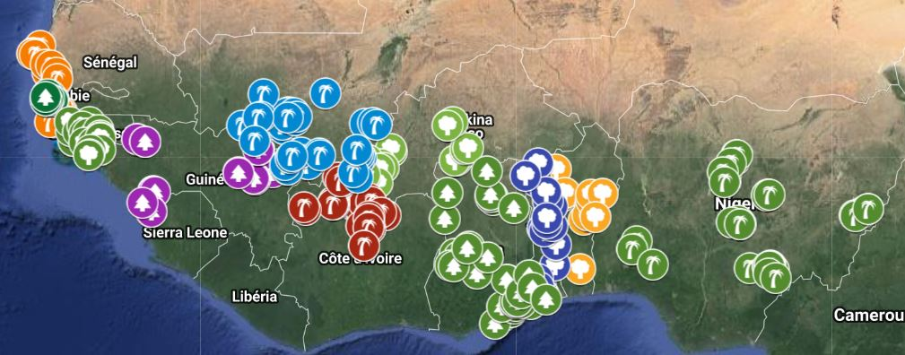
Context and justification:
32 Production zones
Mango Production Zones
310 Vergers (175 Etats membres et 155 Région CEDEAO)
1240 Points de surveillance, 620 points Région CEDEAO
Monitored orchards
Populations adultes de mouches des fruits
Niveaux d'infestation (%)
Température, Humidité, Vent, Plante hôte, Stades de Développement des mangues
Monitored Variabless

Slide 4
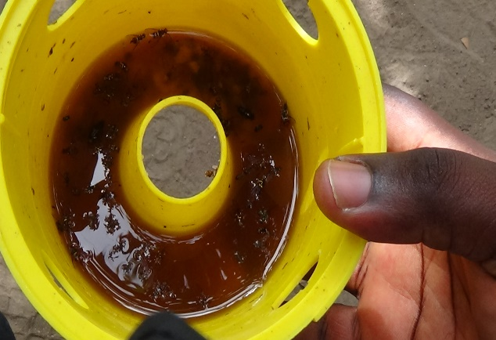
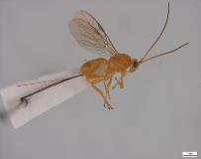
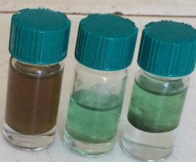
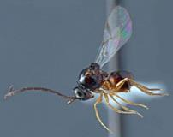
Waste brewer's yeast + papain extracts
Context and justification….
Sustainable control alternative methods
Waste brewsers’ yeast and papaïn extracts
Endogenous parasitoïds
Plant essences extracts

Slide 5
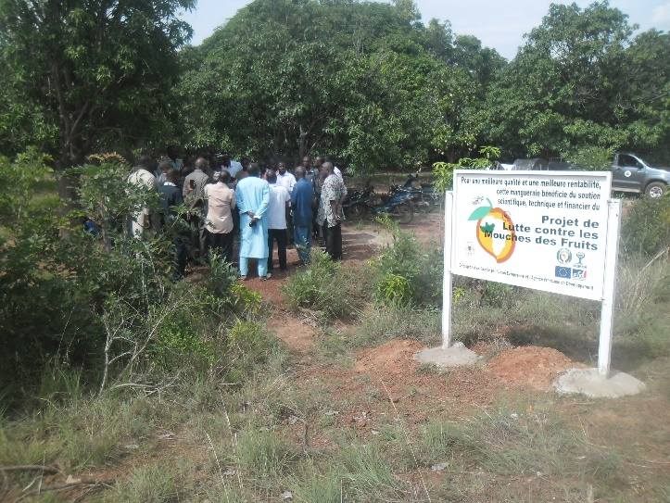
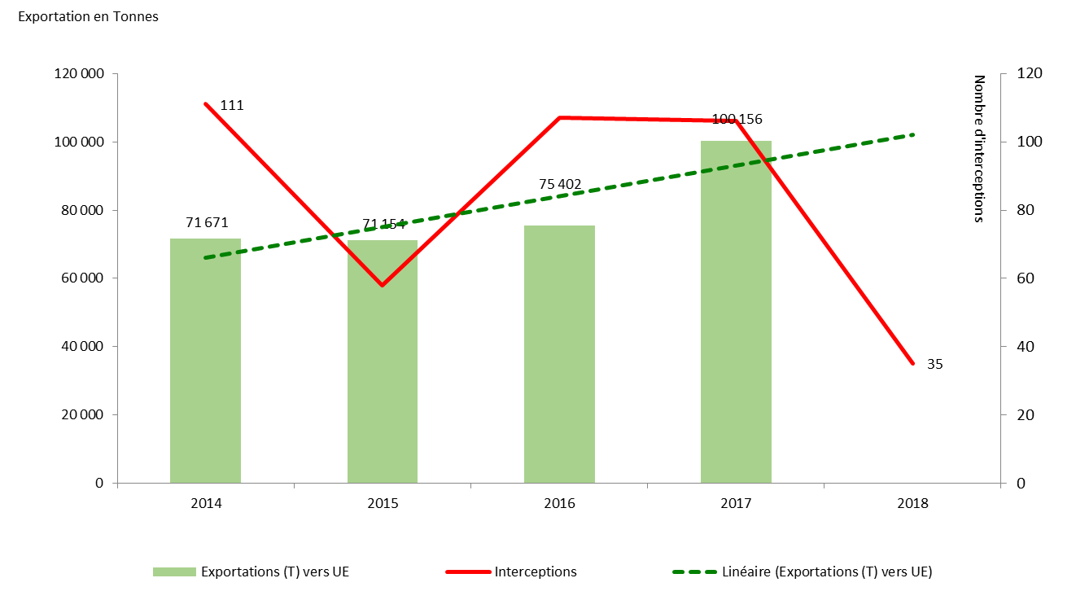
Evolution of exports and interceptions at the end of 2018
Context and justification cont….:
Evolution of exports and interceptions at the end of 2018 on EU borders
Due to lack of time, the developed techniques were not fully finalized and widely disseminated; surveillance system not consolidated and implemented on 11 ECOWAS member states.
SyRIMAO to consolidate and amplify PLMFs’ achievements

Slide 6
Specifically:
Regional and national research systems and their coordination are strengthened to provide producers with efficient control techniques with low environmental impact
Fruits and vegetables production losses due to insects pest infestation, fruit flies in particular are controlled
The mango sector at national and regional levels is strengthened and
An operational and sustainable monitoring and alert system is in place covering all member countries.

Slide 9
Results at Date: 2021 WPAB

Slide 10
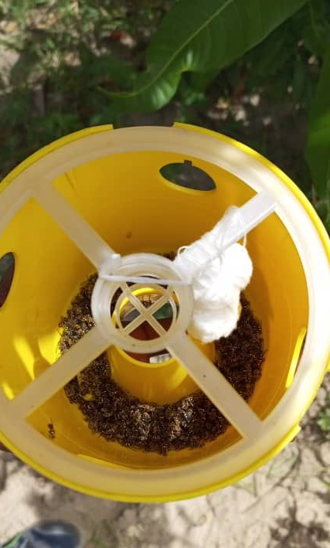
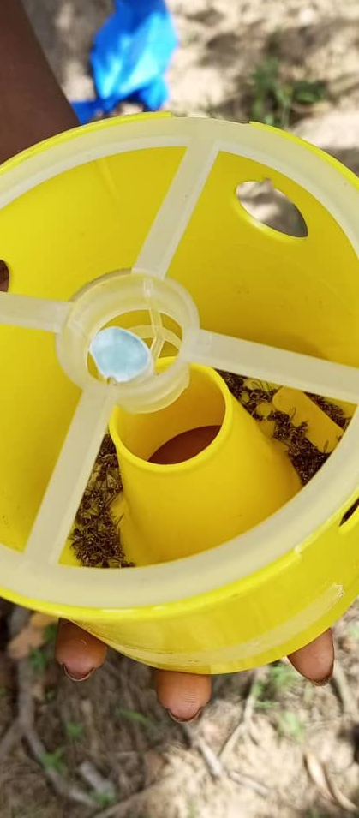
Results at Date: 2021 AWPB
Development and large-scale dissemination
One (1) best option of controls under researcher management during the PLMF has been formulated into “End technology” and tested in the field: Essential oil and derivatives of endogenous attractive plants
a
a
Methyl Eugenol 2g
Essential oil plant Y 2.5 ml

Slide 11
7
Results at Date: 2021 AWPB
Support to the mechanism for matching a fund dedicated to financing the sector mango activities in Burkina Faso and Mali
Support countries in procedures to get first instalment to implement their activities
Give support to fraiche export enterprises to set up enterprises surveillance system in compliance with EU news phytosanitary standards (Burkina, Côte d’Ivoire, Mali, Senegal)

Slide 12
Perspectives

Slide 13
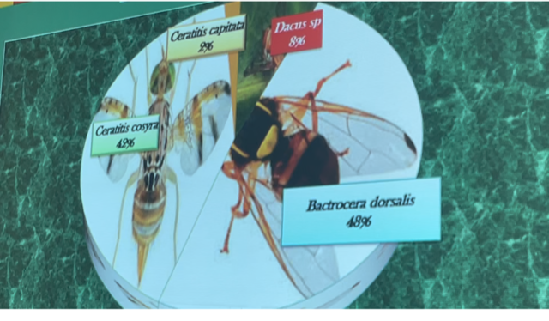
Perspectives: 2022 WPAB activities
RAD1Support for the regional reference laboratory (CNS-FL) to fulfil RCE criteria…
RAD 14 “End technology” registration:
Formulation of 4 “End technology” and bio-efficacy test
Entomopathogenic nematode formulations (Benin)
Processing of waste brewery yeast as attractant (Burkina & Ghana)
Essential oil and derivatives of endogenous attractive plants (Senegal)
Optimization of Fopius caudatus mass rearing (Benin)
Discussion on registration formula

Slide 14
Perspectives: 2022 WPAB activities
RAD 2- Support for research protocols & dissemination of results
RAD21 finalize research protocols:
Field and multi-local testing of the biological efficiency of Essential oil (Plant Y) as mass trapping (Benin, Burkina, Cote d’Ivoire, Gambia, Ghana, Nigeria, Senegal)
Field and multi-local testing of the biological efficiency of waste brewery yeast as food bait (Gambia, Ghana)
Field and multi-local testing of the biological efficiency of IPM package (Benin, Burkina, Cote d’Ivoire, Ghana, Nigeria, Senegal)

Slide 15
Perspectives: 2022 WPAB activities
RAD 2- Support for research protocols & dissemination of results….
RAD22 ToT and dissemination of IPM packages to producers :
ToT in the use of IPM packages and on how to train producers (1/country and 15 countries)
ToT in the use of IPM packages and on how to train producers (20 trainers per country and 15 countries )
Technical and economic fact sheets on effective control options

Slide 16
Perspectives: 2022 WPAB activities
ASN2 Reinforce capacities of PPRS on phytosanitary standards and risk
ASN 21 Reinforce the capacities of PPRS, PO, Border posts staff
ToT for the new countries (Liberia, Sierra Leone Niger
Dissemination of the training in Ecowas 15 countries
Reinforce the capacities of the phytosanitary inspectors to EU Phytosanitary new standards in all Ecowas 15 countries
Support PPRS with phytosanitary inspection equipment (Gambia, Guinee, Côte d’Ivoire, Ghana, Liberia, Sierra Leone, Niger)

Slide 17
ANS3:Structuring mango sector for financial sustainability
Perspectives: 2022 WPAB activities
ASN 31 Support partnership building between mango association and input suppliers
Support mango sector structuring and reinforce mango association capacities 15 countries)
Facilitate partnership building between mango association and input suppliers to facilitate farmers access to good quality of fruit flies control products (15 countries )
ASN 32 Support the establishment of matching a fund to financing mango sector fruit flies activities

Slide 18
Perspectives: 2022 WPAB activities
SVA 1- Extentsion of surveillance system….
SVA 11 purchasing surveillance materials and sept up:
Identification of surveillance orchards and put in place surveillance system(15 countries)
Training exporter enterprises and producers on the system (15 countries )
Training the data collectors and system supers users

Slide 19
Perspectives: 2022 WPAB activities
SVA 2 – surveillance infestation data collection and analysis….
SVA 2 Data collection and analysis
Surveillance data collection(15 countries)
Data analysis and issuing alerts (15 countries )
implementing early warning advises accordingly(15 countries )

Slide 20
Thank you for your kind attention

